Slide 1
PeopleSoft Cloud Manager
A Functional & Technical Primer
Aaron Engelsrud
Sr. PeopleSoft System Admin
Strategic Education, Inc.
@AEngelsrud

Slide 2

SEI – Capella University/Strayer University
Industry:
Higher Education, Accredited, Online Universities
Size:
Capella University
~38,000 students,
~1600 faculty,
~1400 staff
Strayer University
~42,000 students,
~2100 faculty,
~1400 staff
(as of 12/31/16)
Notes:
As you can see, Capella and Strayer are of similar sizes and faculty membership. As I mentioned before, both schools run PeopleSoft instances and this will be our next challenge. Capella has been very aggressive keeping current with Tools version and application versions. One of our challenges is to pair up and make the schools very similar with regard to PeopleSoft.

Slide 3
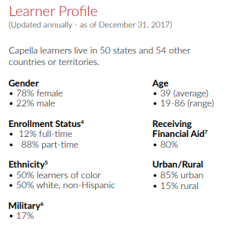
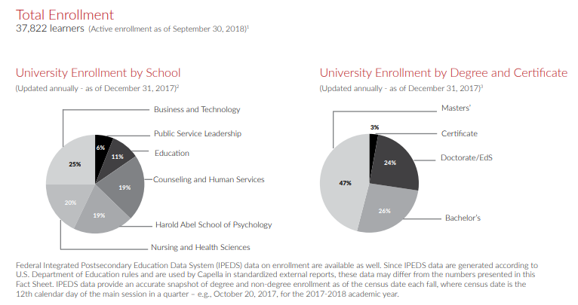
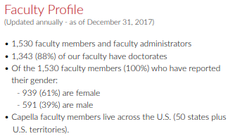
Key Capella Facts (data as of 12/31/17)
Notes:
Capella has nearly 38,000 current students – of which over 2/3^{rds} are Women. Capella has a solid mix of Doctoral, Masters, and Bachelors learners and offers 53 degree programs and 144 specializations. Learners at Capella come from all walks of life – from business professionals looking to increase their personal marketability to Military Learners looking to improve their knowledge and skills while deployed around the World, Capella serves a very broad base of adult Learners.
With this, Capella also has a very talented and dedicated faculty. 88% of our faculty hold doctoral degrees and our faculty includes industry leaders, authors, and dedicated professionals all working to help our learners succeed.

Slide 4

Aaron Engelsrud – About Me
Started as a PeopleSoft Developer in 2005
Implemented Finance and HCM/CS
Built a team around PeopleSoft Upgrades & Maintenance
Transitioned to PeopleSoft System Administrator in 2014
Started working with PeopleSoft Cloud Manager in 2017 – completed a POC for Capella
Notes:
After spending several years working in Business Intelligence and Data warehousing, my PeopleSoft journey started in 2005 when Capella University implemented Finance and HCM/CM to replace aging legacy systems. I took an opportunity to learn PeopleSoft Development and helped implement both Finance and HCM/CS at Capella University.
It was during this time as a PeopleSoft Developer that I noticed a gap in both skills and thought process between the Development Teams, who were focused on building new functionality for the business and getting as much out of the new system as possible – and the Systems Administrators/DBAs, who were intent on providing a stable, current, and secure enterprise system. The problem was that both teams lacked the knowledge, skills, and time to plan/schedule/research/manage bundles & maintenance packs for PeopleSoft. Everyone wanted it – no one was able to do it. I pitched an idea of a Central Team that would manage all PeopleSoft upgrade and maintenance tasks and a few months later I was managing and running that team. This team implemented a consistent process for maintaining our quickly growing PeopleSoft systems and worked to build rapport with the system Business Owners and developers to improve the understanding of the need for maintenance in the systems. We also implemented development change control first with Stat and later with Phire – provide a solid toolset to help manage change within the enterprise.
In 2014 – after spending time in a few other managerial positions at Capella - I transitioned back to a more technical PeopleSoft role – as a PeopleSoft System Administrator, and this is where I am currently am. Now rather than managing the upgrade and maintenance process I’m actually responsible for getting the work done and supporting a large PeopleSoft production and non-prod infrastructure. I think my mix of business acumen and technical know-how give me a unique perspective often missing in largely technical undertakings.
Another interesting component of my time at Capella University is that I hold the current – although unofficial – record for the most courses taken at Capella by any one learner. I have been enrolled as a Learner at Capella since 2004 and I have taken and completed over 70 classes. I have earned an MS in Information Technology, an MBA with an emphasis in IT Management, and I am currently in the final steps of finishing a Doctor of Business Administration with a specialization in Business Intelligence. My time as a learner at Capella has given me a unique focus on doing what is best for those we serve – I’ve seen over an over again the sacrifices and effort people are willing to make to achieve success and I’m proud to be a part of that.

Slide 5

SEI - Capella University/Strayer University PeopleSoft Footprint
Modules: CRM, CS, ELM, Finance, HCM, iHub, Phire
Versions: 9.0, 9.1 & 9.2
PeopleTools: 8.52, 8.54 & 8.55, 8.56
Database: Oracle RDBMS 12c on RAC
Notes:
Now that you know a little bit about Capella and about me – let’s get more to the point . Capella’s PeopleSoft journey began about 11 years ago when Capella began a project to implement PeopleSoft 8.9. This was done in an effort to replace multiple existing legacy systems which we were quickly outgrowing.
A huge, multi-year project, Capella started with HCM/CS for payroll, time and labor, and campus solutions and financial aid. Over the next two years we added Finance for GL and expenses; CRM for Incident Management (trouble ticket tracking), sales, and help desk; Portal (now iHub) which we use as an internal company portal; and finally EPM which we attempted to use for planning and budgeting - this application was retired in 2014.
Given the number of PeopleSoft applications we use, Integration Broker is a key component in our overall architecture. We have a heavily integrated environment between PeopleSoft systems and also integrate with several third party applications for additional functionality.
Since our initial implementation we have gone through a few different upgrade projects to keep as current as possible. Several years ago we upgraded most of our applications to 9.1 and PeopleTools 8.51. We have also implemented multiple architectural improvements as well as hardware and infrastructure upgrades.
More recently – and more to the point of this discussion - we are currently in the process of a multi-year project to upgrade People Tools to latest version (currently implementing 8.56.07) and also recently finished an upgrade project to our application stack to PeopleSoft 9.2. All of this work over the past several years has allowed us to shape our architecture and infrastructure to mesh well with the current Oracle Cloud technologies. It made the proof of concept I went through a lot more straight forward and made the cloud technologies much more attractive as they complimented our in house application infrastructure.
Capella still uses 6 of the PeopleSoft applications – Strayer currently only uses Campus Solutions and CRM. And that will continue going forward for the near future. On this slide you can see along with Capella and Strayer, there are several career ready schools under Strategic education, though these schools don’t use the Campus Solutions or the CRM applications.
That gives all a general background of Capella and the challenges for the future.

Slide 6
Overview of PeopleSoft Cloud Manager

Slide 7
What Can PeopleSoft Cloud Manager Do?
Subscribe automatically downloads PeopleSoft Update Images and PeopleSoft Release Patchsets.
Define environment topology based on PeopleSoft components and Oracle Cloud infrastructure elements.
Use delivered templates and create new templates based on defined topologies.
Create PeopleSoft environments from templates.
Notes:
OK, so before we get into in to the more detailed stuff, it would probably be good to understand what PeopleSoft Cloud Manager can actually do for you. Over the past year or so, I’ve heard lots of negative talk about the Oracle Cloud and, more specifically, about PeopleSoft Cloud Manager. After working with it for a bit, I think this is more because of a general lack of understanding as to what it does and what it doesn’t do rather than the actual functionality of the product or how well it works. I think if you focus on using PCM for the right tasks and parts of our overall architecture it can serve a very important role.
So what does it do?
First, PCM allows you to subscribe automatically downloads PeopleSoft Update Images and PeopleSoft Release Patch Sets – I’ll show you a little bit what that looks like later on.
You can define environment topology – meaning you can define that the application will run on Linux or Windows and include how big you want the host or hosts to be - based on PeopleSoft components and Oracle Cloud infrastructure elements.
You can use delivered templates or create new templates that are based on the topologies you defined and then use those templates to create actual running, happy PeopleSoft environments.

Slide 8
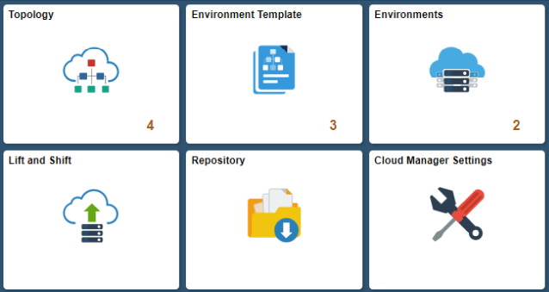
What Can PeopleSoft Cloud Manager Do?
Move PeopleSoft on-premises environments to Oracle Cloud ("Lift and Shift").
Set up PeopleSoft Update Manager environments for Selective Adoption.
Upgrade PeopleSoft environments from PeopleTools 8.55 to 8.56.
Apply PeopleSoft PeopleTools patches
Notes:
As you can see from this screen shot, PeopleSoft Cloud Manager runs on PeopleTools – the screen shot shows the main tiles from the PCM application and, as you may expect, it looks very PeopleSoftey. That’s actually a bonus as well – if you are comfortable working in PeopleSoft applications, you’ll be comfortable in PCM.
What else can PCM do?
You can actually move PeopleSoft on-premises environments to Oracle Cloud ("Lift and Shift").
You can actually set up PeopleSoft Update Manager environments for Selective Adoption that you can use with your on-prem applications.
Along with this, you can upgrade PeopleSoft environments in the Oracle Cloud from PeopleTools 8.55 to 8.56 as well as apply PeopleSoft PeopleTools patches to existing environments.

Slide 9
PeopleSoft Cloud Manager Installation

Slide 10

What is needed to get started with PCM?
Oracle Licensing Requirements
License required for Lift and Shift instances
Oracle Cloud Infrastructure Access
Compute Classic - must have
Object Storage Classic - must have
Database Cloud Service – optional
Users and Roles
Ability to create SSH Keys
Oracle Cloud user ID and password
My Oracle Support account ID and password
Port numbers - specific to what you want in your environment
Default Internet access
Notes:
So – now you know what PCM can do for you and you actually want to get started. What do you need? You actully need a bunch of information and – even more important than information – you need an overall game plan. You can tackle this install very simply – and that is more or less the process I’m going to cover – but if you want to make your PCM instance enterprise ready and pass the muster of your IT Security folks, you’ll need to dig in a bit. Here are some of the basic points you should at least consider:
Do you have an existing Oracle License for an Oracle DB? While you can set up PI instances without a separate DB, an Oracle License required for Lift and Shift instances.
You need to have Oracle Cloud Infrastructure Access – meaning you need to be able to sign-in at cloud.oracle.com and have access to AT LEAST Compute Classic and Object Storage Classic. Being able to have Database Cloud Service access is optional.
You need to make sure you have the ability to set up Users and Roles within the Oracle Cloud infrastructure.
You need the ability to create public and private SSH Keys
To do the actual PCM installation you will need both your Oracle Cloud user ID and password and your My Oracle Support account ID and password.
In several places in the installation documentation it provides default port numbers, but it also notes that if you want to have a secure and enterprise ready instance, you should provide your own standard port numbers that are specific to what you want in your environment.

Slide 11
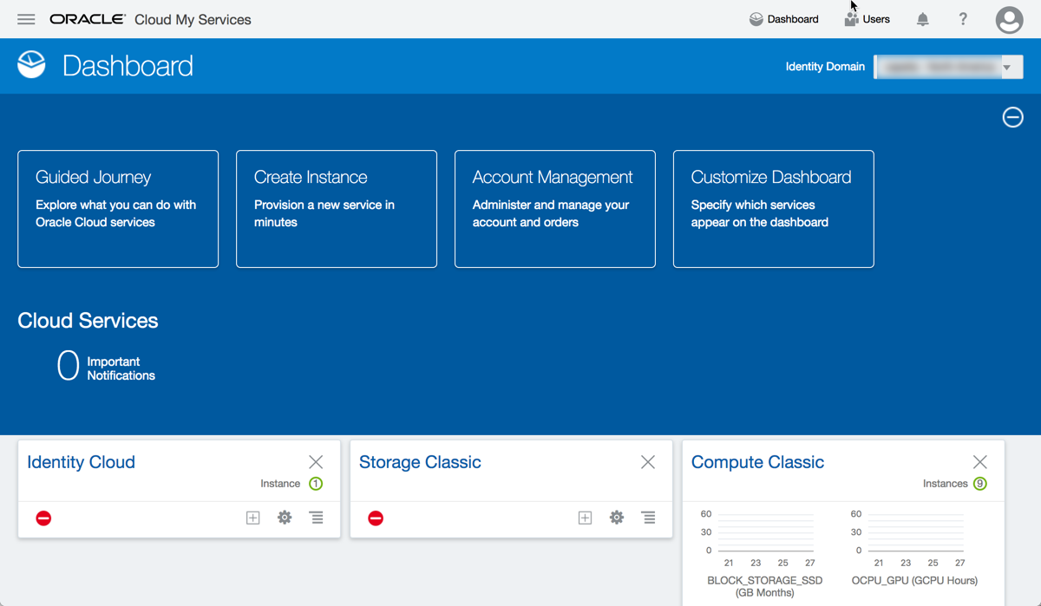
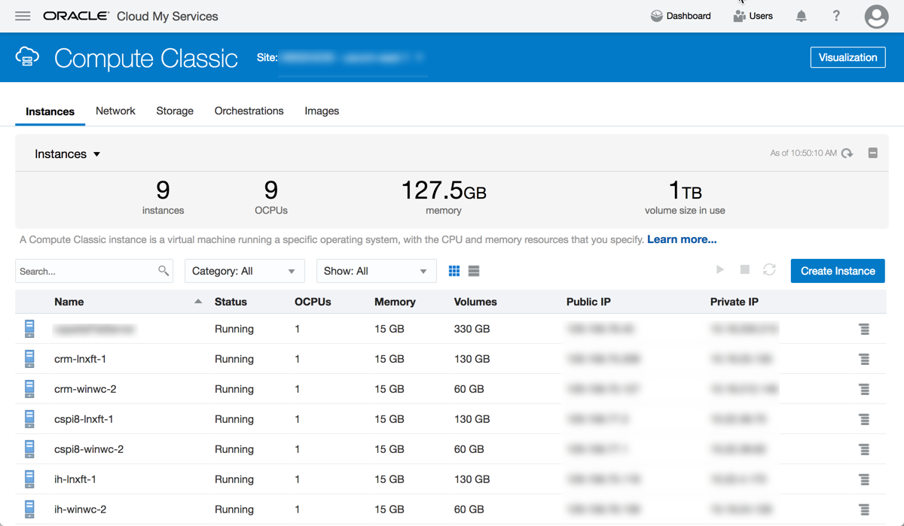
Oracle Cloud Manager & My Services Dashboard
Notes:
These screen shots should give you an idea of what you will see when you login to Oracle Cloud Manager and the My Services Dashboard.
The dashboard – which is shown in the upper left - provides the information you would think a dashboard should – a high level overview of everything you have in Oracle Cloud Manager. It will provide your current cost usage, how many of each type of instance you have set up – whether it’s a compute instance, DB, storage – or any other of the numerous cloud services PeopleSoft offers that you may have up and running.
Within each cloud instance type – in this case the Compute Classic, shown in the bottom right – the page provides various important information about the compute classic service. In this case the key tabs – shown across the top of the page – provide information on the various instances that have been created and their various status’ including the number of CPUs, the memory allocated to each instance, how much space each instance is allocated and the public and private IP addresses for each instance.
The Network tab provides an interface to things like SSH keys, and other relevant network information specific to the Compute Classic instances.
The storage tab obviously provides detail on the storage being used by the various instances that are in use.
The Orchestrations tab provides details on the various orchestrations that are available for you to use when creating Oracle Compute Classic instances. If you destroy a compute classic image, you can use an existing orchestration to recreate image to the state that it was in when it was originally built. This is very useful when you are getting used to the cloud environment and want to try different tasks – like setting up the PeopleSoft Cloud Manager over and over – or you screw it up and want to start from scratch.
Finally, the images tab shows all the Compute Classic images you have downloaded from the Oracle Marketplace and are available for you to use.

Slide 12
Installing PeopleSoft Cloud Manager
INSTALLATION IN A NUTSHELL
Get all the info you need for install
Obtain a Linux image and Windows image from Cloud Marketplace
Upload your public SSH key to Compute Classic
Setup necessary security in Compute Classic
Initiate deployment of Cloud Manager via Cloud Marketplace
Use the Instance Config Wizard to setup Cloud Manager
In Cloud Manager create a file server
Detailed PCM install instruction can be found here: http://www.oracle.com/webfolder/technetwork/tutorials/obe/cloud/compute-iaas/install_peoplesoft_cloud_manager/cloud-manager-deploy-image.html
Notes:
So, to actually complete the PeopleSoft Cloud Manager installation, its important that you carefully read through the detailed installation document I have listed on the screen. If you’ve never worked with the Oracle Cloud before, this process is going to be a lot to take in – read everything first, if you don’t you’ll just end up frusterated with the process and a bit lost. Of course, if you’ve already worked with the Oracle Cloud, most of this should be pretty familiar…
Before we start going through this process – keep in mind, what I’m going through is highly consolidated. The installation document states it should take 2 hours – I would recommend setting aside most of a full day to get through everything and understand what you are doing.
We already discussed in some detail the information required for step 1 – pull everything together and put it all in a text document you can get to easily. IN addition to the username and password information - you’ll need your REST endpoints and a whole host of other information. My advice is to go through this process carefully and capture as much information ahead of time as possible.
Next you’ll need to login to the Oracle Cloud Market Place and download a Linux image and a Windows image – the specific images that Oracle recommends are spelled out in the install documents. Once you have these images downloaded, they will show up in your Compute Classic Images tab.
This next one is imoprtant as you will not be able to access your image and complete the install without it. So, go out to the Oracle Cloud Manager and Upload your public SSH key in the Compute Classic network tab.
Once this is done, you need to continue to work in the Oracle Cloud manager – compute classic dashboard to provide a whole host of security information for the instances to use when they are created.
Now that all this stuff is done – you still don’t have a working instance. To get the instances - both the linux and windows boxes – up and running you need to go out to the Oracle Cloud Manager and Initiate the deployment of PeopleSoft Cloud Manager. This will the show up in your Compute Classic service and you will need to go through a whole host of steps to provision this environment - while not difficult, you’ll need to follow the recommendations provided in the install doc carefully to meet the instance requirements.
Next to get to actually setup the PeopleSoft Cloud Manager on the linux vm. You’ll need to SSH to the box – using the public IP and use the configuration manager to walk through a whole series of installation steps to install PeopleSoft Cloud Manager. Once you get through the user input information you’ll see an install process that follows along much like the PeopleSoft DPK installation.
If everything goes well you’ll now have a working PeopleSoft Cloud Manager – the last thing you’ll need to do is setup a Windows file server to house what ever images you want Cloud Manager to have access to.
That’s it – PeopleSoft Cloud Manager is up and Running.

Slide 13

Install Tips
Gather required information in a text doc ahead of PCM install
Cloud Username
Passwords
REST endpoints
Port Standards
Cloud Service ID
Read through entire install process ahead of starting
Don’t be afraid to destroy and start over
Notes:
First, its super important to gather required information in a text doc ahead of PCM install. This should include:
Cloud Username
Passwords
REST endpoints
Port Standards
Cloud Service ID
Also - Read through entire install process ahead of starting – know what each step means and how to do it.
Finally - Don’t be afraid to destroy and start over. It’s super easy to wipe out your instance and recreate it. Feel free to break stuff and try again!

Slide 14
Important PeopleSoft Cloud Manager Concepts

Slide 15
Important Concepts in PCM
Repository
A collection of deployment packages
Topology
A definition of a PeopleSoft system
Template
Environment
Includes a Topology and Application Package
Think: CRM PeopleSoft Image Download
Manage your subscription
Defines compute nodes and PeopleSoft Services running on those nodes
Defines a complete PeopleSoft System
PeopleSoft Instance Running on the Cloud
Notes:
Before we get in to more detail on PeopleSoft Cloud Manager, there are four key concepts that Cloud Manager uses that should be understood.
First, the Repository – which is your collection of deployment packages – CRM Image 24 or CS image 8 or anythign else you have subscribed to.
Next is the concept of a Topology – the topology is the basic building block of what will finally become a PeopleSoft Instance. Do you want the image to run on windows – or linux – or maybe one of each? What parts run where? All of this is defined in the topology.
The template combines information from the repository (for example a CRM image) with a Template – to finally tell PCM how exactly you want the image set up and running.
Finally, you get an environment – a working up and running PeopleSoft Instance in the cloud.
Let look in more detail at the steps required to get there…

Slide 16
PCM Use and Instance Creation
Step 1
Download/Subscribe to PeopleSoft Image
Step 2
Use Delivered or Create new Topology
Step 3
Create Environment Template
Step 4
Create Environment
Step 5
Manage Environments
Notes:
At a high-level here is how you use PeopleSoft Cloud Manager to create a PeopleSoft image. I’ll review each of these steps in detail in the coming live demo.
First, Download the image
Second, define your Topology – or use a delivered Topology. For my POC for Capella I only used a de1 livered topology, but I could have created a custom one pretty simply if I needed it.
Third, create and environment template.
Fourth, create the environment.
Finally, manage all your wonderfully created environments.
Lets take a look at the screens that these steps are completed on and look at a little more detail on each one.

Slide 17
PeopleSoft Cloud Manager – Live Demo

Slide 18
Step1: PeopleSoft Cloud Manager Repository
Live Demo
Notes:
First, this screen shows you what it looks like when you subscribe to PeopleSoft “Channels”. From here you can Manage your PeopleSoft Image Downloads
You can see what is available to subscribe to – new images, new tools versions, etc.
From here you can also see how much space you have used on your image file server – this is a great place to check if you need to add space to your file server.

Slide 19
Step 2: PeopleSoft Cloud Manager Topology
Live Demo
Notes:
Next – step 2 you can either create a new topology or use an existing one.
A PCM TOPOLOGY does all of the following:
Defines the resources for the VM and a can contain multiple nodes
Each node within the topology Specifies Operating System – in this case Linux, the Hardware requirements, and the PeopleSoft Environment Type
Finally, it is important to understand that PCM comes delivered with a couple of predefined topologies for use – once specifically for Lift and Shift environments and one that is specific to Update images.

Slide 20
Step 3: PeopleSoft Cloud Manager Environment Template
Live Demo
Notes:
Step 3 – creating the environment template - is a very important step in the PCM lifecycle.
Creating a template allows you to name your Template – in this case it’s called IH Template. I also had templates like CS template and CRM Template – but if you had a different Topology to be used for your Demo instance and your Update instance you may have ”CS Demo” and ”CS Update” that include the correct Topology. It also allows you select the correct Database to – from your repository – for the environment to use.
This screen shot captures the basics of the guided process that oracle takes you through to create and environment template.
Creating an Environment Template seems to be a pretty straight forward process – but there is considerable amount of information and detail you need to provide in order for this to happen correctly. In an effort to help you get thorough the process efficiently, Oracle has broken this process down into 4 key steps.
Step 1 is the General Detail section. This section allows you to name your environment and then choose the Environment Template you want to use to Create the environment.
Step 2 is the Select Topology step – this page allows you to select one of the Topologies you have created for the environment to be provisioned using. One of the delivered topologies is called PUM Full tier and provides everything needed to set up PeopleSoft Update Manager for a PeopleSoft Image.
In step 2 of this guided process, Cloud manager allows users to add customization during template creation under Edit Custom Attributes section. This customization can be added only to middle tier, database tier, or full tier. The customization will be available to users when they select this template. This facilitates the user to define custom attribute values for the environment being deployed.
Step 3 of this guided process allows you to define security for this Environment Template. The roles included in this section indicate the roles that have access to the template for creating environments. Only the users belonging to the role specified will be able to access the template while creating environment.
The delivered Cloud Manager roles are:
Cloud Administrator (PACL_CAD)
Cloud PeopleSoft Administrator (PACL_PAD)
Self-Service User (PACL_SSC)
Finally, step 4 allows you to review everything before saving the environment template.

Slide 21
Step 4: PeopleSoft Cloud Manager New Environment Creation
Live Demo
Notes:
To create an environment you need to name the environment, select the template to be be used for the environment, and select the zone the environment will be created in - in the screenshot about, this environment is a development environment, but you could choose production or test also. You also now have the ability to over ride the Topology used in the template with an topology of your choice. Finally, you need to enter the required environment attributes and credentials.
The different attributes available for you to complete are:
Middle Tier Attributes: Middle Tier is the VM where application server domain, process scheduler domain, and the web server domain are installed
Database Tier Attributes: Database tier is the VM where the database is installed for the new PSFT system – this is for cases where you are not using Oracle Database As a Service.
PeopleSoft Client Attributes: PeopleSoft Client is the VM where PeopleTools client (for example, pside) and change assistant are pre-installed. This is important when provisioning an instance to be used as an update image – it will automatically provision a change assistant box for you to use.
Database as a Service: PeopleSoft database is deployed on DBaaS – this will be primarily used in cases where you are doing a lift and shift environment – moving from on-prem to cloud – or creating an all new cloud instance with a Dbaas backend. You will need to provide you own Oracle licensing for this to work correctly.
Click Done to start environment provisioning.

Slide 22
Step 5: PeopleSoft Cloud Manager Environment Management
Live Demo
Notes:
The environment details work center provides a whole host of important functionality to help you manage each environment. From here you can check out the environment details, manage the environment attributes, perform an automated health check on the environment and manage your PUM connections.
From here you can even apply a PeopleTools patch – assuming you have it downloaded in your repository or upgrade PeopleTools from 8.55 to 8.56 – again assuming you have the PeopleTools version downloaded and available in your cloud repository.
Finally, from this page you can see the current instance provisioning status and get access to a number of the log files created by your instance.
Pretty much anything you want to do to your existing environments can be done here.

Slide 23
Questions?

Slide 24
Please Complete a Session Evaluation
Session ID: 100520
Aaron Engelsrud
Aaron.Engelsrud@strategiced.com

