Slide 1
News Feed
Feb. 2020
Copyright@2020, Oracle and/or its affiliate. All rights reserved.

Slide 2
News Feed Layout
What is it?
A “homepage” layout option
Streamlined Navigator menu (Can expand each section or expand all)
Homepage icons now more like a tabbed menu in main area
The layout supports the Responsive Design (Adapts its layout to any device)
Quick access to information (Quick Actions, Things to Finish, Announcements, Analytics)
Still Personalizable (hide/show Navigator entries)
Filmstrip (icons to related pages on top of workarea pages) is hidden
Watchlist, Recent Items, Favorites in the header area are hidden
Copyright@2020, Oracle and/or its affiliate. All rights reserved.

Slide 3
Newsfeed Layout – Home Page
<Snapshots as backup to demo> - servers down from long weekend

Slide 4
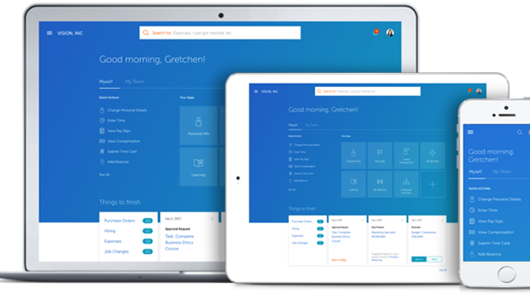

Slide 6
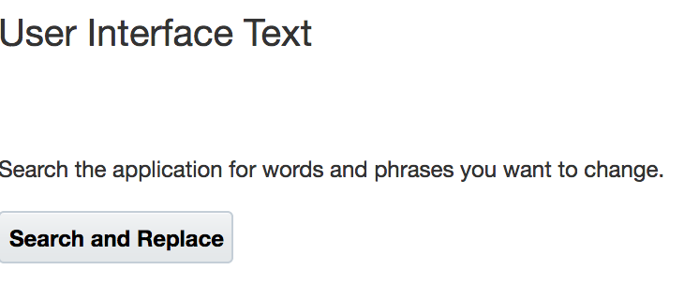
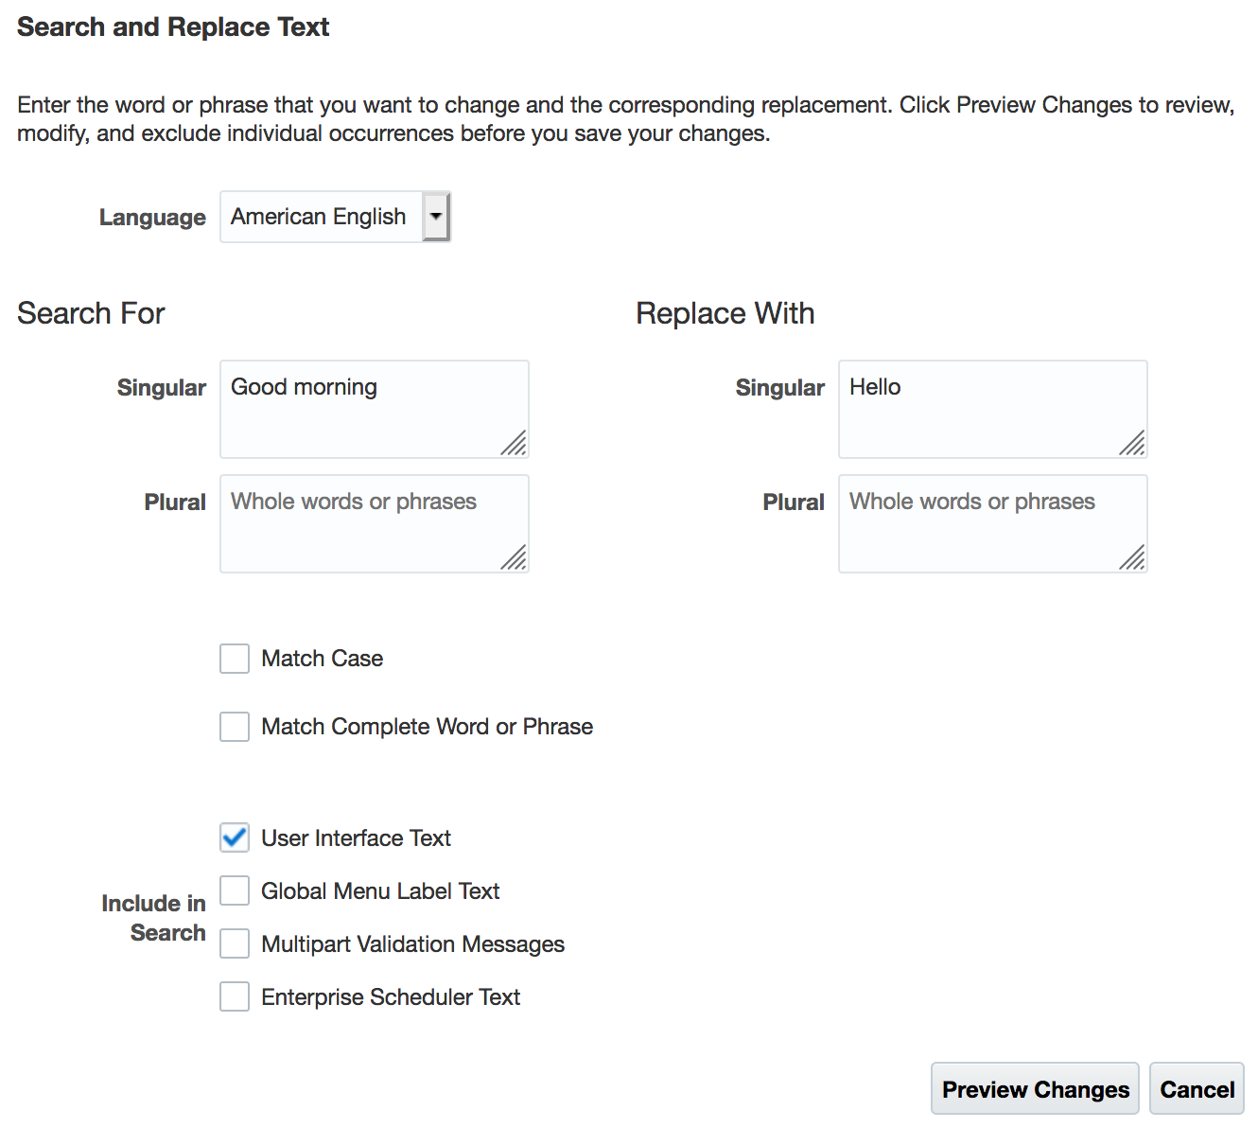
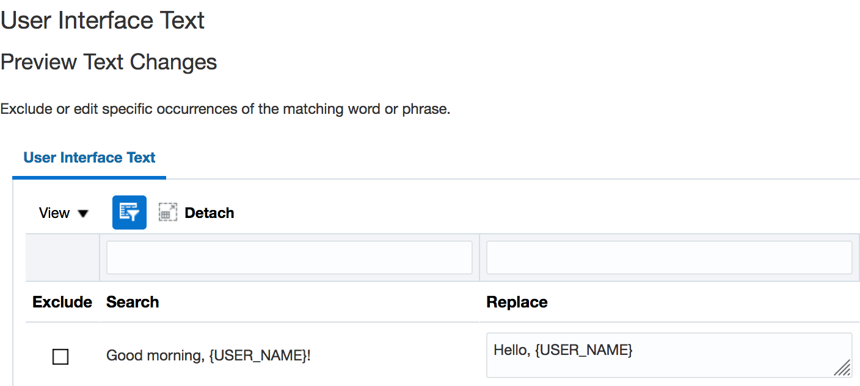
Copyright@2020, Oracle and/or its affiliate. All rights reserved.

Slide 7
News Feed – Planned Ideas
Show Watchlist, Recent Items, and Favorites in News Feed when non-HCM offerings enabled
While HCM likes the streamlined UI based on its user feedback, other products use these features and even seed watchlist entries.
Allow customers to control which users see the News Announcements
News is usually internal company news. It is not meant for partners, suppliers, or students for the Higher Education industry. An expression editor will be made available when creating announcements that will allow who to render the news for. Example, could check if the user has the “employee” role.
Copyright@2020, Oracle and/or its affiliate. All rights reserved.

Slide 8
News Feed - Summary
To be the default layout for customers starting 20C.
Existing customers who have a configured theme are not affected, but you can use it if you want. Changing the logo produces a configured theme.
To enable, create a sandbox, activate the Appearance tool, open the tool and change the layout to “News Feed”. And then save it as part of a new theme.
So why not enable it?
The menu tabs at the top may scroll to the right and requires extra clicks to see them. You can configure the menus as you want, but is there some improvement here Oracle could do out of the box? Like HCM had its menu entries streamlined. Ideas can be posted on HCM Idea Lab.
Will it become the default for all customers?
To be determined. First want to get feedback.
Google “Oracle News Feed” for more presentations, and videos.
Copyright@2020, Oracle and/or its affiliate. All rights reserved.

