Slide 1

Continuous Functionality and Technology Delivery Model in PeopleSoft
Session ID: CAS1807
Arkalgud Venkatesh
IT Manager

Slide 2
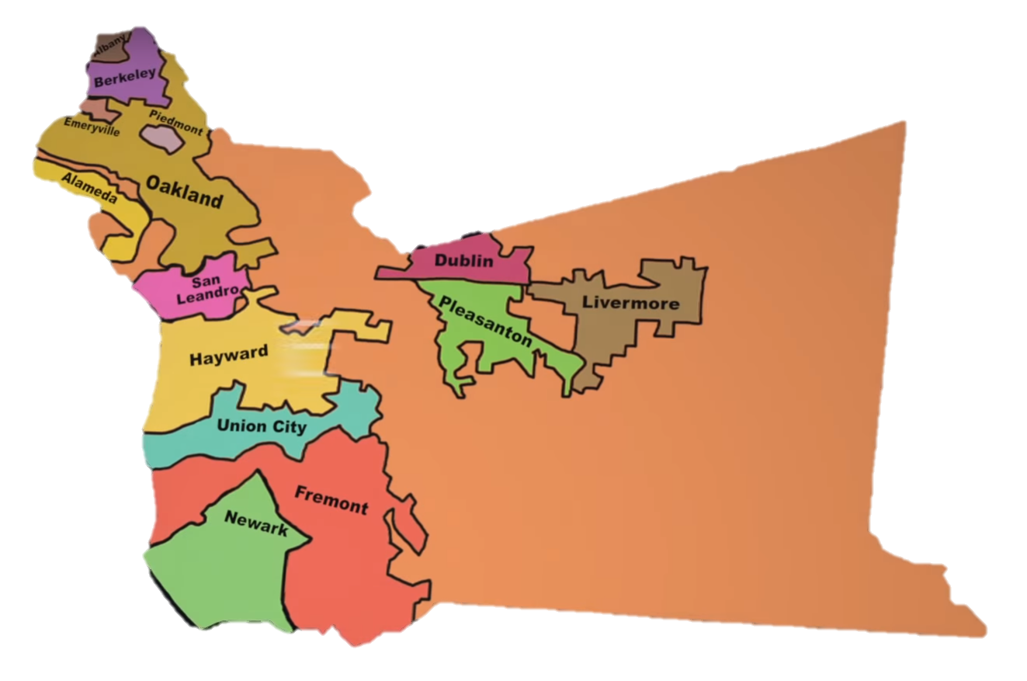
Alameda County

Slide 3

Alameda County - Introduction
Alameda County:
Lean, Green, Constituent-centric machine
County established in 1853
1.6 million residents as of 2014
57 languages spoken
Oakland is the County seat
Approximately 9,500 employees
$3.28 billion annual 2016 budget

Slide 4









Awards and Recognitions - 2015
6 Achievement Awards
Best Agency Application
5 Solution Awards
7 Significant Achievement Awards
Ranked 7th in the Country
Merit Award Recipient
Excellence in Technology Award
2015 Innovation Award
Chef's Award

Slide 5




Awards and Recognitions - 2016
3 Solution Awards
2 Significant Achievement Awards
4th Place Nationwide
4 Achievement Awards
- Best IT Collaboration Among Organizations
- Best Mobile/Wireless Project
Best IT Collaboration Among Organizations
Best Mobile/Wireless Project

Slide 6
PeopleSoft History @ the County
ALCOLINK – internal name for PeopleSoft apps
2000 - Implemented Financials version 7.02
2002 - Implemented HCM version 8.3
2007 - Migrated from DB2 to SQL Server
2009 - Upgraded to Financials & HCM 9.0
2015 - Upgraded to Financials & HCM 9.2
2016 - Upgraded to PeopleTools 8.55

Slide 7
PeopleSoft @ the County
9500+ PeopleSoft HRMS users
1000 PeopleSoft Financials users
41,000 Vendors in the system
105,200 Vouchers created last year valued at $2.19 billion

Slide 8
Highlights of Continuous Delivery Model
Continuous Delivery model gives us the ability to receive new functionality and latest technology updates using PeopleSoft Update Manager (PUM)
Pick and choose what you want and when you want
PUMs are released every 10 weeks
Download and deploy PUM image
Consume bite sized specific updates rather than the whole enchilada approach of big bang upgrades

Slide 9
Highlights of Continuous Delivery Model
Slow and steady changes to the system
Users experience less dramatic and (some times) shocking transformation
PeopleTools need to be updated, irrespective of PUM updates, in some cases PT updates are pre-requisites
Where is version 9.3? No more!!! It is just PeopleSoft.

Slide 10
What is our Model?
Apply PUMs annually!
  Plan to be current on PUMs yearly basis (excluding interim fixes) –
Features
  New feature roll outs
Compliance, Security fixes
  Tax Updates and other regulatory fixes - mandatory
Issues
  Fixes to the Issues and Bugs reported by business users
  Issues identified by other Oracle customers - relevant to us
  Application and tools issues fixed by Oracle

Slide 11
Adopting this new Model…
Steps that can make you a PUM champion?
Use delivered functionality as much as possible rather than customizing
Use every PUM application opportunity to retire your customizations of any of the delivered objects
If retiring customizations is challenging, consider making them bolt-ons
Leverage PeopleSoft Test Framework (PTF) to automate testing, PTF makes end to end testing, less of a burden to business users
Adopting to this model is a JOINT strategy between IT and the business teams

Slide 12
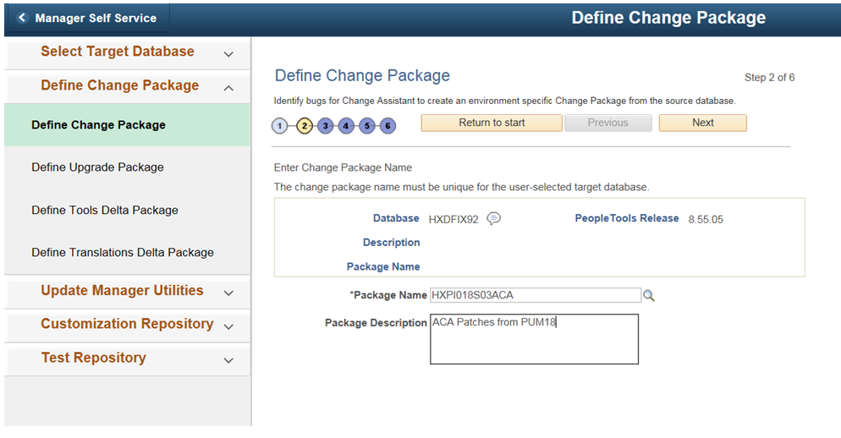
PUM Application Steps
Login to PUM18 database, define the patch

Slide 13
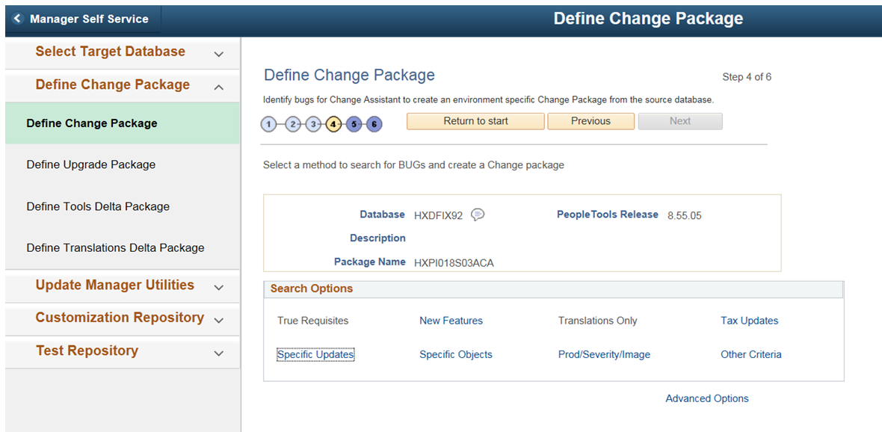
PUM Application Steps
Select the patches needed from the PUM

Slide 14
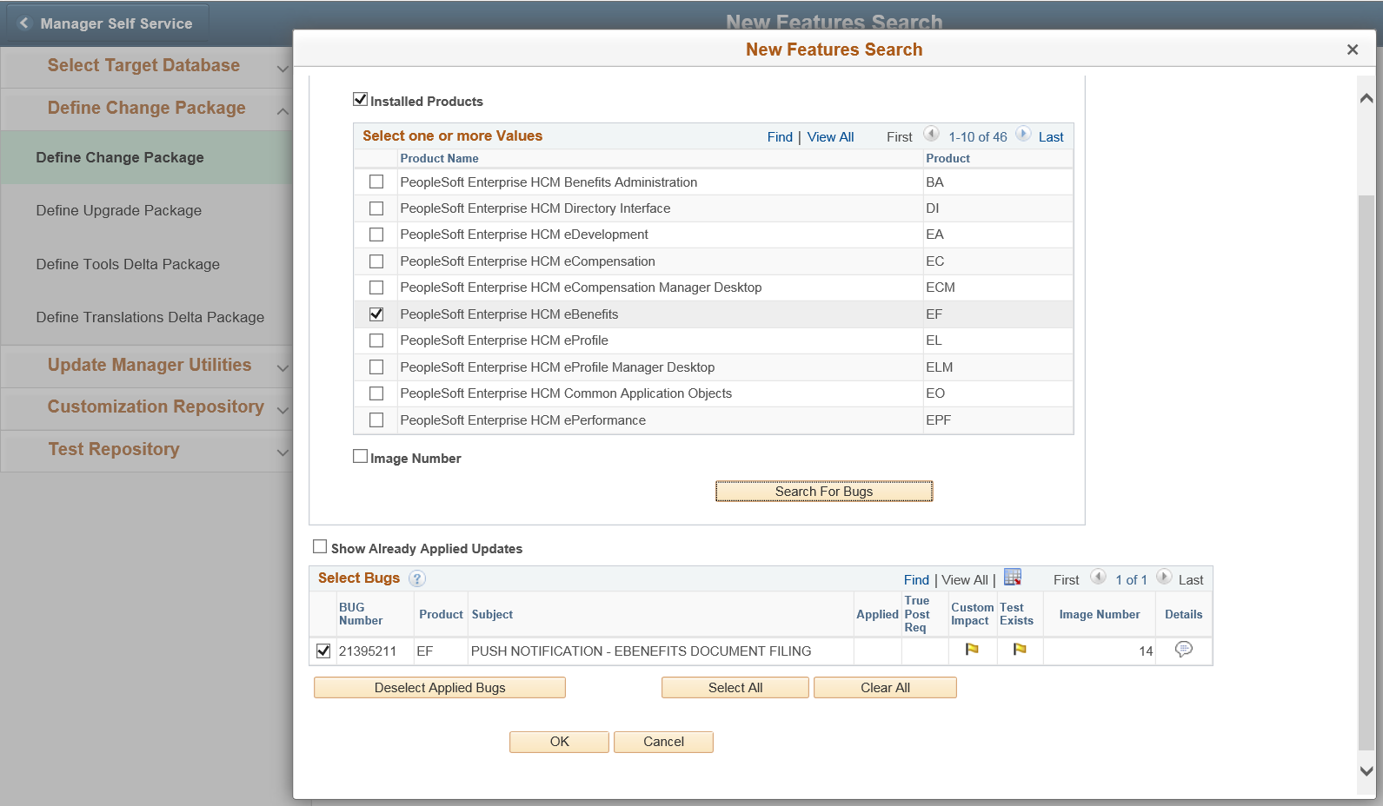
PUM Application Steps
Search based on newly released features

Slide 15
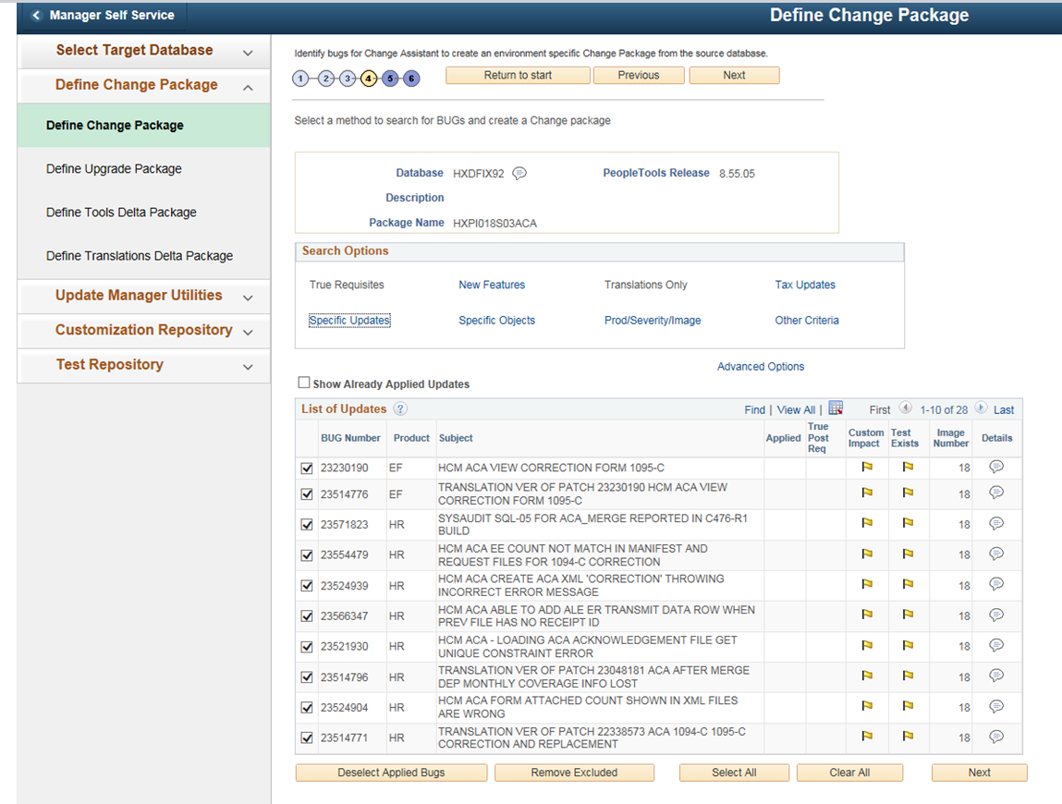
PUM Application Steps
Search based on Specific Updates

Slide 16
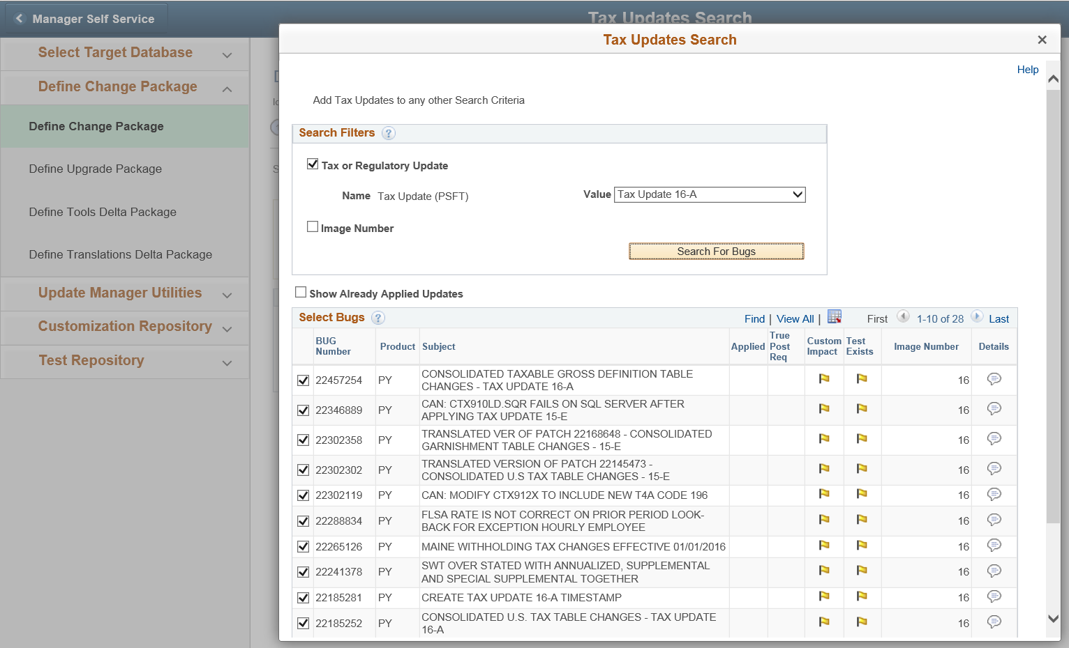
PUM Application Steps
Search based on specific tax update

Slide 17
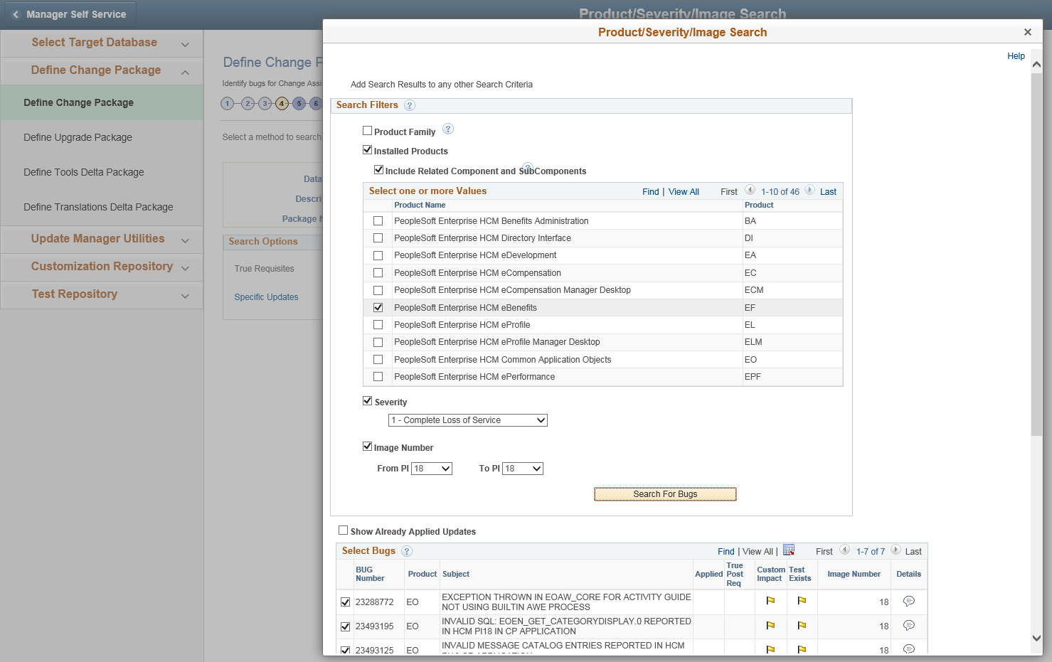
PUM Application Steps
Search based on multiple criteria

Slide 18
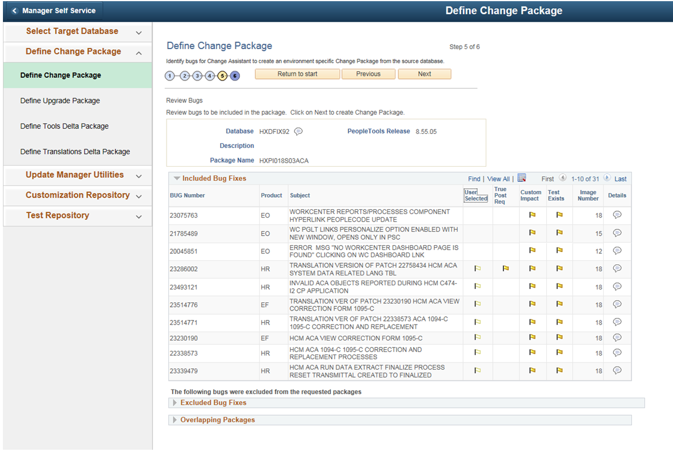
PUM Application Steps
PUM will pull all the required fixes based on the user selections/choices

Slide 19
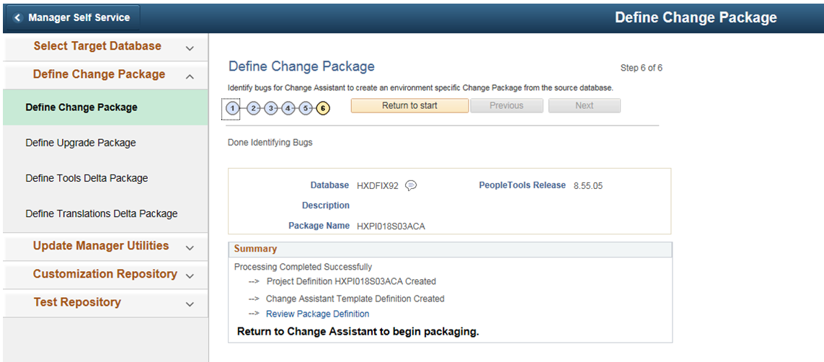
PUM Application Steps
Package is defined and can be created and applied to different environments as needed

Slide 20
ALCOLINK PUM Database Lifecycle

Slide 21
Financials PUM Status (as of Sept 2016)
PUM 9 (currently in Production)
PUM 18 (specific updates, as below)
Will be current - PUM 20
  In Apr 2017
10 | PO: Tax Rate issue after copying an existing PO
12 | SS: Analyze export received extra email on collaboration
14 | PO: Chartfields from the contract default incorrectly during a PO Change Order
15 | AP: 2015 1099 Update
16 | AP: Use Tax calculated on tax exempt PO voucher
11 | AP: Error message is generated when trying to pay the withholding schedule
11 | GL: Edit Chatfield from budget journal or transfer journal page not working
18 | AP: 1099-MISC Correction

Slide 22
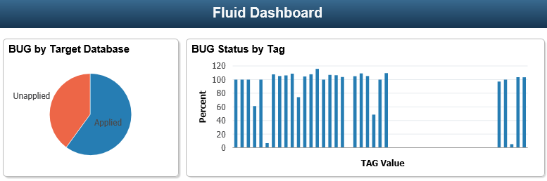
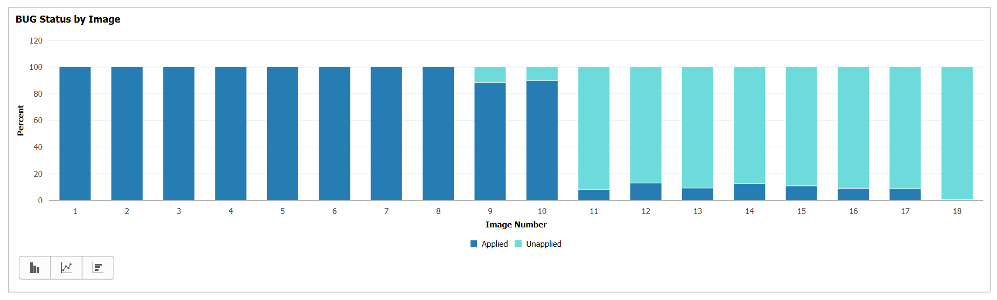
Financials PUM Status

Slide 23
HCM PUM Status (as of Sept 2016)
PUM 10 (currently in Production)
PUM 18 (specific updates, as below)
Will be current - PUM 20
  In July 2017
13 | 2015 Tax Updates A,B,C
14 | 2015 Tax Updates D
14 | Direct Deposit Enhancements
14 | Check Reversal fix issue
14 | ACA changes
15 | 2015 Tax Updates E
15 | ACA changes
15 | Patch 22185037 - Tax Update E updates
16 | ACA changes
16 | W2C Changes
16 | ACA patches
17 | ACA patches
18 | ACA patches

Slide 24
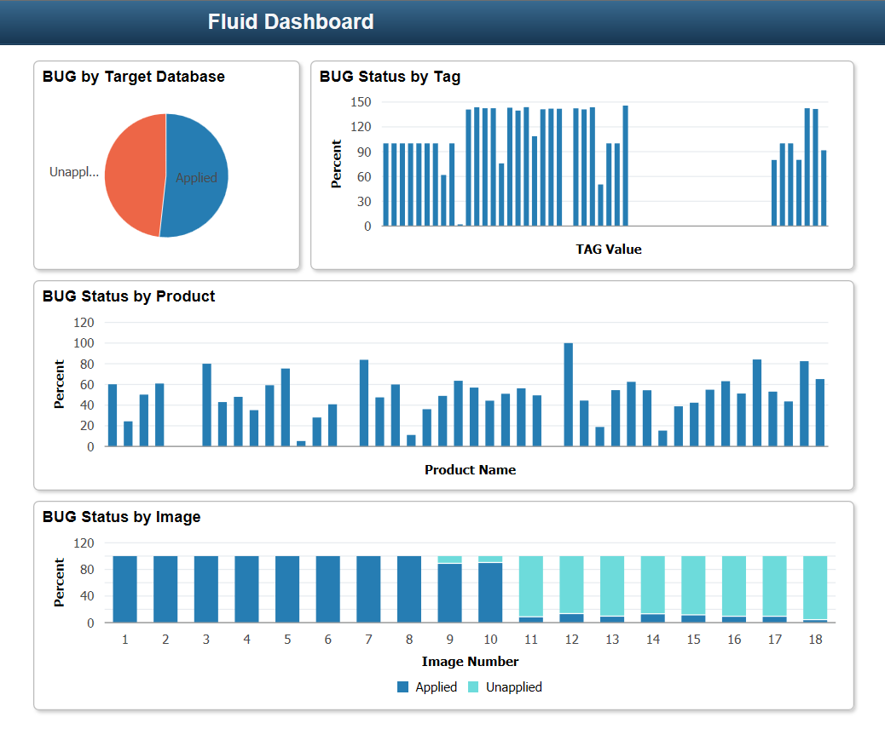
HCM PUM Status

Slide 25
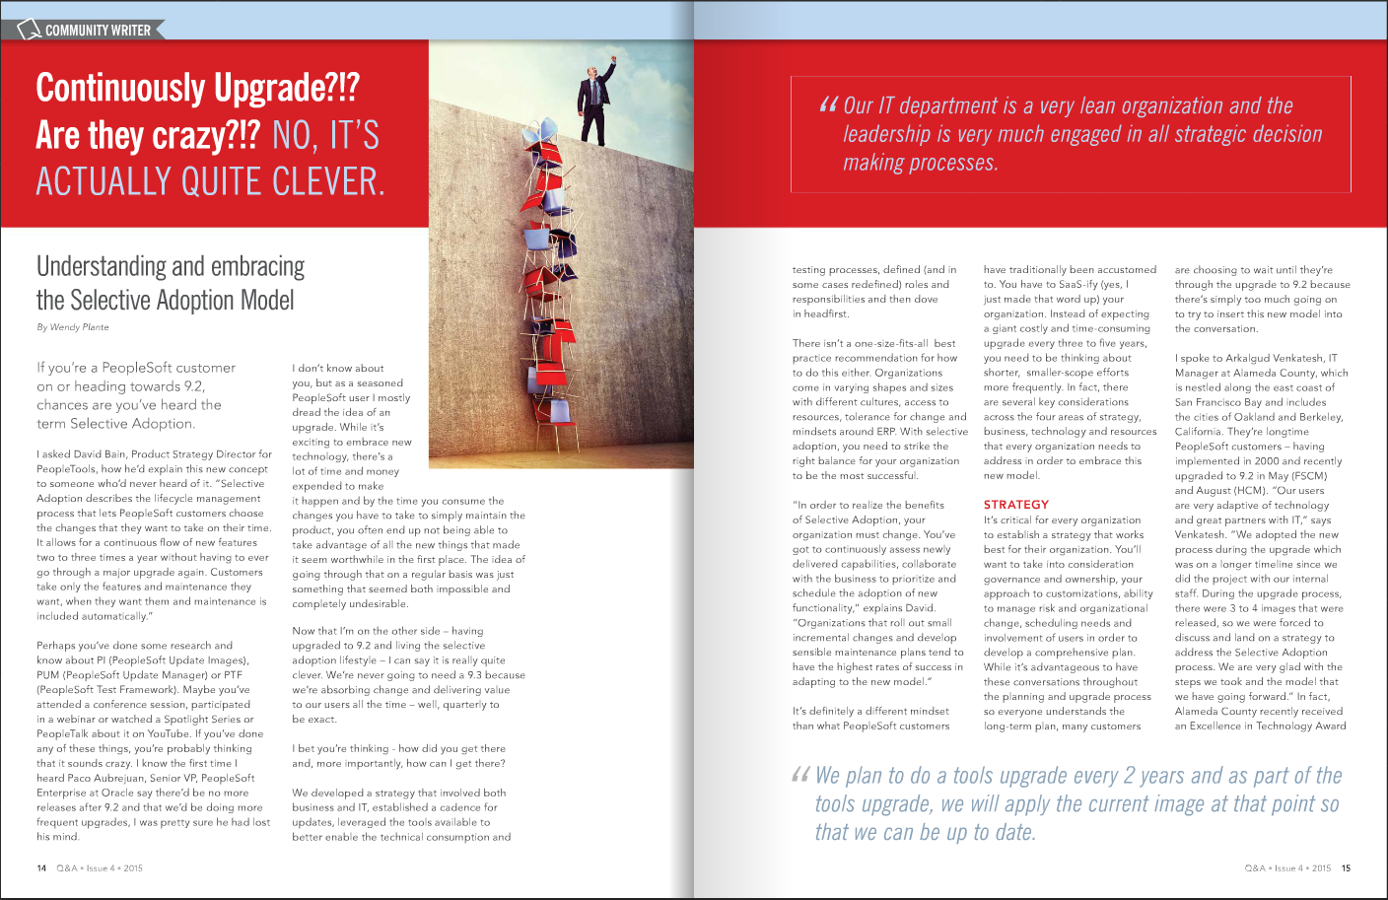

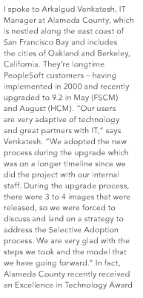
Quest article on Selective Adoption

