Slide 1
Oracle Cloud Implementation to the Non-Profit US Org
Implementing Financials, Procurement and Planning & Budgeting Cloud
Gaurav Oza, Larsen & Toubro InfoTech Ltd
@Gaurav_LTI
106410

Slide 2
Sachin Nade Certified Oracle Specialist and Sr Solutions Director
20+ years of Financial domain and IT experience
Involved in project planning to address business requirements.
Global Implementation across globe and multiple Industries
Complete life cycle management and consulting for IT Strategy for Fortune 500 companies

Slide 3






Meet Larsen & Toubro Infotech
6th
264
Largest Indian IT services company
(NASSCOM ranking 2015)
Active clients
(as of Dec 2016)
23
$880+Mn
Delivery centers globally, with 44 sales offices
(as of Dec 2016)
FY 2016
50
20,000+
Fortune 500 clients
(as of Dec 2016)
Employees
(as of Dec 2016)
Our Key Beliefs

Slide 4







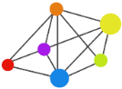








Oracle Capability Highlights – Committed to transform our customer’s business
On Premise
100+
Application engagements across 56 countries
3900+
Professionals with 36300+ man years of experience
35+ Fortune
500 Clients with enduring relationship
Cloud / Digital
E-Business Suite
SaaS
HCM Cloud/Taleo
JD Edwards
Finance Cloud
500,000+
Users Globally Supported
Idea Incubator
Won prestigious innovation award at Oracle Open World
132 +
Countries Supported
Sales Cloud
PeopleSoft
Procurement Cloud
Siebel
Mfg. Cloud
Fusion Middleware
Our Practice Differentiators
PaaS
Business Analytics
Integration
Hyperion
Process
Corporate Relationships
/Synergy
Proven Digital Transformation experience
Experience of handling large and Complex programs
Extreme Automation through Tools and Accelerators
One Stop Shop for
Oracle needs
Cross Industry
Expertise
Mobile
Edge Products
Analytics
Innovation & Solution Centre
Strategic Partner
Accelerate
Partner
Co Dev. Partner with Oracle
Tools & Accelerators
Collaboration
Primavera
Joint Industry specific soln. development
Customer Advisory Board, Partner Advisory Counsel
Certified Beta testing
partner
In Memory, Voice of Factory IOT Soln, Cost Mgmt.
Oracle Certified
IP & Digital ISV Solutions
Security
Utility Tools
IoT
Verticals
Oil & Gas
Logistics
Manufacturing
& Aviation
Consumer Packaged
Goods
Utilities
Banking &
Insurance

Slide 5


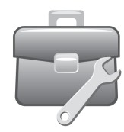


Oracle Cloud Apps Highlights
120+
Oracle Cloud Apps Center of Excellence
Oracle Cloud Apps Beta
Testing Partner
Ready to use accelerators, Best Practices.
Global Delivery Strength
Experience In Successful Oracle Cloud Implementation
Strong Domain Expertise Across Financial & Supply Chain Management
Developed tools/solutions to create value for customers
Integration
Analytics
Reliable
Mobile
Secure
Social
CLOUD
Simplified UI
HCM Cloud & Taleo
Oracle Sales Cloud
Financial Management Cloud
Oracle Procurement Cloud
Manufacturing Cloud

Slide 6
SaaS Market Trend
Total Spending (Excluding Cloud Advertising) and CAGR, by Region
Gartner sees SaaS growing 20.3% in 2016 to 37.7 billion
The SaaS market is poised to surpass $112.8 billion by 2019, according to IDC research
The overall market will reach $164.29 billion by 2022, according to Transparency Market Research (TMR)
SaaS delivery will significantly outpace traditional software product delivery, growing nearly five times faster than the traditional software market
By 2019, the cloud software model will account for $1 of every $4.59 spent on software
Billion Of Dollars
Percent
SaaS Growth by Systems - Gartner Market Trends Future Look
 | 2014 Growth | 2015 Growth | 2016 Growth | 2017 Growth | 2018 Growth | 2019 Growth | CAGR 2014-2019
BI | 51.6 | 43.4 | 40.9 | 36.7 | 33 | 30.4 | 36.8
CRM | 25.8 | 25.1 | 23.7 | 22.4 | 21.1 | 19.8 | 22.4
Digital Content Creation | 38.3 | 39.5 | 33.9 | 24.9 | 23.7 | 21.8 | 28.6
ECM | 12.2 | 10.1 | 10.2 | 11.7 | 18 | 20.6 | 14
ERP & HCM | 29.8 | 21.7 | 18.2 | 16.2 | 16 | 11.6 | 16.7
Office Suites | 42.2 | 26.7 | 20.4 | 14.8 | 11.9 | 10.8 | 16.8
PPM | 27.8 | 24.1 | 23.7 | 20.7 | 17 | 16.1 | 20.3
SCM | 22.5 | 23.1 | 20.6 | 20 | 17.6 | 16.6 | 19.6
Web Conferencing Suites | 12.5 | 10.6 | 11.5 | 10.9 | 11.8 | 10.5 | 11.1
Other Application Software | 15.2 | 17.6 | 19.9 | 18.1 | 15.7 | 13 | 16.8
Total | 23.9 | 22.2 | 21.2 | 19.7 | 18.6 | 16.7 | 19.7
Source: Gartner

Slide 7

Client Profile & Earlier Status
Non-Profit Organization (US)
Service-based Operations: Into Foster Care
Several IT-systems for different Business Processes
No end-to-end Business Process in place

Slide 8




















Scope of Work
General Ledger
Accounts Payable
Payments &
Collections
Asset Management
Financial Management
Accounts Receivable
Cash & Expense Management
Common Modules
Reporting & Analytics
Planning
and Budgeting
Sourcing
Negotiation Styles
Guided Event Creation
Live Negotiation Monitor
Spreadsheet Automation
Procurement
Supplier Portal
Interactive Collaboration
Supplier Work Center
Catalog Authoring
Electronic Invoicing
Procurement Contracts
Contract Lifecycle Mgmt
Contract Repository
Contract Search
Compliance Monitoring
Purchasing
Center Driven Procurement
Unified Approvals
Buyers Work Center
Document Change Mgmt
Self Service Procurement
Consumer Experience
Unified Approvals
Catalog Management

Slide 9
Scope of Work : Continued
Oracle Financial Cloud Oracle Procurement Cloud Oracle Planning & Budgeting Cloud
General Ledger
Expense Management
Accounts Payable
Accounts Receivable
Asset Management
Cash Management
Common Financial Module
Standard Approval Workflow
Enterprise Structure and Security for Procurement
Catalog & Supplier Management
Business Unit Functionalities and Item Management
Supplier Portal Management
Supplier Contract Management
Receiving Setups
Other Miscellaneous Setups
Standard Approval Workflow
Managing Users and Roles
Building a Planning Application
Designing Business Rules, Reports and Documents
Standard Approval Workflow

Slide 10
Project Timelines
&
Activities & Deliverables

Slide 11
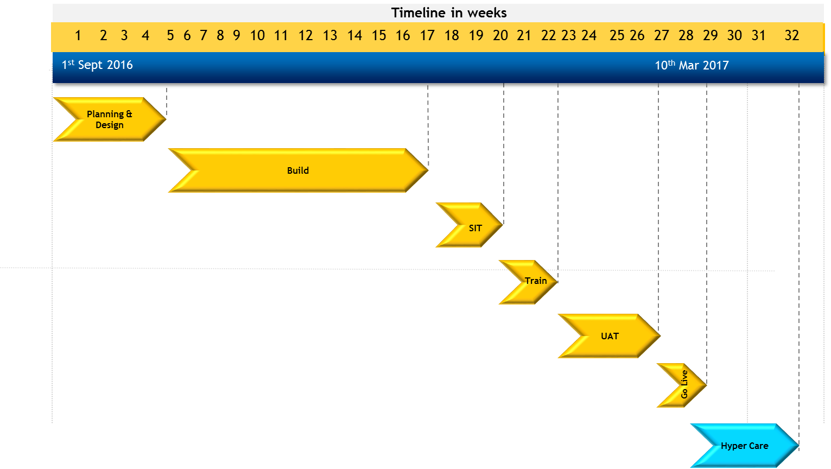
Oracle Cloud Application Implémentation Project Timelines

Slide 12
Application Architecture Overview : Legacy System
Out of System Procurement and Voucher Based Tracking
CoTrack: Contract Management System
Prophix : Financial Reporting & Budgeting
FSFN
Solomon Accounting System
Argos: Payment &Purchase Related Authorization
FRX:Transactional Reporting
Excel Based Asset Management System

Slide 13
Business Process Challenges and Solutions
Challenges
Solution
Finance
Inefficient Third Party System for GL, AP & AR.
No Asset Management in place.
Manual Processing for Expense Management
Procurement
No Standard Procurement Process in Place.
Improper maintenance of Master List.
Manual creation of Procurement Contracts.
Planning & Budgeting
No Integration of P&B with other Systems.
Generation of P&B Reports.
Challenges Across the Business
Lack of proper Approval Workflow
Lack of Automation
Significant Dependence on Manual Tasks
Difficulty in generating important reports
Transformation of Financials, Procurement & Planning by implementing Oracle Cloud
Integration issues solved using Oracle Fusion Middleware: Integrated Cloud Service (ICS)
Extensive Leverage of
BPM (Business Process Manager): Approval Workflow
OIM (Oracle Identity Manager): Security & Maintenance of Users
EPM (Enterprise Performance Management): Reporting & Allocation
Detailed Reporting: OTBI, FRS, Smart View, Accounting Inspector & Accounting Monitor
Cloud Acceleration Toolkit

Slide 14
Application Architecture :CBCCF Oracle ERP Cloud
Oracle ERP Cloud Financial Stack
Oracle Cloud Enterprise Contracts
Argos Payment &Purchase Related Authorization
Oracle Cloud Procurement Cloud
Oracle OTBI Cloud
FSFN
Oracle ERP Financials Cloud
Oracle EPM Cloud
Oracle Planning & Budgeting Cloud

Slide 15
Challenges Faced in Implementation : Functionality Gaps & Mitigations
Module | Functionality Gaps | Mitigation of Gaps
Enterprise Contracts | Fusion Enterprise Contract enables management of contract deliverables , however in absence of Supplier Portal and Web center both inbound deliverables management and document storage was a Functionality Gap | We Leveraged the Out of Box Enterprise Contract delivery management functionality and created an interface with the local FTP for linking the inbound contract related deliverables ( documents )
Procurement Cloud | Third Party Source System Integration for Requisitions. In absence of the Fusion SOA Middleware License, establishing a Service based integration with Argos Source system for requisitions was a challenge. | To Mitigate this we leveraged the Oracle Fusion Out of Box requisition upload templates and created a java program which will stage the data in the Oracle Accepted formats, the descriptive flex field were created to adequately capture the source system document reference and manage the mapping
Accounts Payable | Third Party Source System Integration for Voucher Data from the FSFN System to Oracle Cloud Accounts Payable In absence of the Fusion SOA Middleware License, establishing a Service based integration with FSFN Source system for requisitions was a challenge. | To Mitigate this we leveraged the Oracle Fusion Out of Box File Based Data Import templates and created a java program which will stage the data in the Oracle Accepted formats, the descriptive flex field were created to adequately capture the source system document reference and manage the mapping

Slide 16
Risks , Mitigants & Decisions
Major Risk | Mitigation | Decisions
Change in Scope: The Original ERP Cloud Implementation, involved the Implementation of Oracle Cloud ERP for Procurement, Financials and Planning & Budgeting. During the build phase Client wanted the Supplier Portal to be implemented and thus bringing out a major scope change | The Additional scope change was being handled through Change Request for the Additional Scope | The Impact on the additional change in scope on the timelines was negated as the requirement gathering and design process were aligned to include Supplier portal inclusion in Future.
Non Availability of Dedicated Subject Matter Experts from Client Side, Client being a Non-Profit Organization is lean on Staffing and with project of this scale the business team was stretched due to Audits and Regular Activity | Project planning was tailored to meet the timing and availability of client staff. The Various requirement gathering templates were tailored to business process of client based on the initial documents shared by the client | The aspect of non-availability of dedicated subject matter expert was factored during the initial stages of the project and activity scheduling was carried out accordingly
Slippages in deadline by either of the party would affect the entire schedule of project | A weekly status meeting would be scheduled between CBCCF and L&T Infotech to monitor project plan. For any slippages proper measures can be taken with mutual agreement
Product issues / bugs | Work with Oracle Support Team to resolve the issues on priority. Escalate it to Oracle Account Manager for CBCCF to expedite the resolution. | A detailed application related issue registry and probable solutions listing was being carried out as a part of pre project planning. This data is current being used across various implementation project.
Major changes in Oracle Cloud Application systems during implementation | L&T Infotech & CBCCF team shall work together to manage any major change during the implementation. | L& T being a platinum partner is in constant dialogue with Oracle ERP Cloud Team and carry out a detailed discussion on the latest releases and changes. Oracle Cloud COE team at L&T Reviews the changes and shared the details with project teams on a regular basis

Slide 17
Key Performance Indicator and Measurement of Success
Key Performance Indicators | KPI Performance | Rating in the Scale of 1 to 10
Standardized and aligned business processes | Standardization has been brought about in Enterprise structure, Chart of Account Structure and Usage, Standardized Reporting | 10
Centralized project map and timeline | Project Delivery and Customer Inclusion at various stages of project execution. With a Lean Staffing model of the client and no dedicated project resource committed by the client, the delivery timelines has been achieved | 9
Cycle Time | Month End Closing reduced to 2 Days from the earlier 9 Days Complete Automation of Voucher Processing Vendor Management is vendor driven through supplier portal Approval related delays reduce to less than 4% | 10
Application Rationalization | Close to 4 Long Tail Applications has been Sunset | 10

Slide 18












Cloud Acceleration Toolkit
Smart Solutions
Accelerated Assessment and Design
Data Migration Tools
Accelerated and Reliable
Data Migration
Cloud Configurator
Accelerated Configuration
MOSAIC
Test Automation
Automated Testing & Tracking
Powered by Testing CoE
Cloud
Acceleration
Toolkit
Data
Accuracy Tool
Data quality enhancement
Pre-Built Adapters & Reports
Ready Interfaces &
BI Reporting
Data Auditor
Monitor transactions & system changes
Improved Accuracy in execution
Defect Reduction by 30%
Shortened End-to-End Duration
IT Team Time Saved by 15-20%
Effort savings by 18-22%

Slide 19
Conclusion
Functionally led, practical approach | Upfront process exception handling strategy |Automation leverage|
Proprietary Tools results in 18-22% reduction in Implementation
Advantage of the embedded technologies with Lower costs
Functionally led, practical approach | Upfront process exception handling strategy |Automation leverage|
A+ talent | Well rounded team composition| Access to L&T business SME pool | L&T business leaders as advisory |

Slide 21





…THANK YOU FOR LISTENING
Kindly reach out to us at:
Gaurav.Oza@Lntinfotech.com
OracleBD@Lntinfotech.com
Or Connect with us at:

Slide 22

A 55,000+ member user community for JD Edwards, PeopleSoft and Cloud Applications customers.
Visit Quest International Users Group at Booth #435
Learn how Quest can help you receive 4x the return on your ERP investment
Walk through a customized Quest Activation Plan (QAP) to help your ERP team
Find out more about Quest’s product-specific events, PeopleSoft RECONNECT and JD Edwards INFOCUS

Slide 23
106410

