Slide 1
Implementing Modern Data Security into Legacy ERP Systems
July 10th, 2019

Slide 2
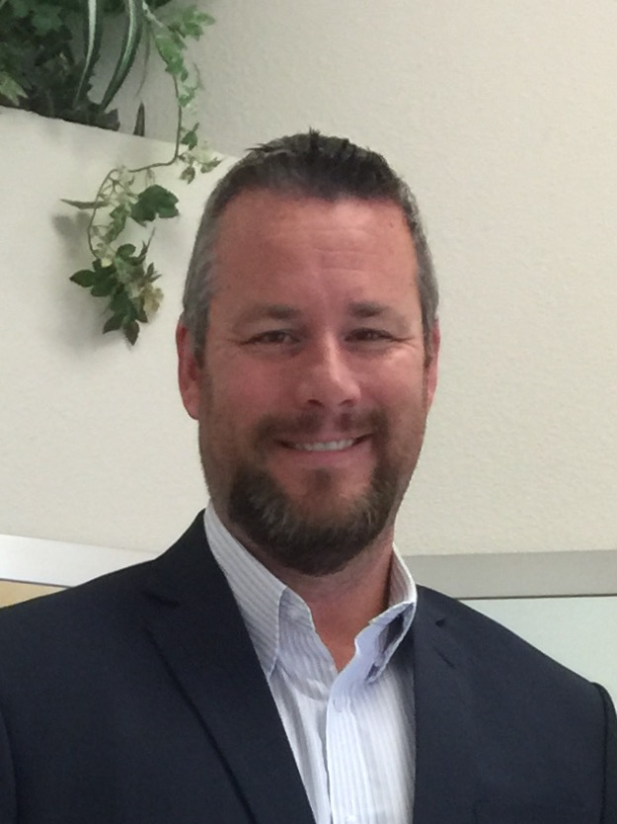
Agenda
Introduction
Why do we need security
Increase Security
Demo
Greg Wendt
Executive Director Security Solutions

Slide 3
We Make PeopleSoft Exceptional
Transform, Modernize, Secure
Application Security
User experience
200+ customers globally
Oracle Gold Partner
Engaging
UX
Contextual Security

Slide 4
Global Customer Base (300+ Customers)
Government | Commercial | Financial | Healthcare | Higher Ed

Slide 5
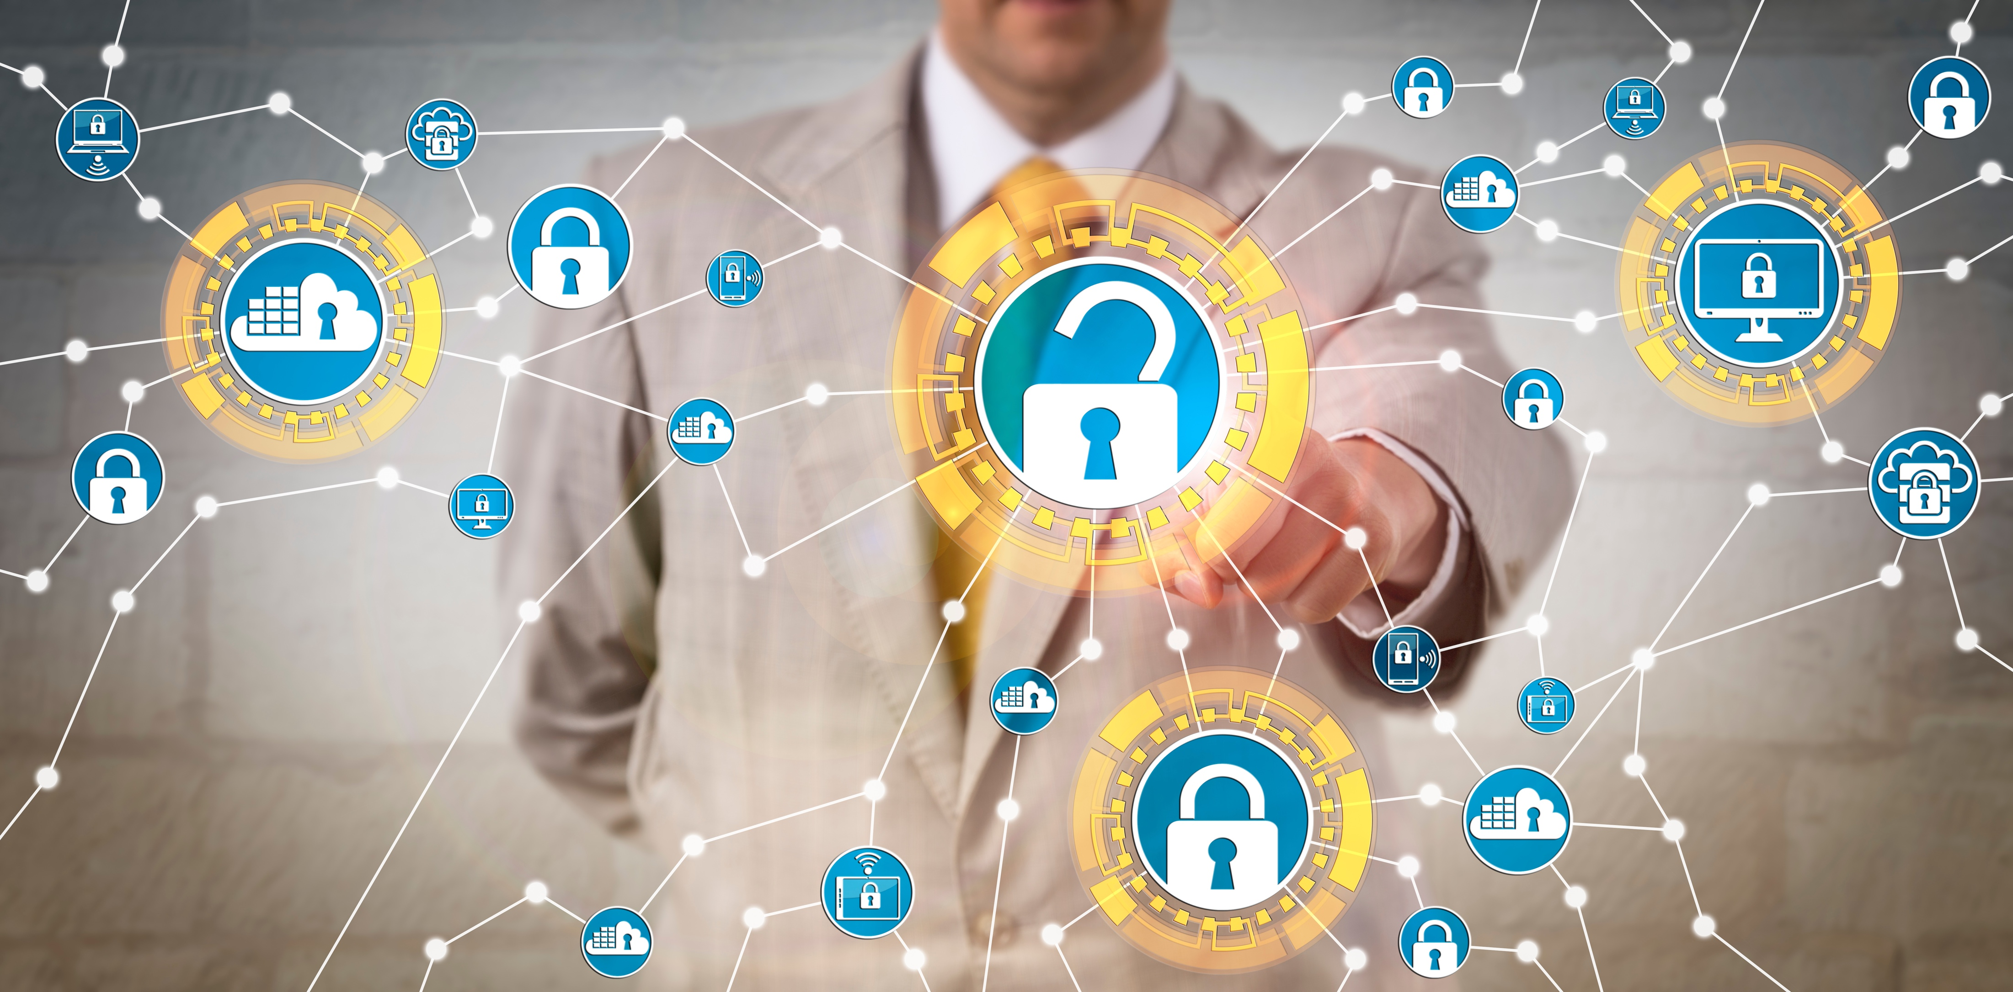
Why do we need security

Slide 6
Business is Now Dynamic & Mobile
Growing adoption of...
Mobile Applications
Remote Work
Self-Service Capabilities
BYOD Policies
51%
of IT professionals consider excessive privilege to sensitive data to be one of the greatest security concerns.
CyberArk’s 2018 Global Advanced Threat Landscape Report
...Remote access only
multiplies this risk
Notes:
Medium-Large organizations now have 160+ applications with individual employees using 10.6 different apps on average.
This app proliferation has spurred enterprise-wide SSO initiatives to improve user engagement and productivity as well as reduced support costs.
While leading identity providers use SAML, PeopleSoft has been left behind without SAML compatibility - putting customers in a tough spot.
Another component of this app explosion has been the increase of self-service applications accessible from anywhere, on any device.
The adoption of enterprise mobility delivers great benefits, but brings its own risks.
Outside of your secure corporate network, malicious access could spell disaster. Without additional security controls, hackers could have unrestricted access just as your employee does at work.

Slide 7
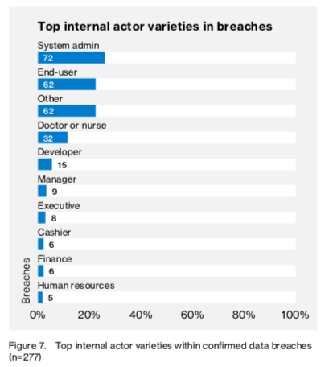
Insider Threats are on the rise
53%
of organizations confirmed insider attacks against their organization in the previous 12 months
27%
of organizations say insider attacks have become more frequent
Source: 2018 Insider Threat Report, CA Technologies​
Source: Verizon 2017 Data Breach Investigations Report​
Notes:
And while account take-over has grown, so have insider threats.
Over half of organizations have experienced an insider attack in the past 12 months and many believe these insider threats are growing.
Regardless of intent, malicious and accidental insider data leakage persists due to the complexity of the ERP environments and a lack of data-level protection within the application. Already inside, tradition security measures fall short in mitigating these threats.

Slide 8
A Lack of Response is Inviting Bold Tactics
Average of months to YEARS to discover​
58%
Credential compromise rose
70% from 2017-2018,
and has increased
280% since 2016
- 2019 State of the Phish Report
Includes breaches from outsiders and insiders. Discovery, (n=390)
Source: Verizon 2019 Data Breach Investigations Report​
Notes:
Cybercriminals are increasingly turning to bold tactics like phishing because they know organizations are slow to react.

Slide 9
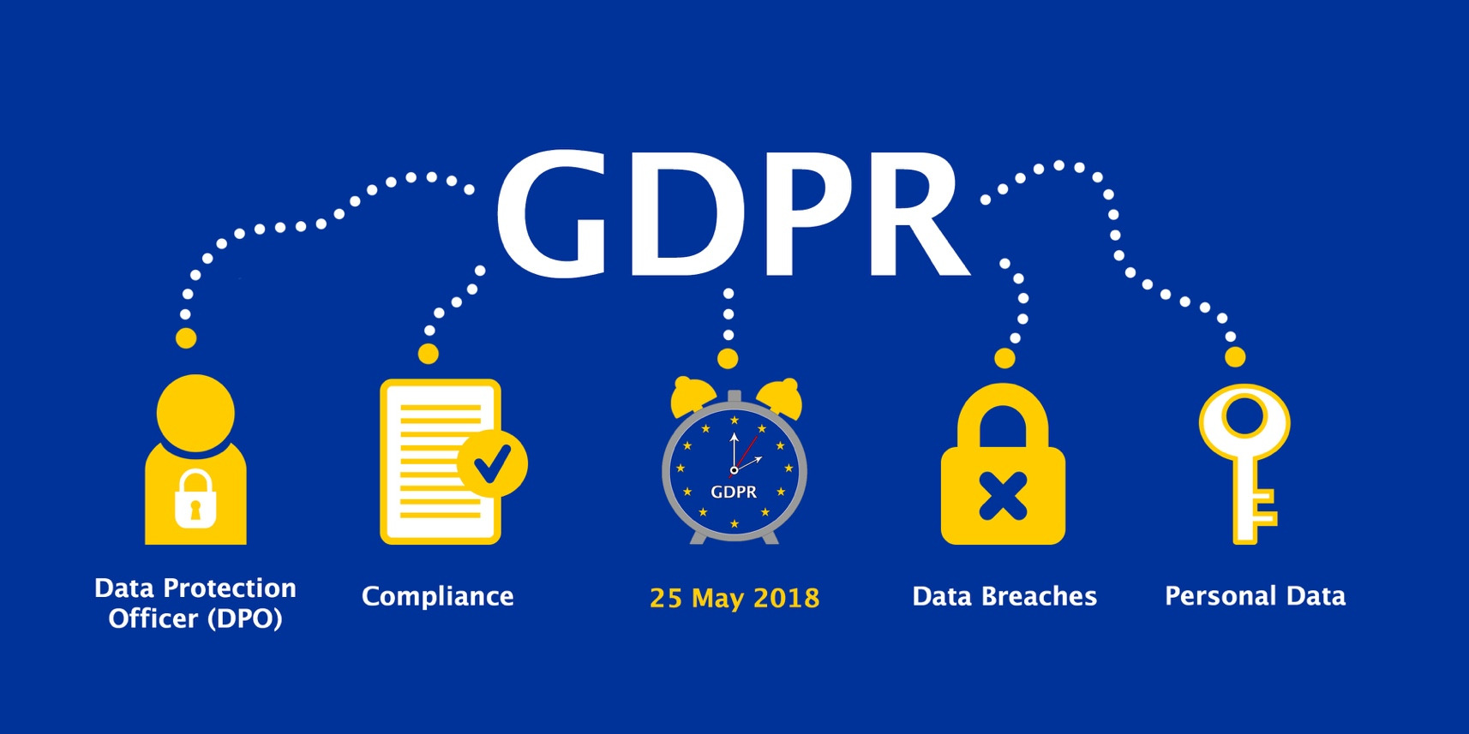
Data Privacy Mandates Are Requiring Direct Visibility into PII Usage and Activity
General Data Protection Regulation
Implemented May, 2018
California Consumer Privacy Act
Announced in 2018; in effect January 1, 2020
PIPEDA, Digital Privacy Act (Canada)
Others in progress...?
State-level privacy laws...
■ Non-compliance can cost 4% of annual revenue or €20 million
■ Breaches need to be reported within 72 hours of discovery ■ Individuals can demand an audit at any point in time
Notes:
Not just breaches but also about responding to compliance requests - which can be a much more punitive model about fines
Growing Data Privacy Mandates are requiring direct visibility into the usage of your user’s information... A troublesome scenario for PeopleSoft customers
Article 30 – “Records of processing activities”
GDPR requires organizations to maintain a detailed Record of Processing Activities. The article emphasizes on organizations’ ability to record, report on, and revisit user activity with specific details and context around personally identifiable information (PII).
Article 30 - http://www.privacy-regulation.eu/en/article-30-records-of-processing-activities-GDPR.htm
The NYDFS cybersecurity regulations also require a 72-hour notification in the event of a cybersecurity event
Condense compliance slides – all boils down to visibility

Slide 10
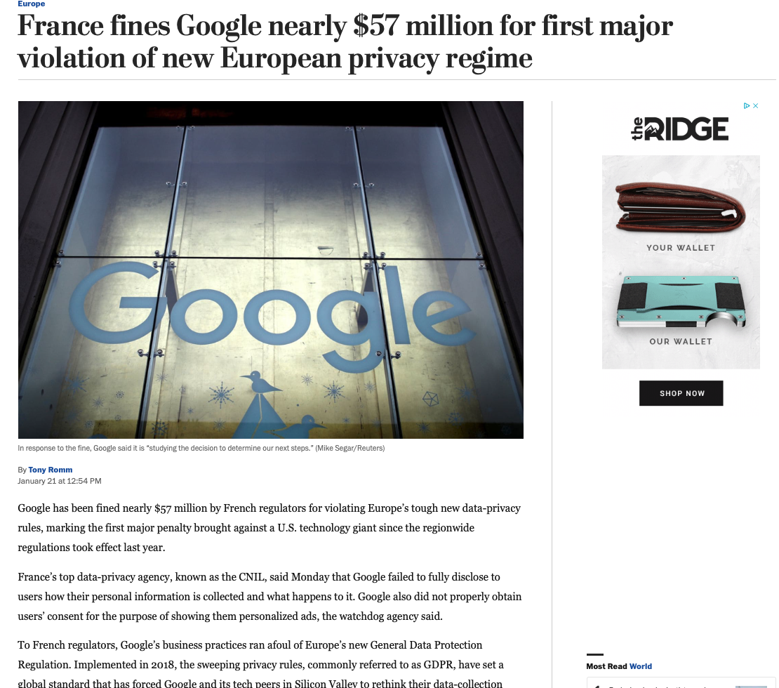
In the News : GDPR
“While the group said it appreciated the initial move to fine Google, they felt that the French regulators had focused only on a small portion of the tech company’s alleged violations. They said they hoped that the enforcement agency would respond soon to the rest of their complaint, and they noted that the maximum possible fine is more than $4.7 billion.”
https://www.washingtonpost.com/world/europe/france-fines-google-nearly-57-million-for-first-major-violation-of-new-european-privacy-regime/2019/01/21/89e7ee08-1d8f-11e9-a759-2b8541bbbe20_story.html?noredirect=on&utm_term=.765cae0a8b43

Slide 11
Breach Notification Requirements Are Demanding New Capabilities
Rapid Response
72 Hours: The General Data Protection Regulation
14 – 60 Days: All 50 states & major territories
Thorough Forensics
Notifications to victims required in all cases, often with additional protections
Minimum thresholds from 500 to 2,000 data subjects requiring reporting to appropriate agencies
Notes:
Requiring a complete forensics trail to gauge the notification threshold...
Requiring rapid incident response capabilities so you are left hanging...
Breach notification requirements demand a complete audit trail to address effectively
Rapid incident response capabilities are required to meet deadlines
https://info.digitalguardian.com/rs/768-OQW-145/images/the-definitive-guide-to-us-state-data-breach-laws.pdf
https://www.dlapiperdataprotection.com/system/modules/za.co.heliosdesign.dla.lotw.data_protection/functions/handbook.pdf?country-1=CA&country-2=US
Familiar with their own states.
They don’t even know they have a breach....

Slide 12
Increase Security

Slide 13
Adaptive Security Model
1. PREVENT
2. DETECT
Harden Systems
Isolate Risks
Prevent Attacks
Detect incidents
Identify vulnerabilities / weak spots
Confirm and prioritize risk
3. RESPOND
Investigate incidents
Contain incidents
Remediate
5. ADAPT
Anticipate threats/attacks
Assess risk-prioritized exposure
Adapt and improve security posture
4. ANALYZE
Conduct audits
Baseline systems and security posture
Design/model policy change
Notes:
ASP is aligned to an Adaptive Security Model, allowing customers to continuously monitor & improve their security posture
Ability to dive into conversation here, or use followup slides for deeper information.
Target 30min disco call

Slide 14
ASP Enhances PeopleSoft with Granular & Contextual Security
Modern Access Management
PeopleSoft SAML SSO Connector
Multi-Factor Authentication
PS_TOKEN Security
Contextual Access Control
Contextual Access Control
Field-level Multifactor Authentication
Privileged Access Management
Field & Transaction Level Data Protection
APPSIAN
SECURITY PLATFORM
Fine-Grained Data Security
Contextual DLP Policies
Dynamic Data Masking & Redaction
Click-to-View Field Masking
Query and Search Masking
Dynamic, Contextual Security
Unified Rules Engine
• Contextual Security Policies
• Pre-built Policy Templates
• Versatile Configuration
Real-Time
User Behavior Visibility
User Activity Logging
Granular User Activity Logging
Full Audit Trail of User Access
Compliance-ready Logs
Real-Time Analytics
Intrusion Prevention
Data Loss Prevention
Incident Response
Compliance Monitoring
Notes:
At the Platform/Module level, these are the features we offer -
Consider less technical version

Slide 15
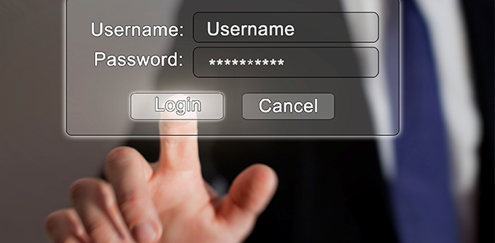
Demo

Slide 16
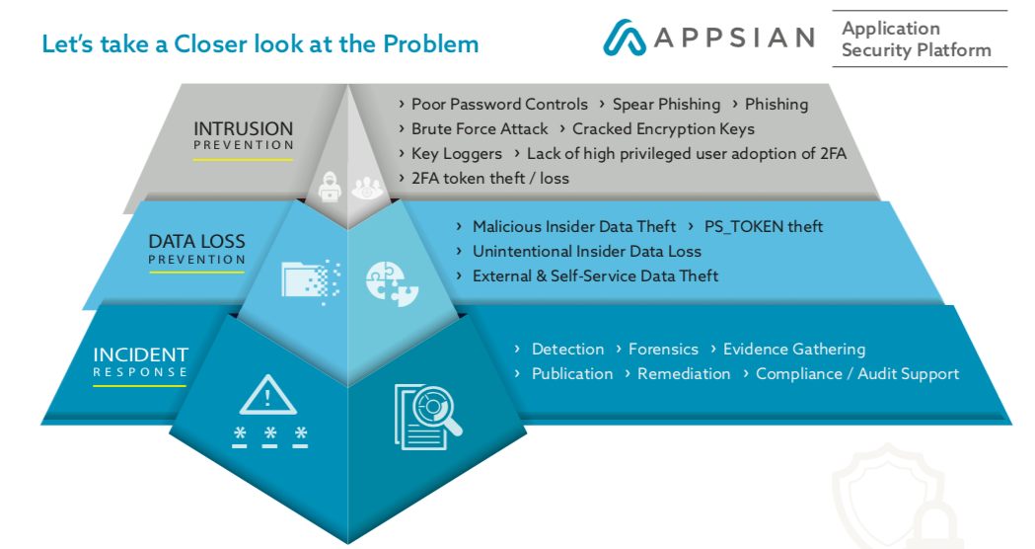
Summary
Organizations must understand who is touching data
Increased security is a must for todays applications
Complete solution is achievable

Slide 17
Questions
Reconnect July 16-18
Booth 101
Email:
info@appsian.com

Slide 18
Thank You

