Slide 1
A Mouse in the House: Don't Lose Sight of Internal Control in the Panic Around External Threats
Jeff Soelberg
CIO - Fastpath

Slide 2

Speaker
Jeff Soelberg
CIO
Fastpath

Slide 3
Agenda
Current Threat Landscape
Areas of Focus
Common Mistakes
Building from the Inside Out
Questions
Wrap Up

Slide 4
Current Threat Landscape
Hacking is in the news all the time
Cybersecurity threats are growing daily, powered by the cloud and Internet
More and more difficult to keep up with emerging threats
Bad guys and girls always seem one step ahead
PCAOB now requires Boards of public companies to review cybersecurity at every Board meeting

Slide 5
Areas of Focus
Addressing internal threats
Addressing external threats
Identifying skill sets and capacities for effectively addressing and controlling or mitigating these threats
Technology is key enabler, but not a silver bullet
Effective program requires executive commitment and support to promote a strong internal control system

Slide 6

FACT
INTERNAL CONTROL WEAKNESSES WERE RESPONSIBLE FOR NEARLY HALF OF ALL FRAUDS
Source: 2018 Global Study on Occupational Fraud and Abuse, published by Association of Certified Fraud Examiners

Slide 7
Common Mistakes
Focusing primarily on outside threats
Trusting your employees
Relying on technology alone to protect you or help you become ‘compliant’
People + Process + Technology = Compliance
Not funding controls at a level commensurate with the risk to your company
Not evaluating all threats to your company, both external AND internal
Annual risk assessments should cover both

Slide 8
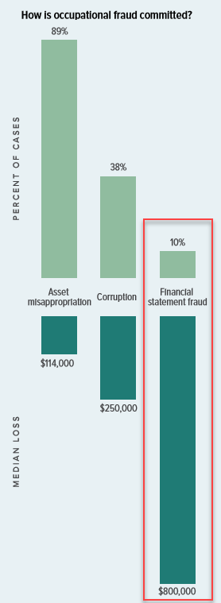
FACT
FINANCIAL STATEMENT FRAUD SCHEMES ARE THE LEAST COMMON (10%) BUT THE MOST COSTLY ($800,000 MEDIUM LOSS)
Source: 2018 Global Study on Occupational Fraud and Abuse, published by Association of Certified Fraud Examiners

Slide 9
Building from the Inside Out
It starts with strong internal controls, for example:
User Access
SOD
Change Management
Elevated Privileges
Each of the above relates to internal business processes and employees
Need to secure inside first
Risk based approach, balancing control needs with risk exposure

Slide 10
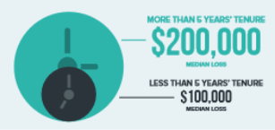
FACT
FRAUDSTERS WHO HAD BEEN WITH THEIR COMPANY LONGER, STOLE TWICE AS MUCH
< 5 YEARS - $100,000
> 5 YEARS - $200,000
Source: 2018 Global Study on Occupational Fraud and Abuse, published by Association of Certified Fraud Examiners

Slide 11
Controls are Important, Whether Public or Private
Public or Private doesn’t matter, all companies benefit from strong controls
Some standards are government backed, others are industry backed
List of compliance standards/regulations seems to be growing daily:
HIPAA · GLBA
GDPR · PCI
NITS · HITRUST
ISO27000 · FedRAMP
COSO
Vendors are requiring evidence of compliance from their key business partners

Slide 12
Executives Still Do Need to Have Security on their Radar
Publicly traded companies Boards must talk about Cyber Security
Boards should review Cyber Security budgets and have Director(s) assigned ownership for Cyber Security programs
Business owners don’t want to have their reputation damaged
Ask Equifax, Yahoo, Sony Pictures, Home Depot – this list is long…..
Increased regulations around data privacy impact security
GDPR, PCAOB, HIPAA, GLBA, FedRAMP, ISO27000, NIST
Auditors and Regulatory bodies are all inquiring about Cyber Security
Don’t be caught not having the answers they are looking for
Executives themselves are often targets
Email phishing and takeover, AP wire transfer fraud, contact info easy to find

Slide 13
Verizon 2018 Data Breach Investigations Report – The Threat is Real
Notable Statistics
76% of breaches were financially motivated
73% of cyberattacks were from outsiders, 28% from insiders
4% of employees will still click on a phishing email, good news is 78% don’t
81% of hacking related breaches leveraged either stolen or weak passwords
17% of breaches were just normal employee errors, nothing malicious
68% of breaches took MONTHS to discover

Slide 14
Wrap Up
Internal and external threats need to be addressed, with both being given adequate time and resources to put the right controls in place
Don’t fall into the trap of worrying primarily about cybersecurity threats
A risk based approach is always best, identifying all risks, external and internal, then designing and implementing effective controls for each
No silver bullet solutions, people, process, and technology all required to build a strong internal control system

Slide 15
QUESTIONS

Slide 16
Please complete a session evaluation
Session ID: 123456
Contact Info:
soelberg@gofastpath.com
Tel: (515) 276-1779 x115

