Slide 1
Improve Your Image
Jeremy Irrthum
Session 100550
07/18/2019

Slide 2
or
Manage Your Mods or
How to Run Your Retrofits
Notes:
Rocky and Bullwinklle alternative titles.
Dr. Strangelove or: How I Learned to Stop Worrying and Love the Bomb
Attended a lot of alternative to mods sessions. Page Field Configurator, Event Mapping, Drop Zones. You will still have mods. Here is how to manage them

Slide 3
Presenter
Jeremy Irrthum
PeopleSoft Developer
University of Minnesota
  Jeremy Irrthum has been a PeopleSoft developer since 1997. He has worked on Campus Solutions, Finance, HRMS, and Interaction Hub.
  His first PeopleSoft assignment was a charitable contributions report for Air Canada.
  Jeremy and his family are the fourth generation living on their family farm. They raise sheep.

Slide 4
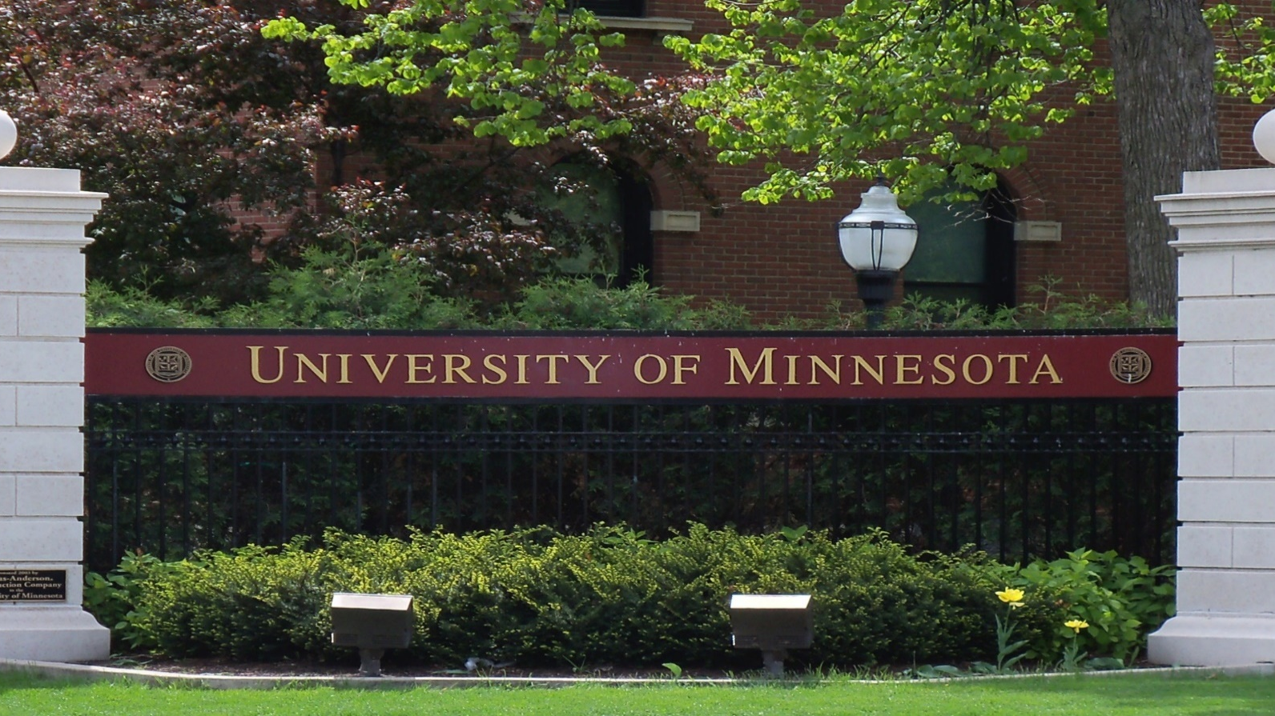
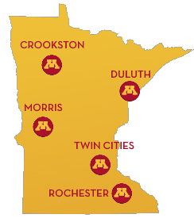
The University of Minnesota
Twin Cities - Duluth
Morris – Crookston - Rochester

Slide 5
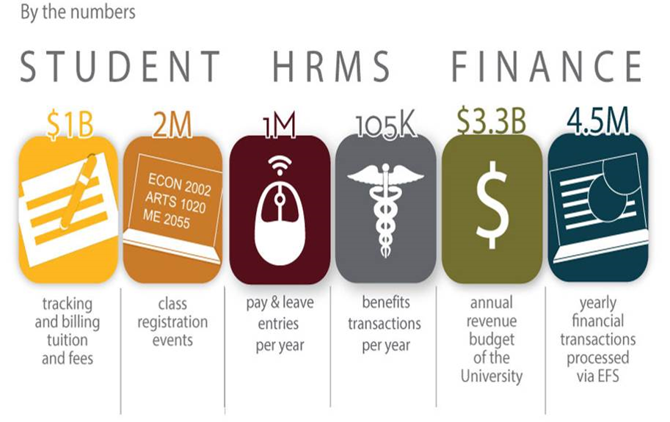
U of M by the numbers

Slide 6

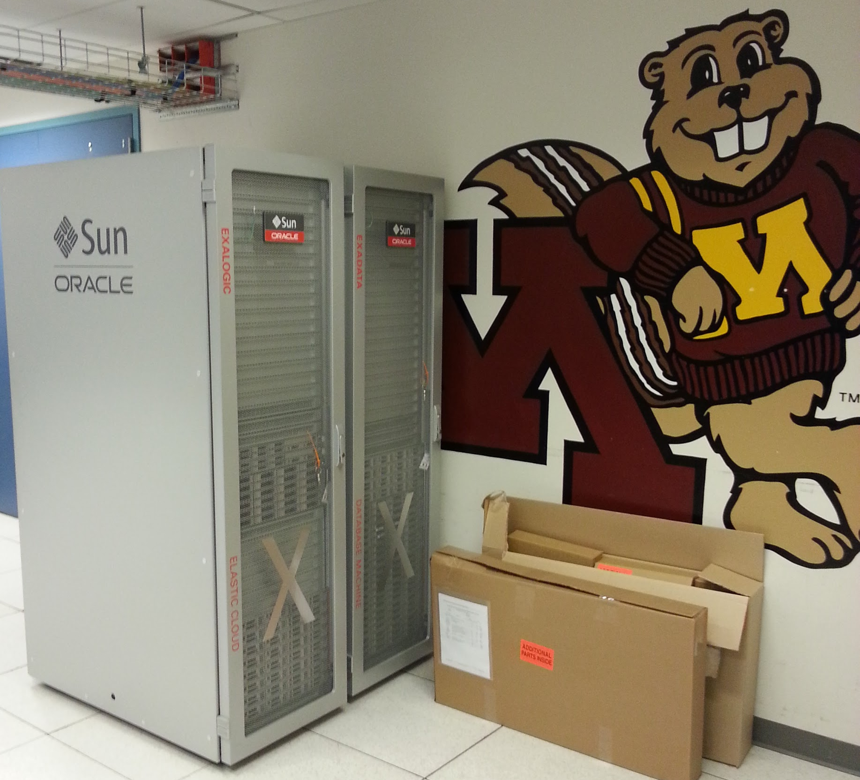
Oracle at the U of M
History 1998 Campus Solutions 2008 Finance 2015 Interaction Hub | Current Campus Solutions 9.2 Finance 9.2 HRMS 9.2 Interaction Hub 9.1 PeopleTools 8.56
Notes:
Exadata - databases
Exalogic – servers
PeopleTools 8.55

Slide 7


Improve Your Image
Notes:
This is the University’s story.
Improve your process. Best practices.
Improve how your business sees you?
Set expectations. Open up the discussion. Ask people to interrupt.

Slide 8



Who’s Involved
Administrators/
Migration Team
Business Analyst/
Testers
Developers
Notes:
Explain the roles and responsibilities – from a university perspective
We all cooperate and coordinate efforts for success
Show of hands for each group

Slide 9
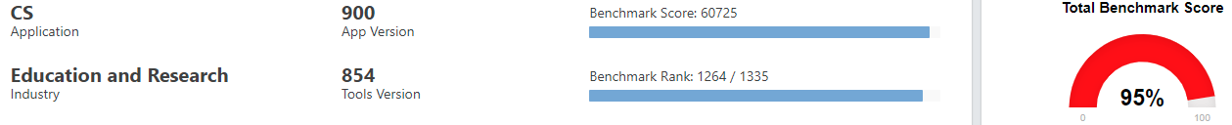
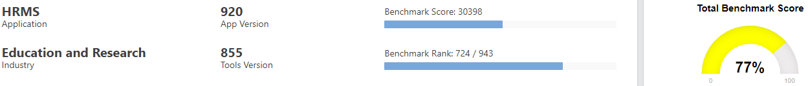
How Modified are we?
Notes:
Pretty modified.
How do we reapply quickly. Less cost.

Slide 10
Experience
9.2.7
9.2.8
9.2.9
9.2.10
9.2.11
Campus
9.2.6
9.2.18
9.2.25
9.2.4
Financials
9.2.17
9.2.21
9.2.23
9.2.26
9.2.4
HCM
2016
2017
2018

Slide 11



Overview
Image Management
    Architecture
Image Application
    Analysis
    Object Management
    Deploy
Notes:
The University’s process

Slide 12
Image Management

Slide 13

Infrastructure
Multi-tenant Database
Four instances
in one database
PSPRD
Notes:
All tightly integrated
One down – all down
Refresh refreshes all
Less databases

Slide 14
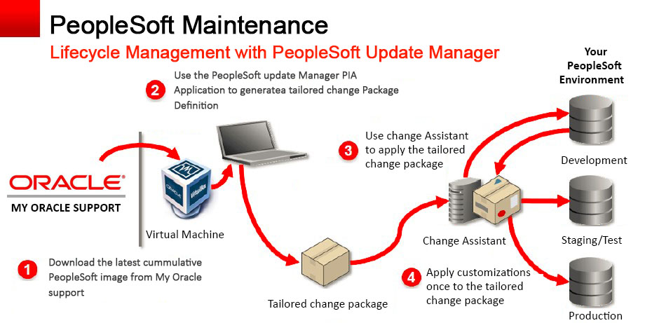
Lifecycle

Slide 15


Environments
PUM
Latest Oracle Image
Latest Oracle Tools
Software Development Life Cycle
DMO
Latest Oracle Image
University Tools
DMN
Production Image
University Tools
DEV
TST
QAT
PRD
UPG
Upgrade
Notes:
How is each used. What is the role of each.
Yes, we have this for all – CS, FS, HCM, IH
Use of DMO and DMN
Dmo always updated
DMN after migration to production

Slide 16


Application process
DEV Initial pass
  Work out the kinks
  Improve performance
  Identify custom steps
TST, QAT, PRD Move to Production
  Establish timings
  Practice
Notes:
Dev – very deliberate. Takes more time.
8 days?
Our opportunity to add steps to the change assistant process.

Slide 17


Automation
Automated Download/Provisioning
  Enter Bug ID
  Automated Download
  Enable DPK

Slide 18

Retention
Controlled Retention of Previous Images
  Archived as DAT files
  Change Assistant Wizard

Slide 19

More About Administrators
http://psadmin.io/
  Blogs
  Podcasts
  Tools

Slide 20
Image Application

Slide 21


Were to Begin
Object Organization
Modification Number
  UM_XX000_9999
    UM: U of M
    XX: Functional Area
    000: Business Process
    9999: Sub-Process
All customizations in Projects
  Project Name: UM_XX000_99999
  Matches Modification Number
Notes:
It all starts at the beginning. It’s all about organization and Standardization.
60% of time spent on 10% of objects that are not properly organized. How to make it faster? Make it clear.
We were skeptical at the beginning. Only able to maintain this through vigilance and commitment.
Only custom and customized objects in the Modification projects
How you modify matters. Modifications with retrofits in mind. Page – use suppage. PeopleCode,

Slide 22

Application Steps
Export change package
Compare against target
Review conflicts
Apply retrofits
Migrate to next environment
Test!
Notes:
DEMO New pages sql

Slide 23

Identify Conflicts
Compare Reports
  HTML Reports
  Compare Report Summary Tool
Query Project Tables
  Compare delivered project to modification projects
    PSOBJECTIEM
Notes:
Its all about the projects
DEMO compare report.
DEMO: Compare report summary tool demonstration
DEMO: Compare report project.sql
DEMO: Database compare SQL & spreadsheet

Slide 24

Identify Conflicts
Don’t forget COBOL, DMS & SQR
Notes:
Not on the compare reports.
We do modify the delivered file reference object – flag in the compare report.

Slide 25

Estimate
How long will it take?
  Spreadsheet of object types and historical time to retrofit
  Reconcile compare results and historical data to produce estimate
Notes:
DEMO: Estimation Spreadsheet

Slide 26
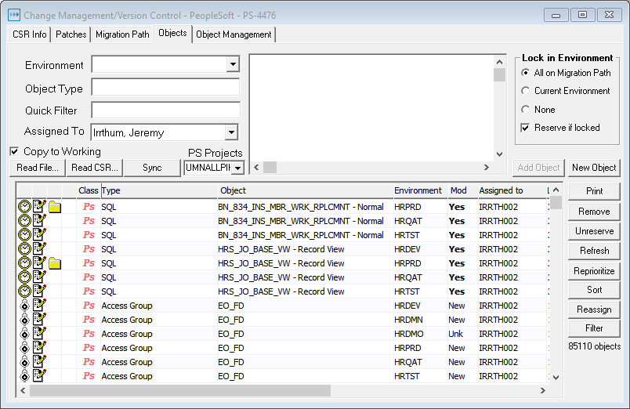


Object Control
Notes:
Enables us to process image and have in flight work
Object locking in DEV only
Read only access in all other instances
STAT creates the object lock for dev but also a lock that prevents migration / overwrite
STAT has version history

Slide 27
Object Control
Quest STAT
  Lock all delivered Objects
    Identify current conflicts
    Identify future conflicts
  Lock retrofits

Slide 28

Retrofit Assignment
Assign to several developers
Group by modification
Notes:
DEMO Show assignment / task spreadsheet
Why group by modification instead of object types?

Slide 29


Applying Retrofits
Comparison Tools
  Compare Reports
  STAT
  PeopleTools Queries
Notes:
We take all delivered changes. Very important to get ALL delivered changes. Especially pages.
We do not spend time evaluating which to take (and we apply our changes) and which to ignore (and we apply Oracle’s changes).
Time better spent just adding our stuff back. That way we know we have ALL the delivered changes.
Triangulate changes. DMN to DMO – Oracle changes. DMN to PRD – our changes.

Slide 30


Applying Retrofits
Compare Report and XML Files
  Open XML files in Excel
  Formulas
  Filters
  Conditional Formatting
Notes:
DEMO Open xml as spreadsheet. Show examples.
Portal Registry on the compare report
Portal registry xml spreadsheet
Page xml spreadsheet

Slide 31

Applying Retrofits
Page compare SQL
  Use query with database link to compare page structure
    PSPNLFIELD.PNLFLDID
Notes:
PNLFLDID very important. Keeping customizations and adding the delivered changes destroys the delivered PNLFLDID numbers.
DEMO page compare sql and spreadsheet

Slide 32
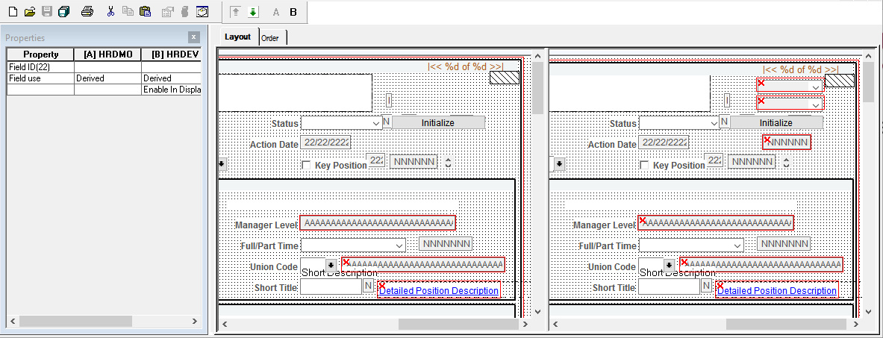
Applying Retrofits
Application Designer Diff/Merge Page
  Tools > Diff/Merge Page
Notes:
Identify differences and quickly (and accurately) apply retrofits.
Don’t miss an option buried deep in the page field properties tab.
DEMO Diff/Merge Page

Slide 33

Deployment
Change Package
Change Assistant
Let change assistant drive the process
Run on Virtual Machine
STAT
Migrate retrofits
PeopleTools and File Objects
Notes:
Multiple test moves.
Testing in each environment
Follow their steps.
Always changing
Hubris when we start to believe we understand it.

Slide 34

Post Migration Verification
Change Package
Project Object Query
Technical Verification
Let change assistant drive the process
Run on Virtual Machine
Functional Verification
Functional Testing
Notes:
Change Assistant has lots of steps. We have encountered some peculiarities. Images have thousands of objects.
Technical verification by application development team. Run ae, sqr, cobol, IB test connections to CS, FS, and WSDL
Testing two things.
Testing the code – the applications but also testing the installation process.
Complete regression test of everything. Even if not on the Cumulative Feature Overview or release notes.
DEMO – Project verification SQL
21-JUL-2018 12:00:01AM
UMNALLPI24TO26HR05022018

Slide 35

Production Application
Practice what you implement
Implement what you practice
Notes:
DEMO Deployment spreadsheet.
Test well no need for luck.

Slide 36


Looking Forward
Customization Repository
  More Organization
  Better and faster estimates
Automated Testing
  Faster and repeatable
Campus Solutions 4 images/year
Standardization
  DevOps
Notes:
We better get good at this!
Customization Repository – clean up our projects. Identify modified objects not in project. Identify delivered objects in projects.

Slide 38
Tomorrow at RECONNECT19
Tiles, Tiles Everywhere
And no content underneath
Tile & Navigation Collection Security Syncing
Session 100560
Thursday, July 18th
8:00am to 9:00am
Grand Ballroom F

Slide 39

Jeremy Irrthum
PeopleSoft Developer
University of Minnesota
irrth002@umn.edu

