Slide 1
Migrating PeopleSoft to Oracle Cloud Infrastructure:
How and Why Southcoast Health Made the Move
Joanna Wheeler Manager Business Systems Southcoast Health Systems Derek Tomei Director of PeopleSoft Line of Business Velocity Technology Solutions

Slide 2
AGENDA
Who is Southcoast Health Systems?
Who is Velocity Technology Solutions?
The Southcoast PeopleSoft Foot Print
An Overview of Southcoast’s Journey to the Cloud
What Does a Migration to the OCI cloud look like
Challenges, Tasks & Considerations along the Journey to the Cloud
Benefits of Running PeopleSoft in the Cloud with a MSP
Questions and Answers

Slide 3
Who is Southcoast Health Systems?

Slide 4

Who Is Southcoast Health?
Not-for-Profit, community-based health delivery system offering an integrated continuum of health services
Serves Southeastern Massachusetts and parts of Rhode Island
Largest provider of primary and specialty care in the region
Three hospital – Charlton Memorial in Fall River, St. Luke’s in New Bedford and Tobey in Wareham
Two Cancer Centers
Seven Urgent Care Centers
Partnership – Southcoast Behavioral Health in Dartmouth VNA
600 employed and affiliated providers
7,500 employees (largest employer in Southeastern Mass)

Slide 5
Who is Velocity Technology Solutions?

Slide 6



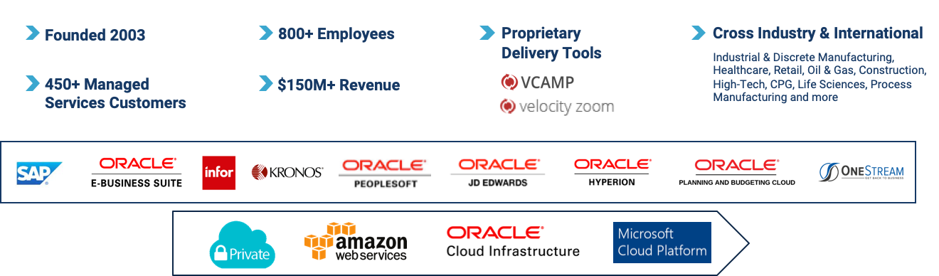
TRUSTED MANAGED SERVICES AND CLOUD PARTNER SINCE 2003
Leverage the difference our deep application expertise makes.
15+
17+ Years Oracle Platinum Partner
Oracle Cloud Managed Services Partner (MSP)
Full Lifecycle Suite of Services for Oracle Apps Unlimited
350+ Global
Oracle Resources
Velocity Zoom Oracle Validated Integration Certification
Any Cloud Public, Private, Vendor, Hybrid

Slide 7
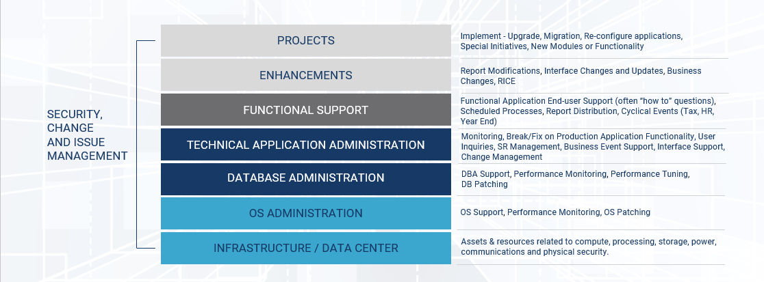
Full Stack of Services

Slide 8
The Southcoast PeopleSoft Foot Print

Slide 9
Southcoast PeopleSoft Applications
Finance
Supply Chain
Human Resource
Payroll
General Ledger
Asset Management
Project Costing
Accounts Payables
Accounts Receivables
Inventory
Purchasing
HR
Base Benefits
Ben Admin
ePerformance
ESS
MSS
North American Payroll
(4) Hospitals
(4) Pay groups
Unions
Kronos Time Keeping

Slide 10
An Overview of Southcoast’s Journey to OCI with Velocity

Slide 11
Southcoast Challenges
Southcoast implemented PeopleSoft on a Previous Hosting Provider
The Implementation’s were Complex
Faced Severe Challenges with Previous Provider
Not getting the Expected and Needed Guidance
Rigid processes, Lack of Flexibility
Turn around times for tasks took too long
Additional Challenges
Struggling with the Implementation aftermath and Application Support
Struggling to keep up with calls from Employees surrounding HR, Benefits, Payroll

Slide 12
Partnerships and Relationships
Velocity engaged with Southcoast to Fill Knowledge Gaps and Build both IT and operational knowledge around FSCM and HCM applications with Remote Application Management Support on Previous Hosting Provider.
Southcoast’s partnered with Velocity to provide 3rd tier application/functional support behind the Southcoast IT Helpdesk and IT Developers/Analysts.
Velocity Engaged to Provide Project Development Services and Functional How To Support as Needed
Velocity Business Process Outsourcing team engaged as Tier 1 support center for Southcoast employee's to call with HR/Payroll/Benefits questions
Velocity provided leadership and guidance to plan the move to OCI

Slide 13
Decision to Migrate from Previous Provider
Southcoast Desired to:
✓ Improve Performance
✓ Fill Gaps on Infrastructure
✓ Increase Application Efficiency
✓ Improve Service Levels in Order to Allow for Growth
✓ Achieve Faster Response Times on Requests
✓ Have one Throat to Choke
Already Partnered with a leader in Enterprise and Business Application Managed Cloud Hosting Provider

Slide 14
Migration to OCI
Southcoast Chose Velocity and their VCAMP Cloud Platform to Move their PeopleSoft Applications to OCI
To Maintain choice and control with their own unique configuration of PeopleSoft applications, customizations, and data
Oracle Best in class hardware, storage and Compute
Velocity performed the migration and wrapped it all together with a complete Managed Cloud solution on our Proprietary Platform
Southcoast is able to reap the cost savings Oracle provides to Velocity as a Managed Services Provider (MSP), with bundled services into a consolidated, contractual, SaaS-like solution
More flexibility, faster response times, and agility to grow the business.

Slide 15
What Does a Migration to the OCI Cloud Look Like?

Slide 16
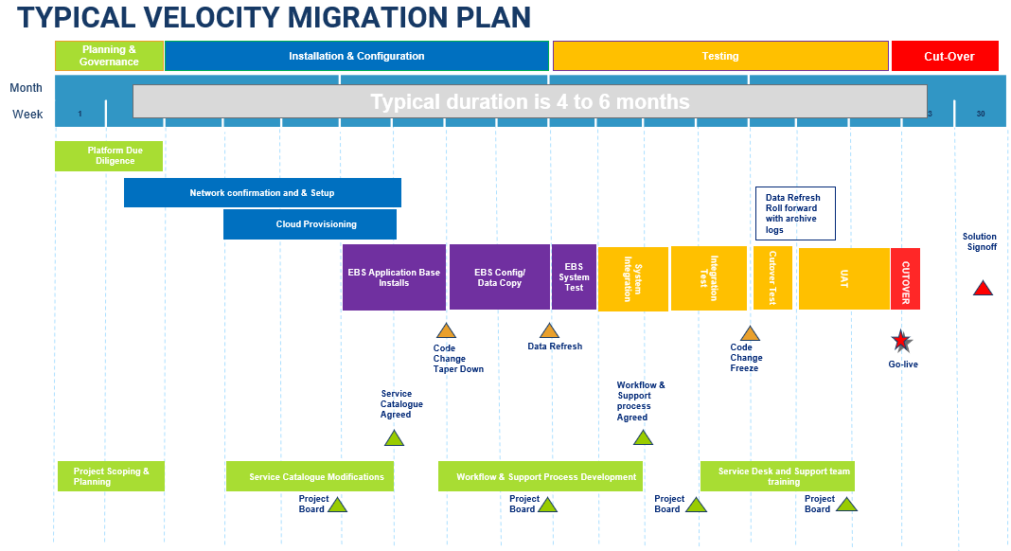


Slide 17
Challenges, Tasks & Considerations Along the Journey to the Cloud

Slide 18
Challenges, Tasks, & Considerations
Alignment of Business and IT Early in Project and Planning
Velocity Stepped up to be a Conduit and True Partner between Southcoast and their Previous Hosting Provider
Be sure to Inventory of Current Environment
Integration Points Internal and External
Networking Considerations (VPN, Fast Connect – MPLS)
Active vs. Future URL’s and Domain Names
Firewall Rules for interconnectivity with Cloud App and Internal Resources
Simultaneous Access to Current and Future Environments
App Designer, SQL Developer, nVision, MoveIT jobs
Tracking In Progress Development Projects
Migration Cutover Timings (Practice, Practice, Practice)
Test, Test, Test

Slide 19
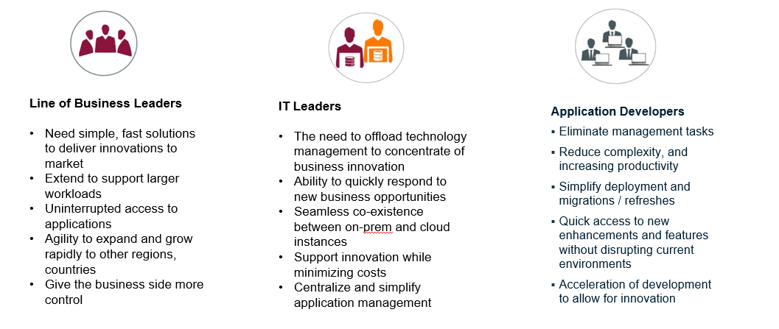
Your Cloud Strategy Should Be a Convergence of Roles

Slide 20
Benefits for Running PeopleSoft in the Cloud with an MSP

Slide 21
Benefits of PeopleSoft in the Cloud / MSP
✓ Fill Gaps on Infrastructure
✓ Increase Application Efficiency
✓ Improve Service Levels in Order to Allow for Growth
✓ Achieve Faster Response Times on Requests
✓ Have one Throat to Choke
✓ Cost Savings and Increased Profits
✓ Agility, Flexibility
✓ Increased operational efficiency and compliance
✓ Data Security
✓ Automated Patching and Environment Refreshes
✓ Improved Performance

Slide 22
Q&A Please complete a session evaluation
Session ID: 100610

