Slide 1
Supply Chain Management Special Interest Group
Dianne Taylor

Slide 2
PeopleSoft Supply Chain Management Special Interest Group
PeopleSoft SCM SIG provides its members with networking opportunities with other companies that have similar challenges and interests. The SCM members are encouraged to share implementation strategies and product experiences to help others shorten the learning curve related to PeopleSoft products.
This group will cover the following PeopleSoft Modules: -Order Management -Manufacturing -Quality -Engineering -Inventory -Mobile Inventory -Cost Management

Slide 3
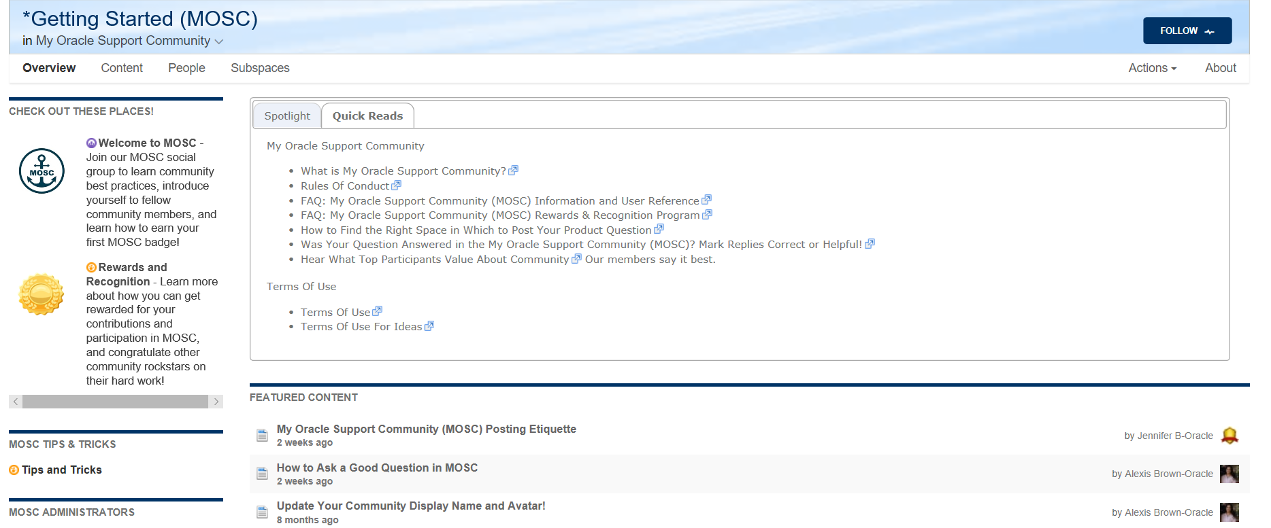
My Oracle Support MOSRC
Through PeopleSoft SCM SIG, members can join together to communicate to Oracle with a common voice with the intent of improving communications regarding product expectations and strategic product improvement ideas. Using My Oracle Support Community, is a great place to start.

Slide 4
Supply Chain Management SIG Leadership Board Members
DAN ROTERMUND SIG President and Communications Coordinator
Roush Enterprise
Systems Analyst – Supply Chain Modules
Daniel.Rotermund@Roush.com
DIANNE TAYLOR Vice President and Content Lead
SAVANNAH RIVER NUCLEAR SOLUTIONS
Asset Management & Distribution – Systems Support
Dianne.Taylor@srs.gov
STEVE CANTER Member at Large
SMART ERP SOLUTIONS (Oracle Platinum Partner)
Director, Global Service Delivery
Steve.c@smarterp.com

Slide 5
Topics / Webinars / White Paper
We want to hear from you, is there a particular topic you would like to discuss?

Slide 6
[Section Header]
[Section sub-header]

Slide 7
[Slide Title]
First Level
Second level
Third level
Fourth level
Fifth level
First Level
Second level
Third level
Fourth level
Fifth level

Slide 8
[Slide Title]
First Level
Second level
Third level
Fourth level
Fifth level
This section can be used for a summary, quote, or quick fact.
The quick brown fox jumped over the lazy dog.

Slide 9
[Slide Title]
First Level
Second level
Third level
Fourth level
Fifth level
This section can be used for a summary, quote, or quick fact.
The quick brown fox jumped over the lazy dog.

Slide 10
Please complete a session evaluation
Session ID: 123456
Contact Info:
email@email.com
Tel: 555.555.1234

