Slide 1
Managing FMLA through Extended Absence Framework
David Case
July 16-18, 2019

Slide 2
Managing FMLA through Extended Absence Framework
Human Capital Management Track
  Absence Management
  Human Resources
  Time & Labor

Slide 3
Agenda
Meet the presenter
Where we came from
  Current spreadsheet
  How we use absence management
Where are we now
Lessons we learned
  Configuring
  Integrating delivered features
  Customizations
  Q&A

Slide 4
Presenter
David Case
  Sr. Business Analyst
    19 years of state experience
    11 of those year in implementation and maintenance of various Human Capital Management related Oracle PeopleSoft modules
    Business Subject Matter Expert for FMLA
    David.Case@tn.gov

Slide 5
State of Tennessee
PeopleSoft Products:
  HCM
  FSCM
  ELM
  CRM
  OIM
PeopleTools 8.56.12
  Image 26 (HCM)

Slide 6
State of Tennessee
Employs more than 40,000 employees in more than 50 agencies across all 3 branches of government
Provides HR and Benefits services for more than 270,000 retirees and non-payroll employees
Implemented PeopleSoft on September 16, 2008
Protected Leave Division
  Centralized HR solution for managing FMLA
  One Agency (4,000) as a pilot (go live March 2019)

Slide 7
Managing FMLA through Extended Absence Framework
Objectives:
  Learn how the State of Tennessee used the Extended Absence Framework to implement a full service solution.
  Customizations that were made and how they enhanced the process.
  Benefits from our lessons learned

Slide 8
Managing FMLA through Extended Absence Framework
Learn how the State of Tennessee used the Extended Absence Framework to implement a full service solution

Slide 9
Where we came from…

Slide 10
Managing FMLA - OLD
FMLA was tracked by each agency, and often in different ways.
Manual Updates
  Updating dates for each employee
  Easy to update wrong fields
No way to query information

Slide 11
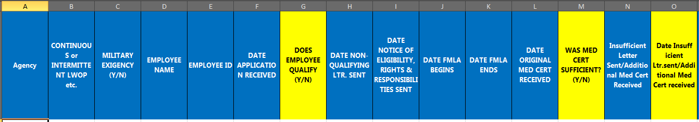
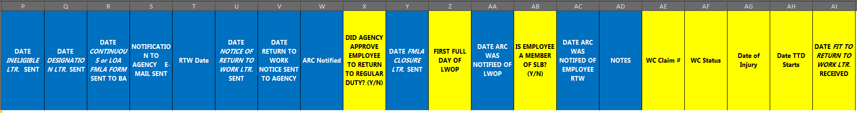
Managing FMLA - OLD

Slide 12
How we use Absence Management

Slide 13
Absence Management
Calculate balances for employees
Not used for Future Time
Not used to populate Time sheet

Slide 14
Where are we now?

Slide 15
Managing FMLA - NEW
FMLA can be tracked within PeopleSoft
Automated Processes
Easier to Report on information
Visual overview of employees
Working towards Centralization

Slide 16
demo

Slide 17
Lessons Learned
Configuration
The extended absence framework can be used in a demo environment, but there are a lot of pages to configure to make it work according to the business design.

Slide 18
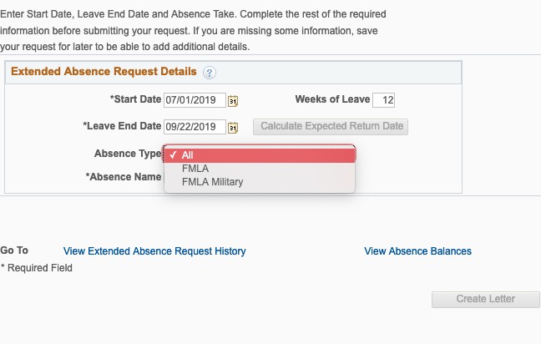
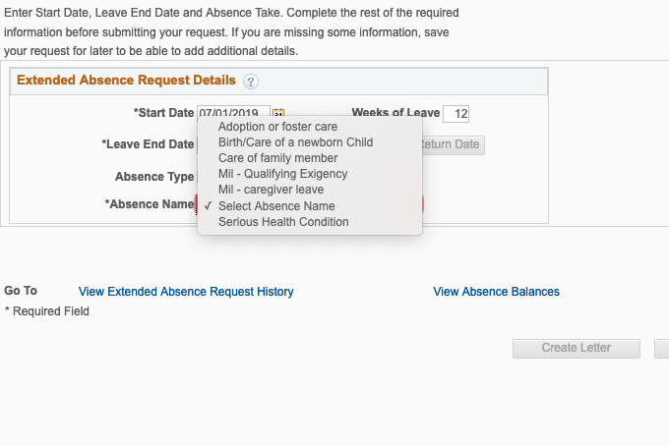
First setup the Absence Type and Name

Slide 19
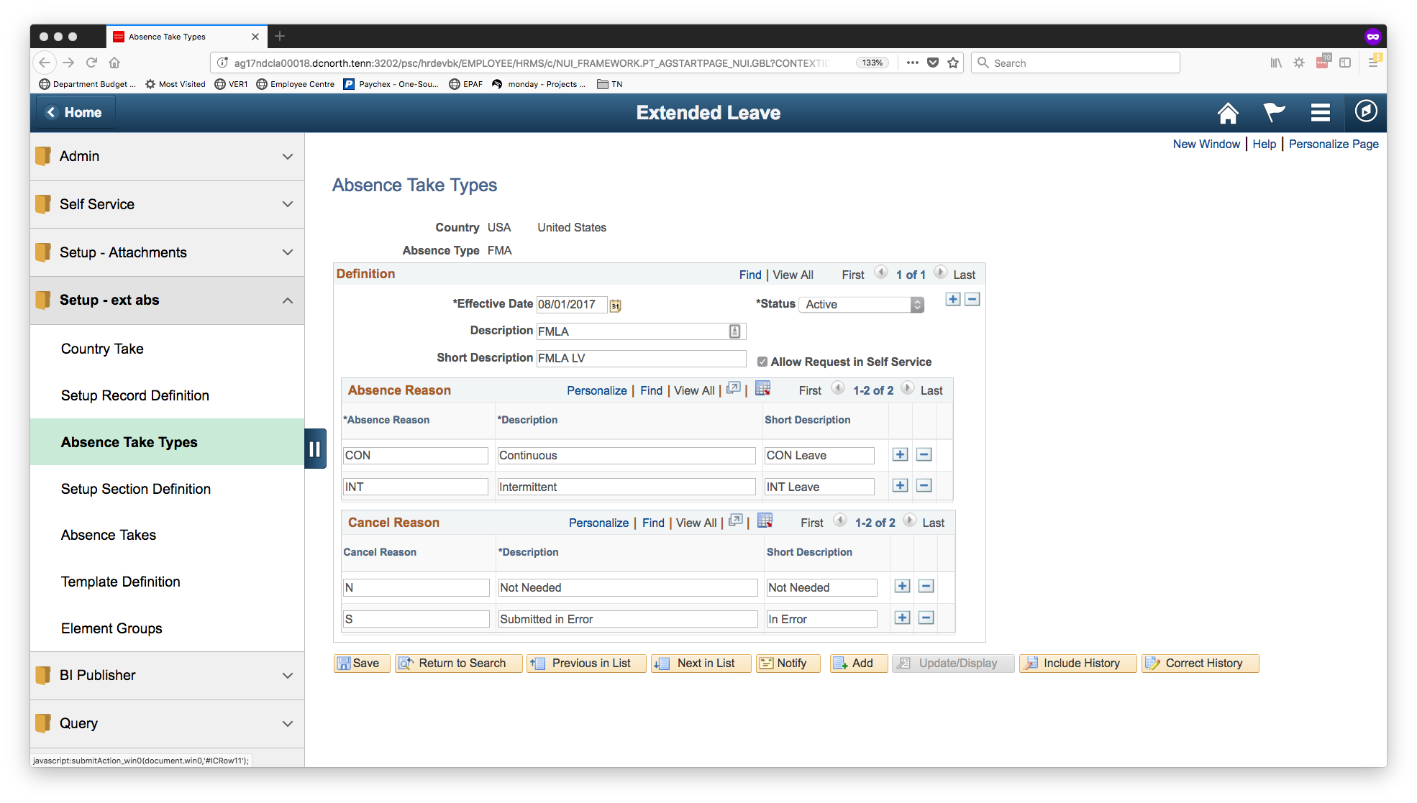
Add the absence take types
This is the page used to setup the ‘Absence Type’ that is associated with the ‘Absence Name’ (Take Type)

Slide 20
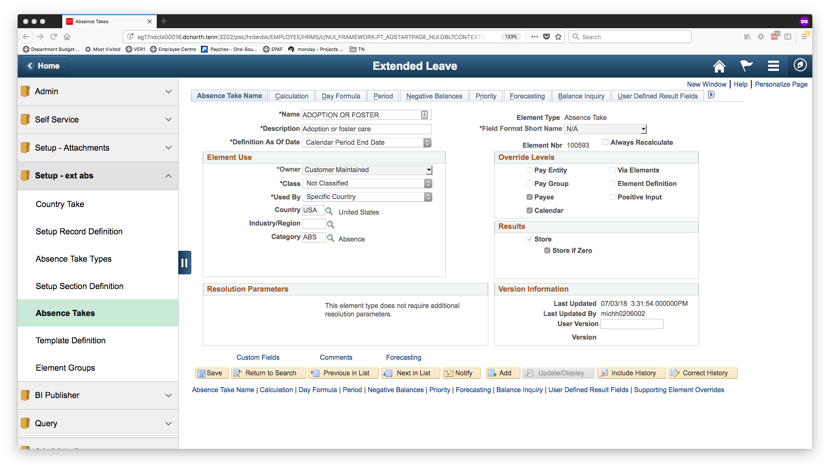
Absence Takes
This is the first step to add an ‘Absence Name’, additional steps are required before it will show in absence management. The other step is Country Take.

Slide 21
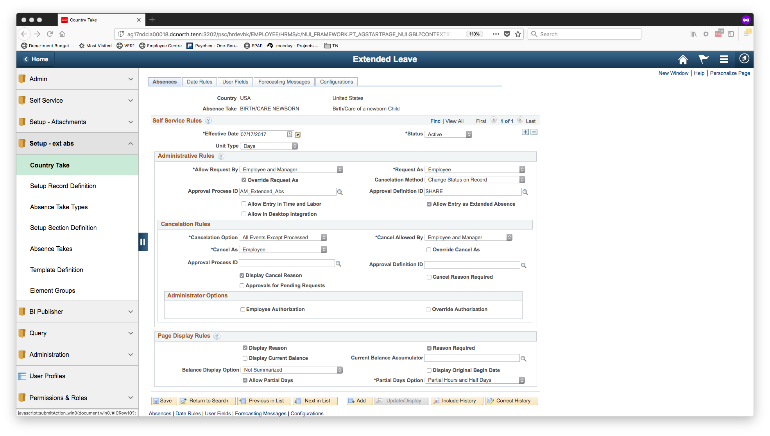
Country Take
This is the second setup page that is used to configure the “Absence Name” and make it show in extended absence.

Slide 22
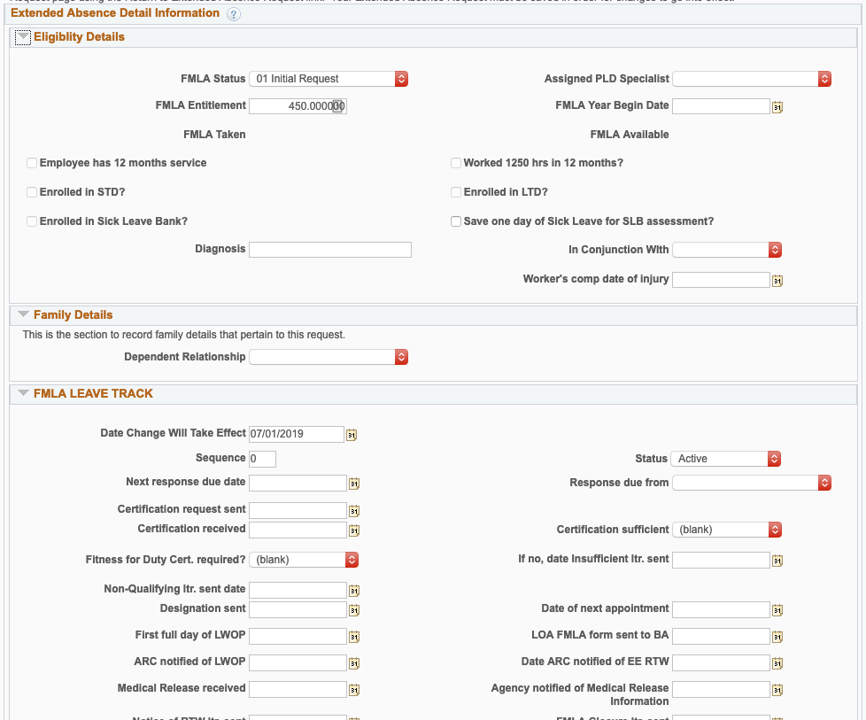
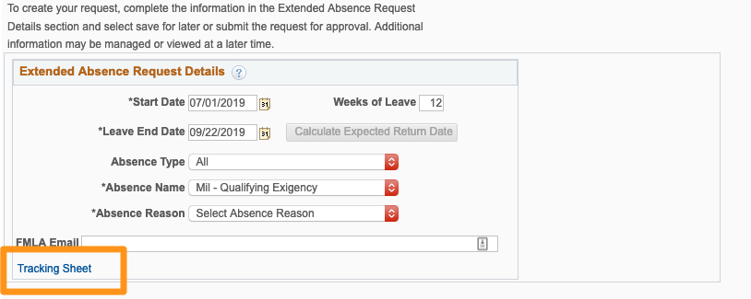
Next create the template

Slide 23
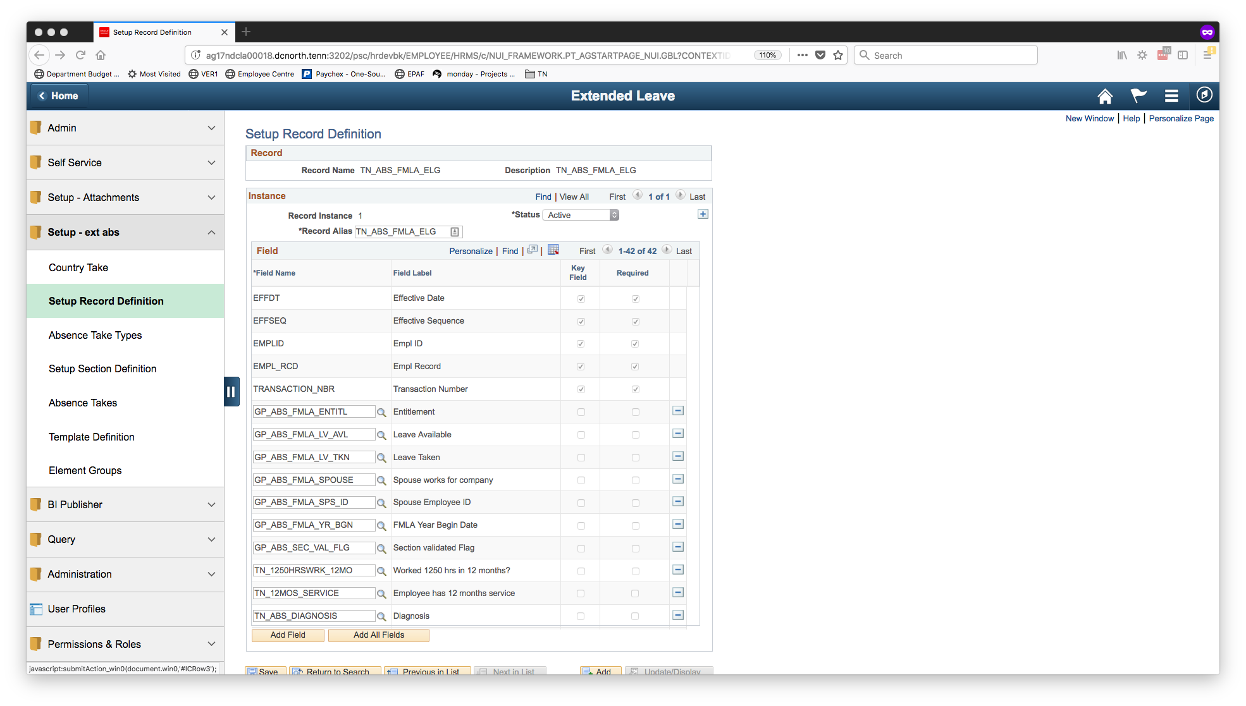
Setup Record Definition
Any new records that should be used to configure a section or template must be added here first.

Slide 24
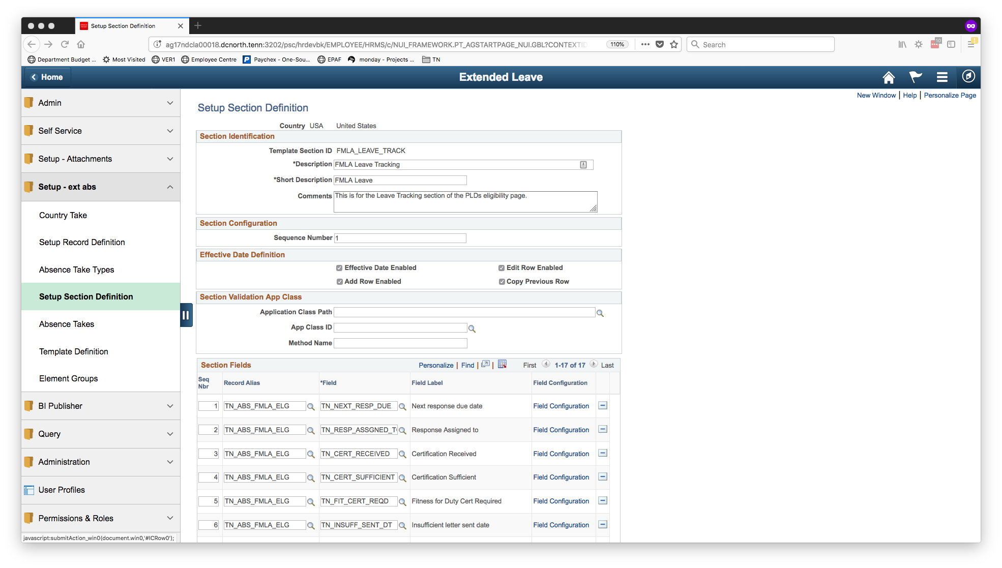
Setup Section Definition
This is used to create the sections that can then be added to a template definition.

Slide 25
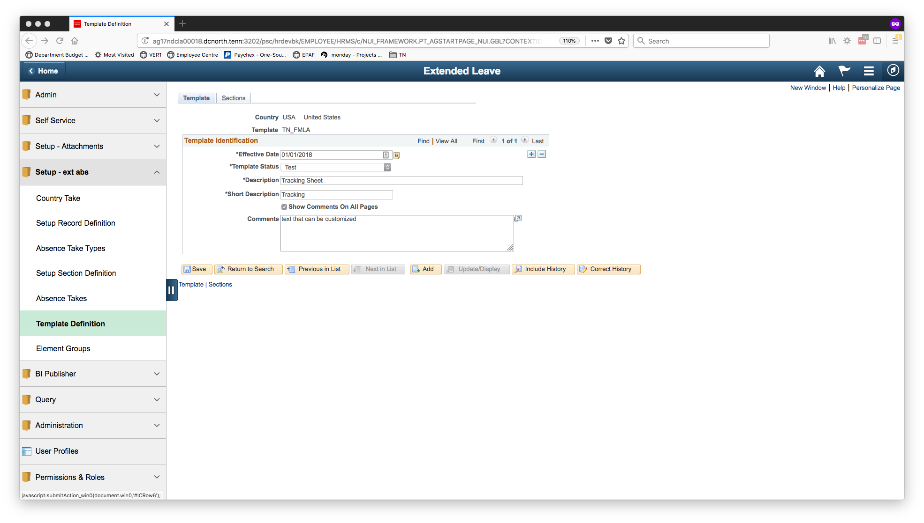
Template Definition
This is the place to configure a unique Template Definition.

Slide 26
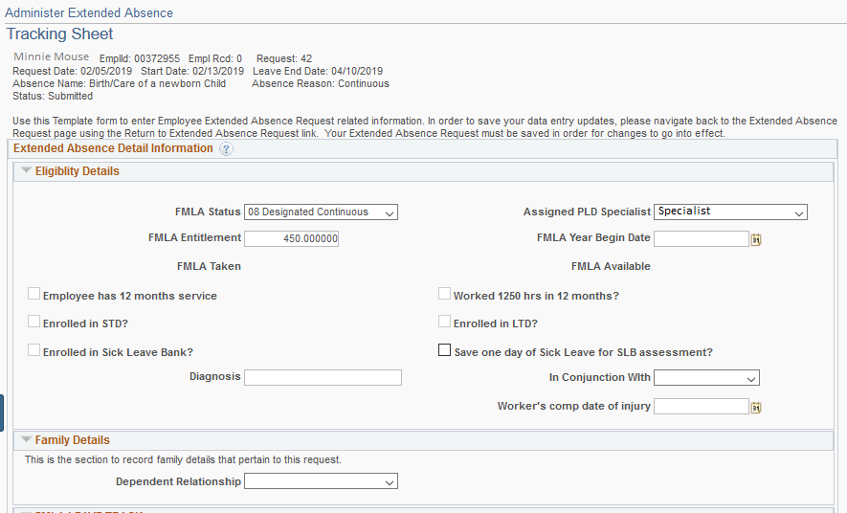
Tracking Sheet

Slide 27
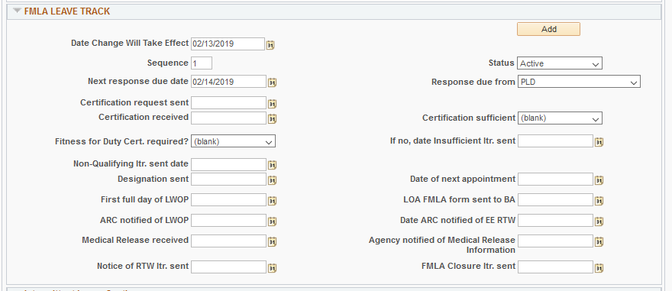
Tracking Sheet

Slide 28
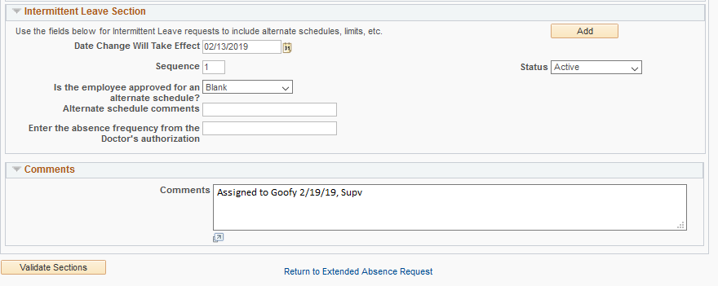
Tracking Sheet

Slide 29
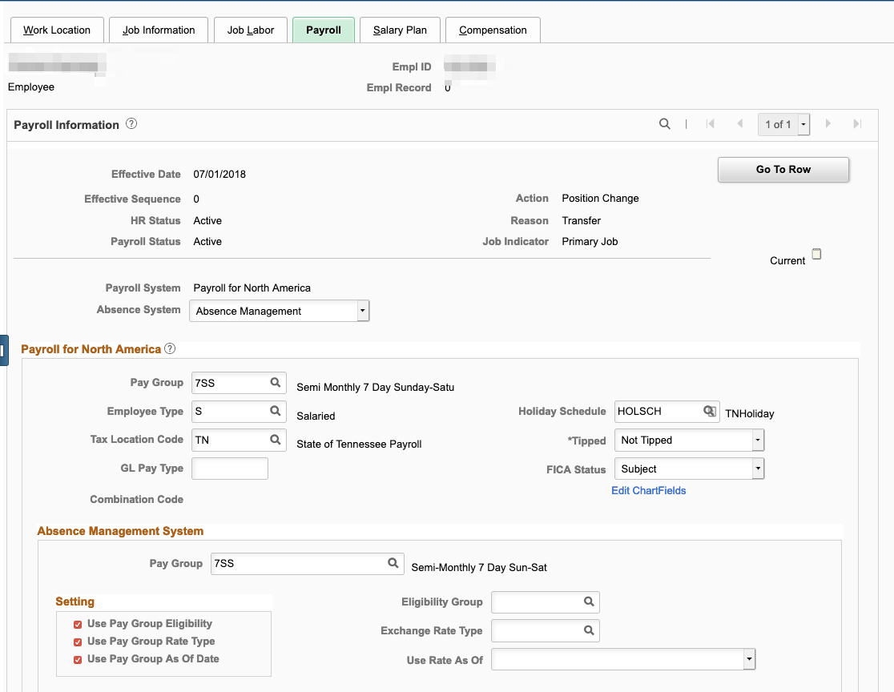
Give the employee access

Slide 30
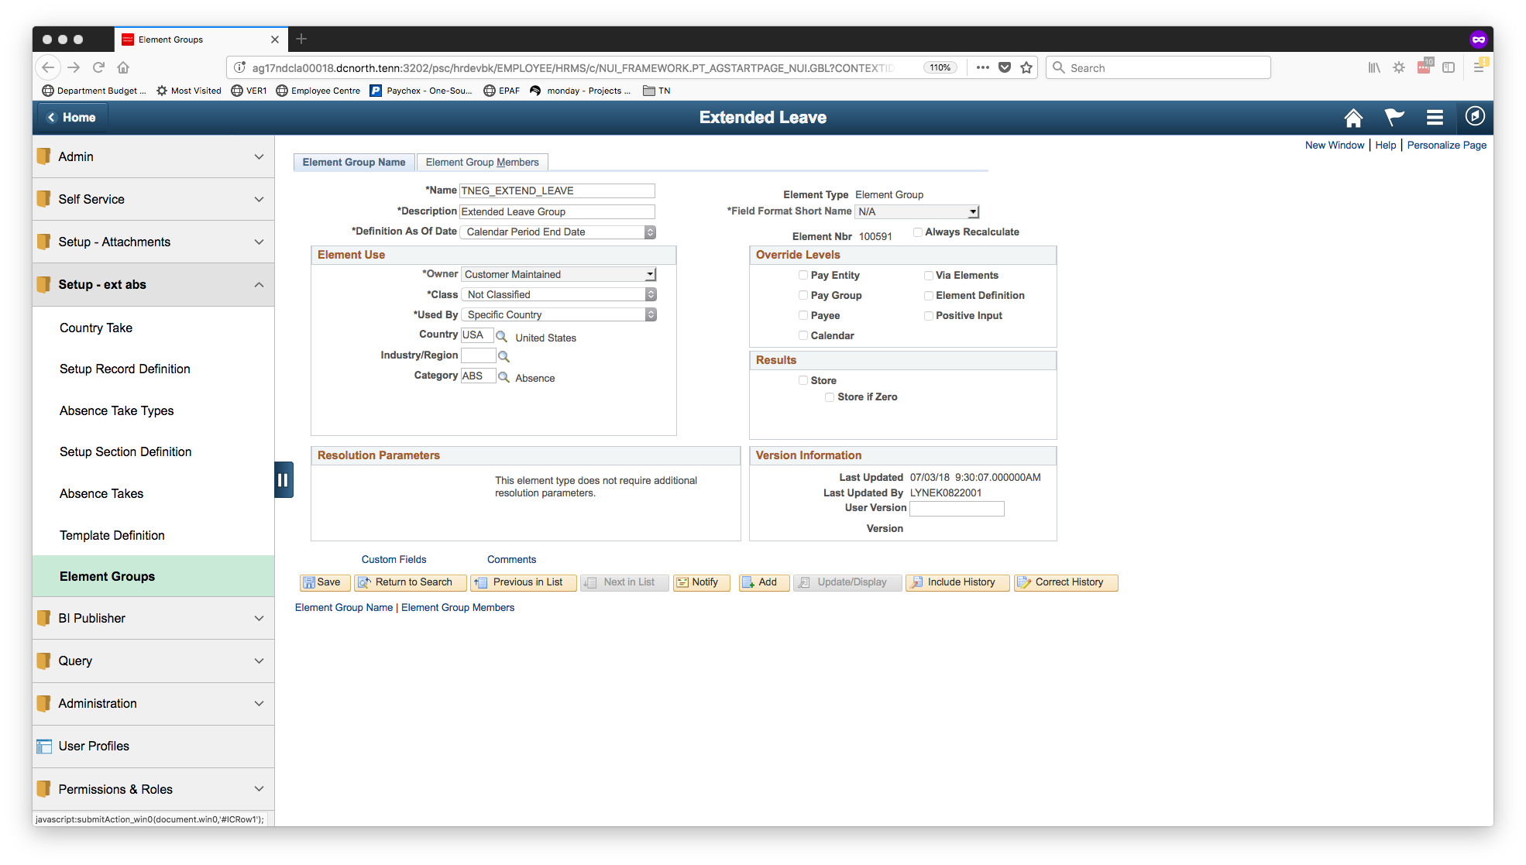
Element Groups
The Element Group is used to define which “Absence Name” are valid for a user. The Element Group is assigned in the Eligibility Group.

Slide 31
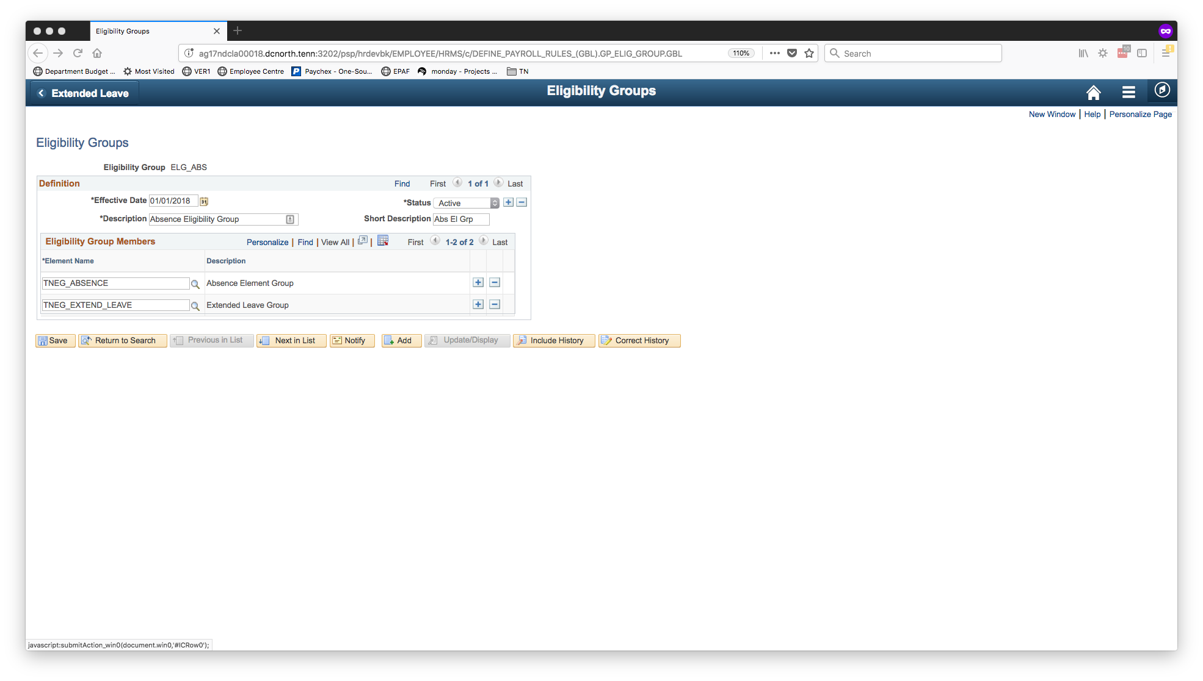
Eligibility Groups
The Eligibility Group is used to assign the element group. The Eligibility Group is assigned on Job Data.

Slide 32
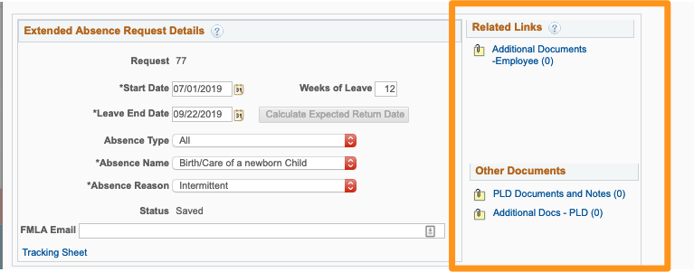
Configure Attachments

Slide 33
Attachments can be downloads, uploads, or links. Use the PS Attachment Framework pages:
Configure Keys
Define Authorization
Define Authorization Entries
Define Attachments
Maintain Definitions

Slide 34
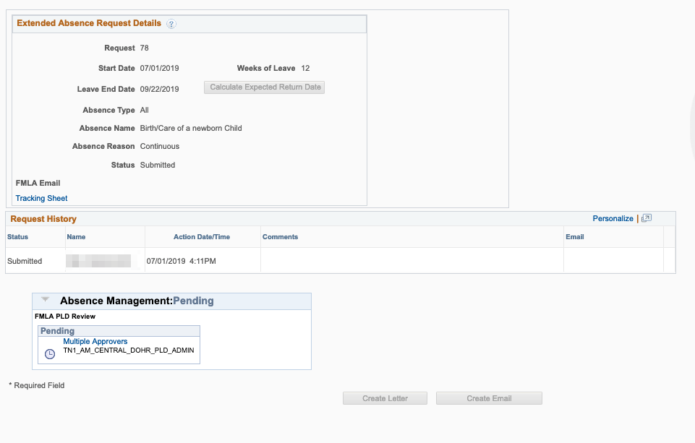
Configure Workflow

Slide 35
Use the PS Approval Framework pages:
Process ID
Definition ID(s)
User List
Email Notifications

Slide 36
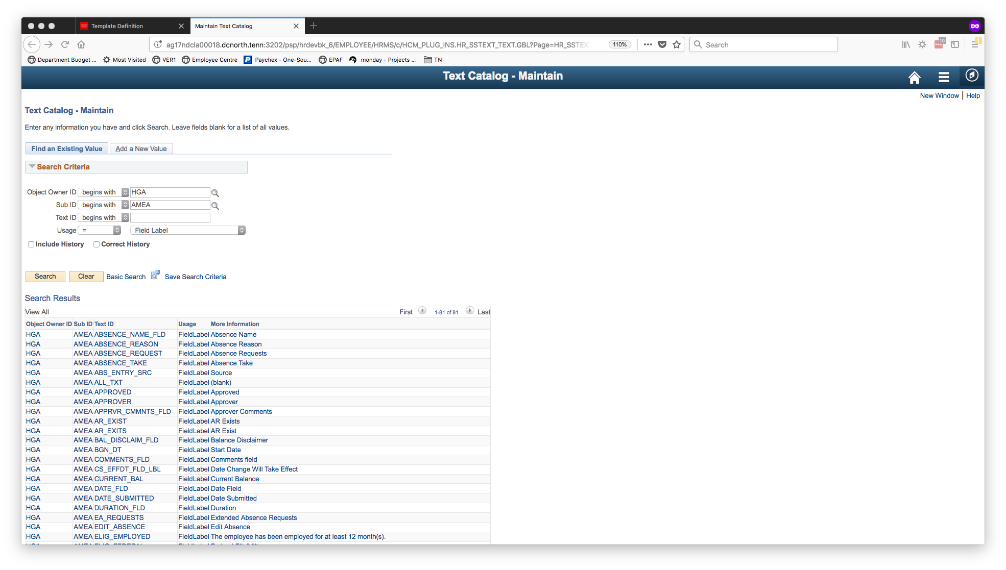
Update text using PS Text Catalog
Text catalog is used to update instructions on a page.

Slide 37
Enhancing the functionality with PS Tools

Slide 38
Tool #1
Fluid Pivot Grids

Slide 39
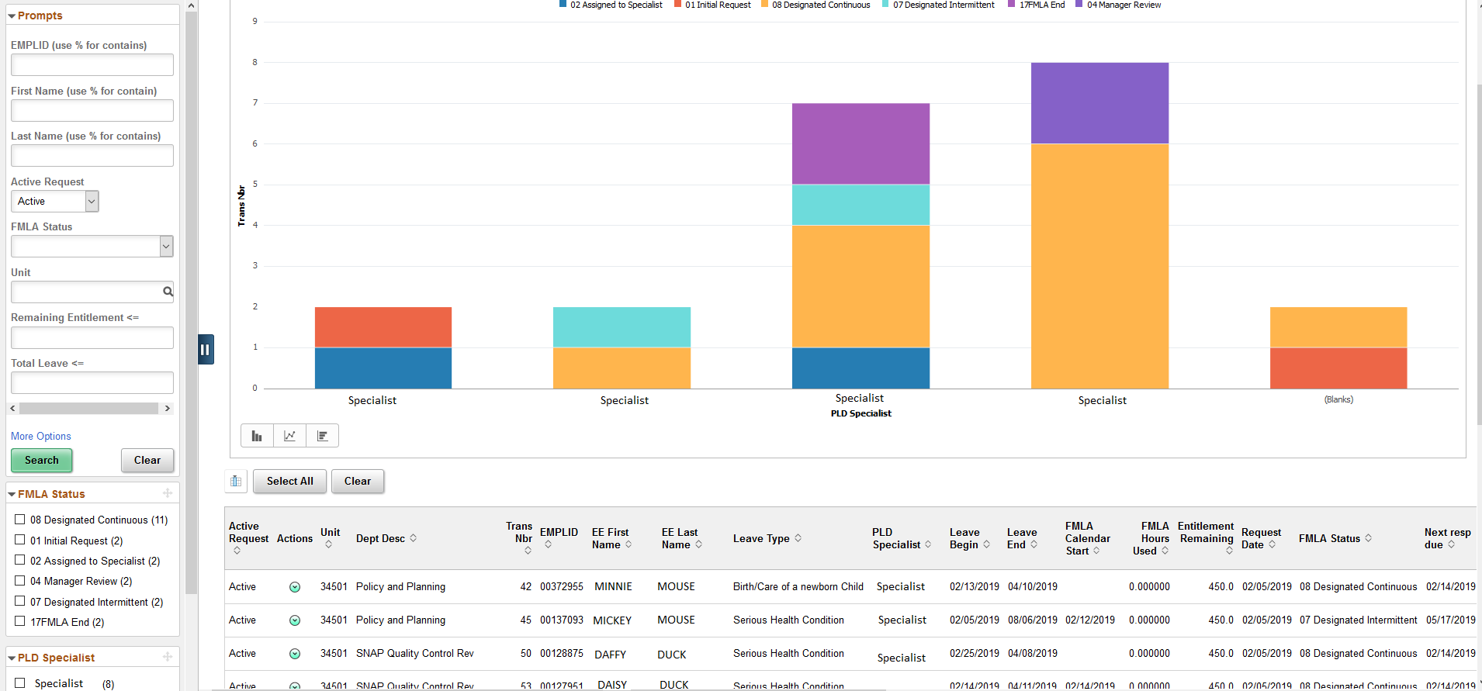
Managing FMLA - NEW

Slide 40
Tool #2
Related Actions

Slide 41
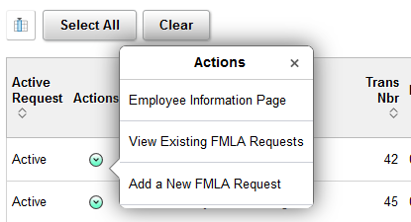
Related Actions

Slide 42
Tool #3
Activity Guides

Slide 43
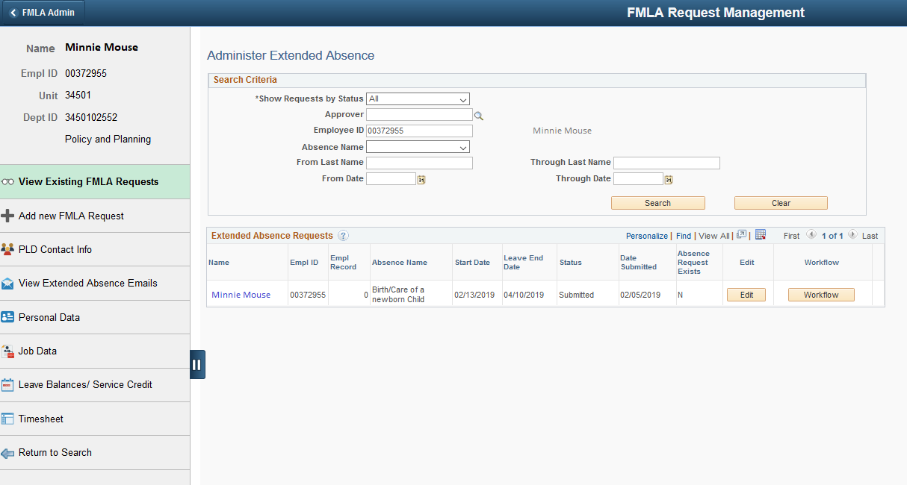
One Stop Shop

Slide 44
Tool #4
BI Publisher Reports
(letter templates)

Slide 45
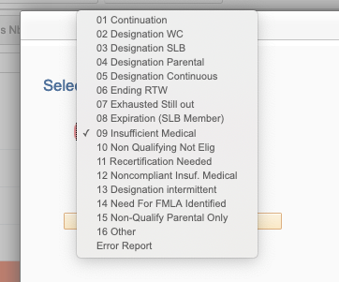
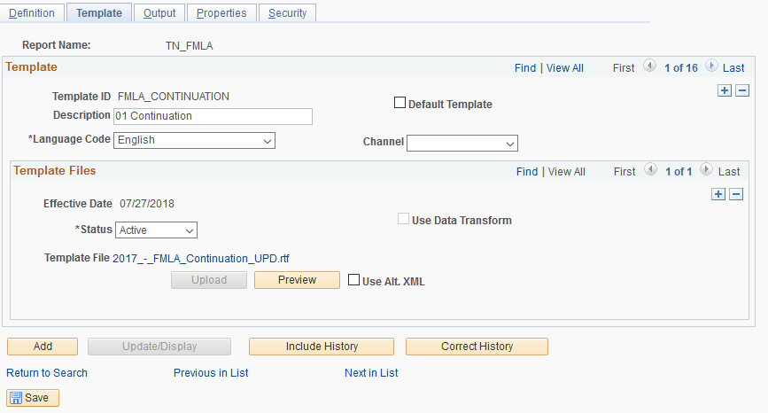
BI Report Definition

Slide 46
And then we customized

Slide 47
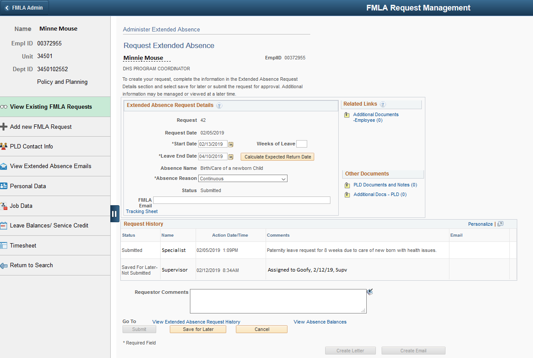
Absence
Request View
Removed some sections, added some fields, and threw in a calculator.

Slide 48
Tracking
Sheet
Added fields from the main request page to the “template”.

Slide 49
Time Sheet Population

Slide 50
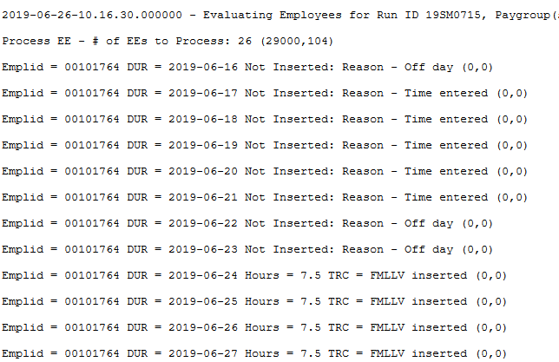
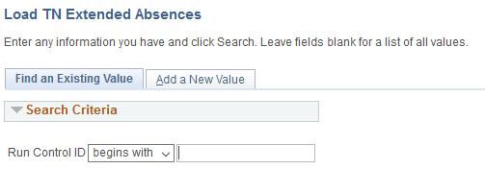
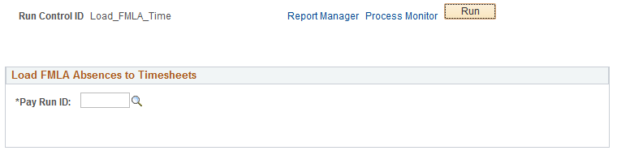
Time Sheet Population
Created a process to load timesheets based on schedule.

Slide 51
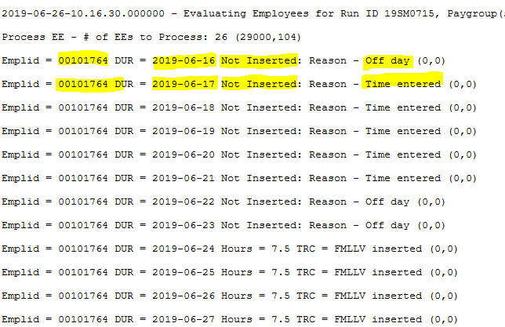
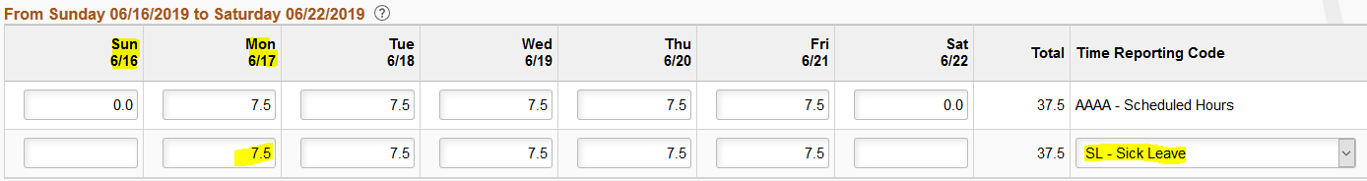
With a fancy log
Time already reported, could not load.

Slide 52
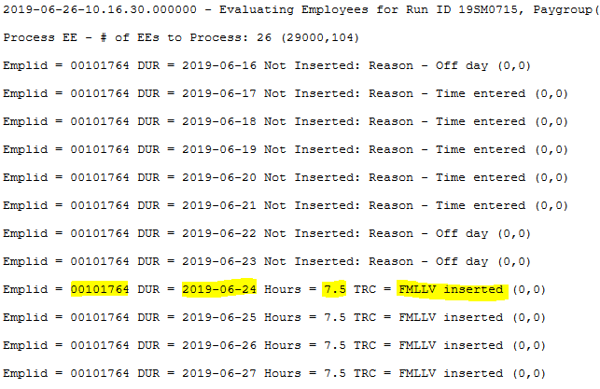
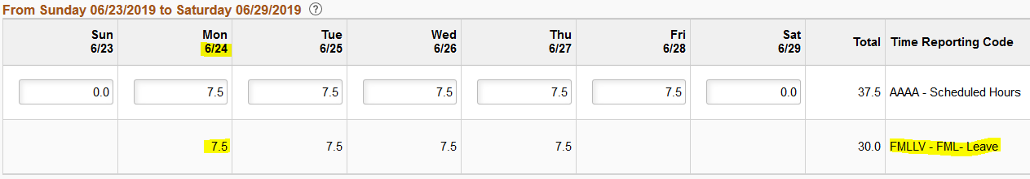
Time Sheet View – time inserted

Slide 53
And some email features to enhance communication

Slide 54
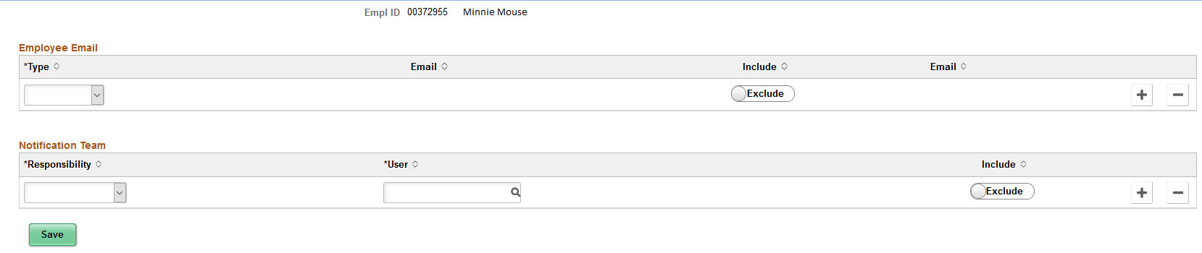
Email Notification Distribution Page

Slide 55
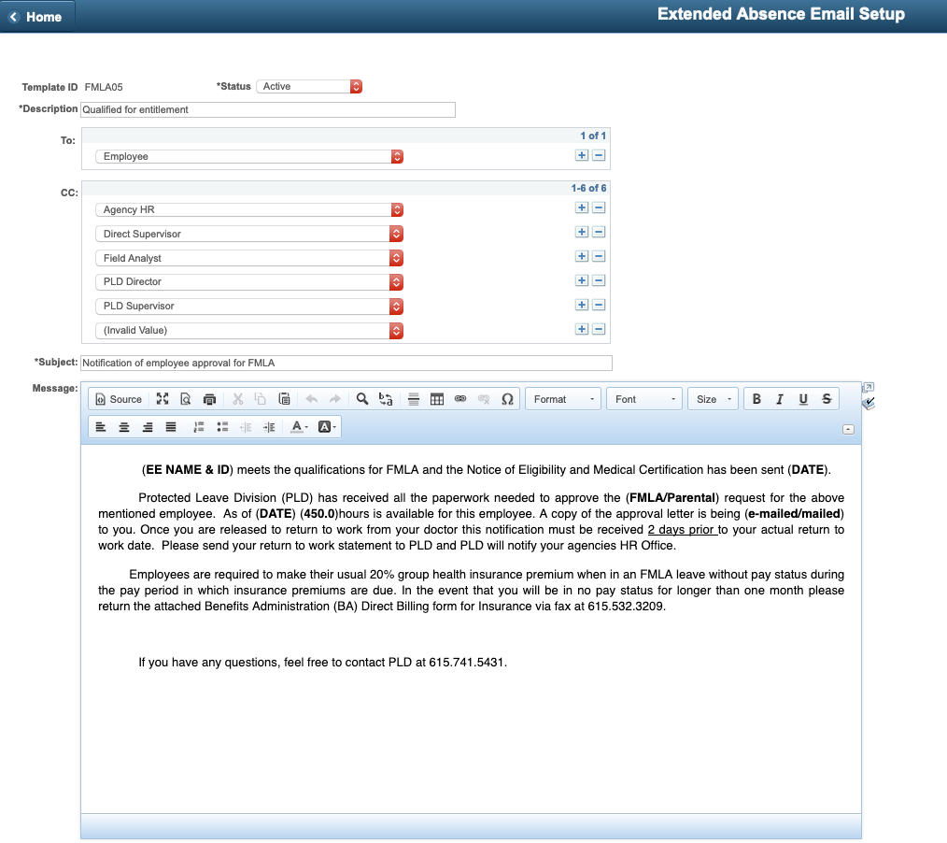
FMLA Email
Templates

Slide 56
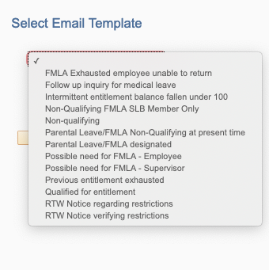
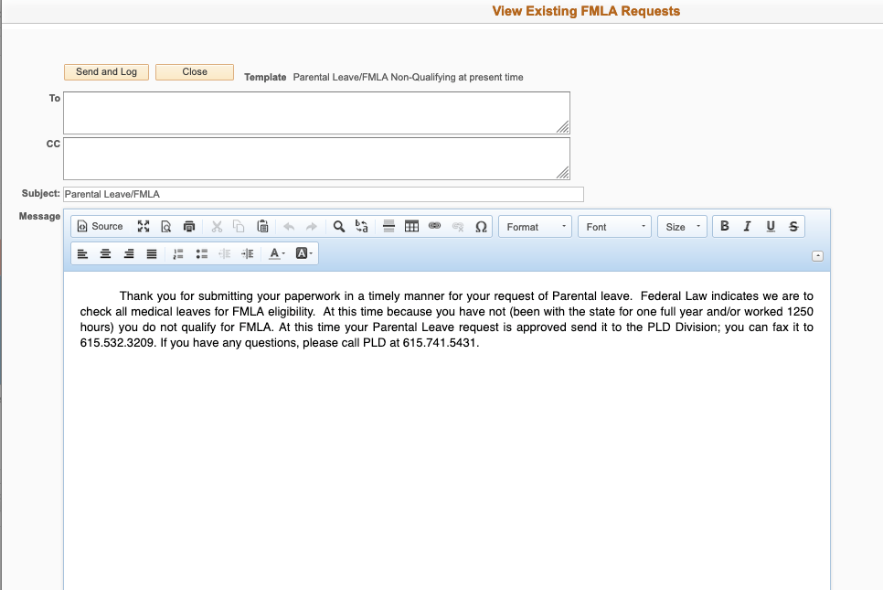
Send Emails

Slide 57
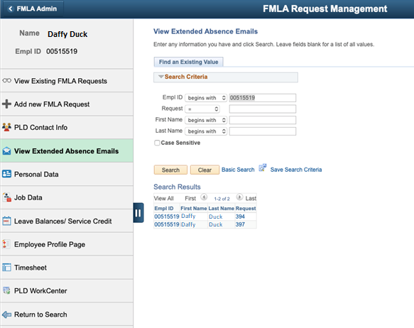
FMLA Email Log

Slide 58
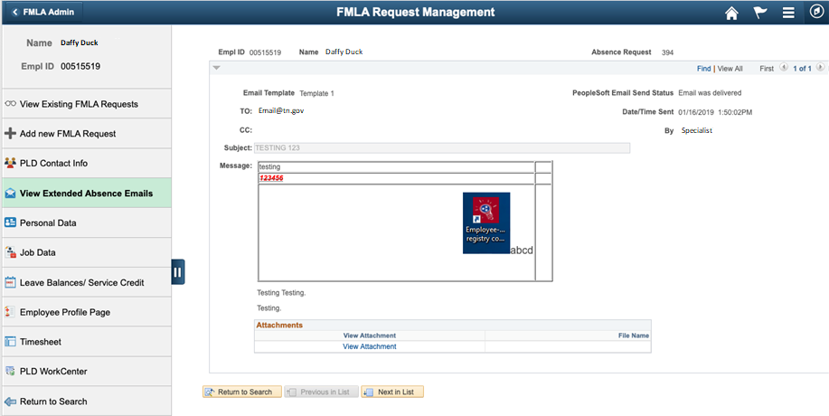
FMLA Email Log

Slide 59
Q&A

Slide 60
Please complete a session evaluation
Session ID: 101740
Contact Info:
David Case@tn.gov
Tel: 615.253.7678

