Slide 1
PHIRE User Group 2019
101990
Name : Frank Dolezal
Title : NeSIS PeopleSoft Administrator
Company : University of Nebraska

Slide 2
Phire Overview
NeSIS Overview
Phire Features / Pros
NeSIS Change Management Process
NeSIS Phire Demo
How Phire is used @ your organization
New Features of PHIRE

Slide 3
Phire Features
Tracks Changes / Mods to PeopleSoft Code
Keeps version control – backup of existing code
Can rollback / Failover a change if needed
Move Mods into an environment quickly, automating most tasks
Follows workflow process
PeopleSoft Enviroment, No New Hardware needed / Simple to maintain
Easy to implement, Great Support Services

Slide 4
New Features 14
Format SQL from record or standalone view SQL objects for better readability.
Add support for POP3 Access in Email Approval. Enhance readability and presentation of zipped compare reports.
Provide support for PeopleTools 8.57.
Provide options to submit and monitor Change Request and Release Migrations on the process scheduler. Deliver fluid tiles for access to My Issues and My Change Requests.
Ability to execute the project build on a Linux/Unix app server when using PT 8.55 or 8.56

Slide 5
New PHIRE Features (13)
Change Process Tracking with Workflow
Code Version Control (PeopleTools and File Objects)
Automated Migrations with Rollback
Perform Application Designer Project Builds
Execute DMS, SQL, and OS Scripts
Object Locking with Reservation System
Automate Task Assignments and Notifications
Online Real-time Audit/History Inquiry
Wizard Driven Setup and Configuration

Slide 6
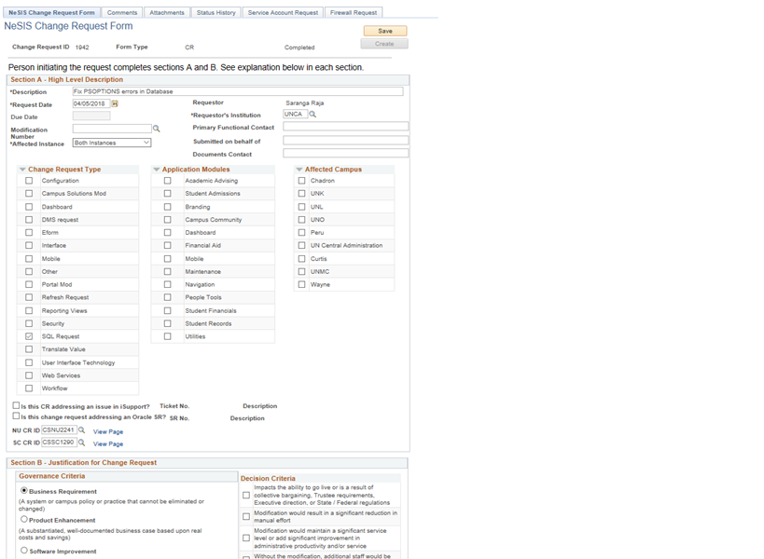
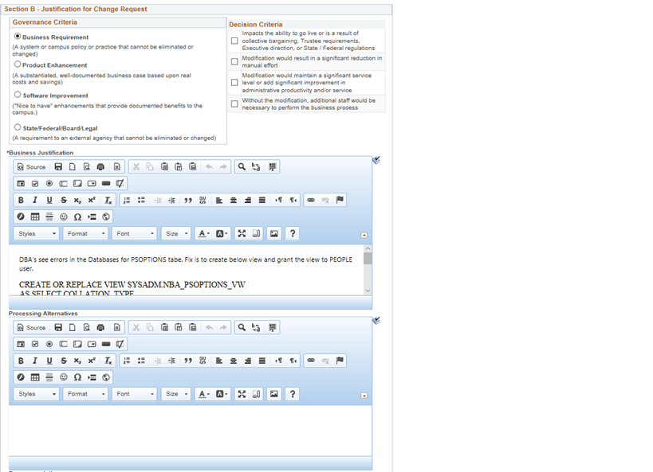
Custom CR PRocess

Slide 7
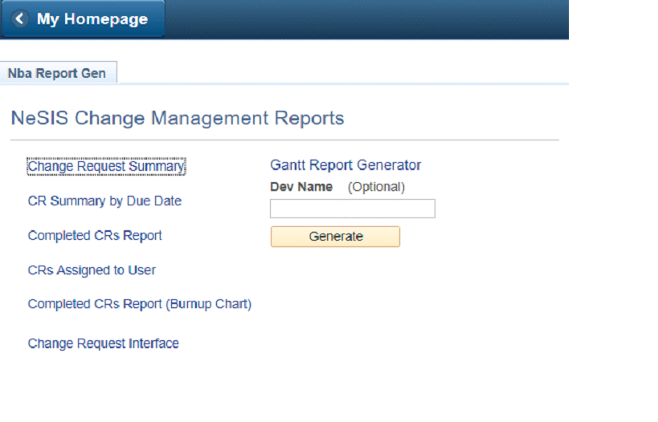
Custom Reporting

Slide 8
101990

