Slide 1
Billing and Accounts Receivable Round Table
Session ID 2019PSFT-102030
David Laden
July 17, 2019

Slide 2
David Laden
Director Accounts Receivable Services
University of Minnesota
laden003@umn.edu
Mr. Laden is currently Director of Accounts Receivable Services at the University of Minnesota where he oversees customer maintenance, billing, receivables, collections, and credit card operations and compliance. Previous to this he served as the Accounts Receivable and Billing Functional Lead for the University’s implementation of PeopleSoft Financials. Mr. Laden has previously held positions as Management Information and Business Analyst and as an Information Systems Consultant.

Slide 3
Abstract
This is an open forum for users of the order-to-cash modules (Billing and Accounts Receivable) to discuss best practices, ask questions of other users, etc.
Notes:
Discussion can also extend to Grants, Contracts, and Projects; or Order Management

Slide 4
Learning Objectives
Network with other users of similar processes.
Gain ideas to share with colleagues after the conference.
Discuss pain points and potential enhancements.

Slide 5
Get to know your neighbor
Version of PeopleSoft
Current user of PeopleSoft Billing and Accounts Receivable?
Type of organization?
Corporate, Non Profit, Government, Education
What do you hope to learn from this session?
Notes:
This fulfills the network objective

Slide 6
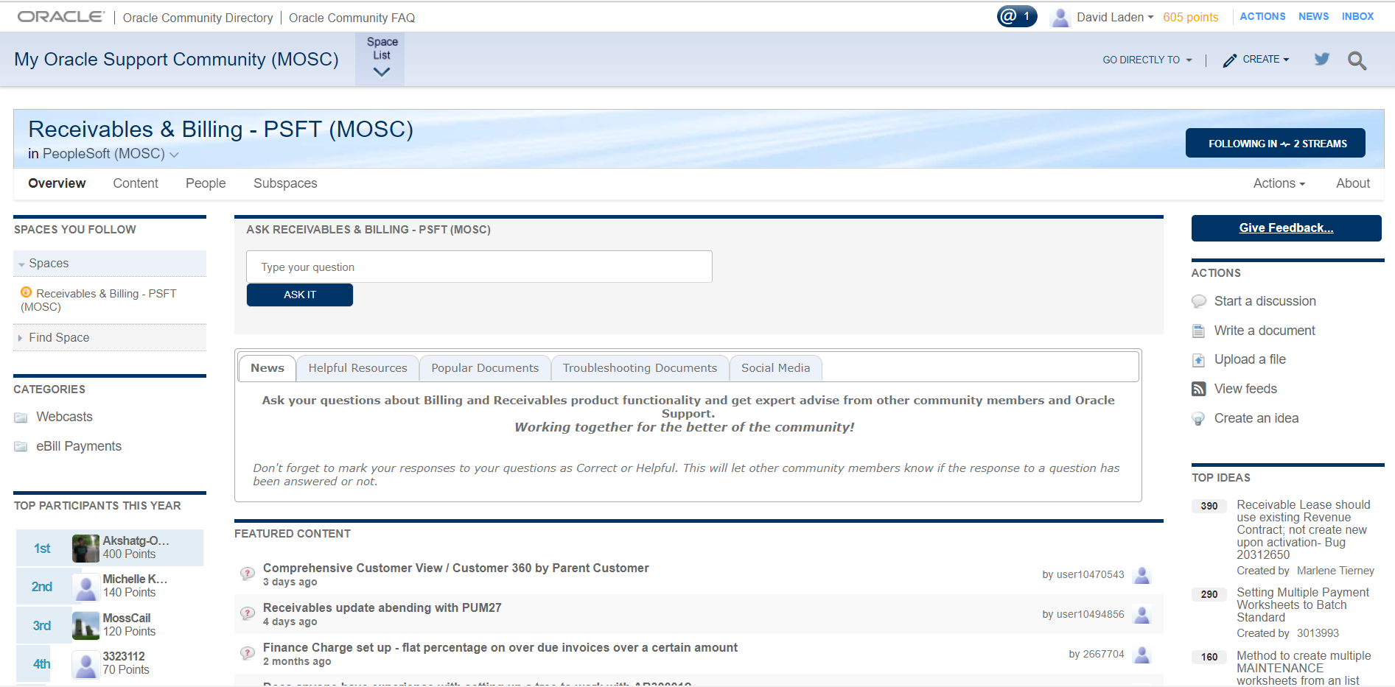
My Oracle Support Communities Receivables & Billing – PSFT (MOSC)
Notes:
My Oracle Support Communities
AR/Billing community
Place to ask questions, get knowledge articles
But more importantly, place to suggest ideas for enhancements to PeopleSoft

Slide 7
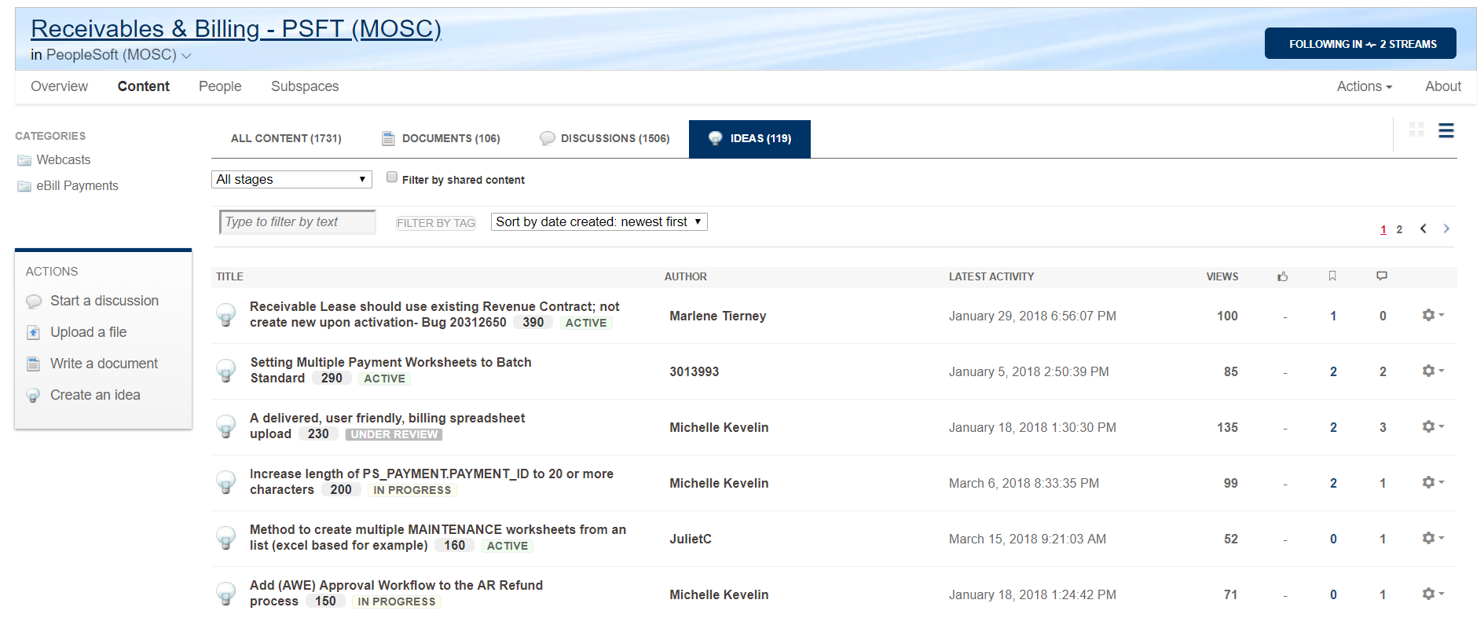
My Oracle Support Communities Receivables & Billing – PSFT (MOSC)

Slide 8
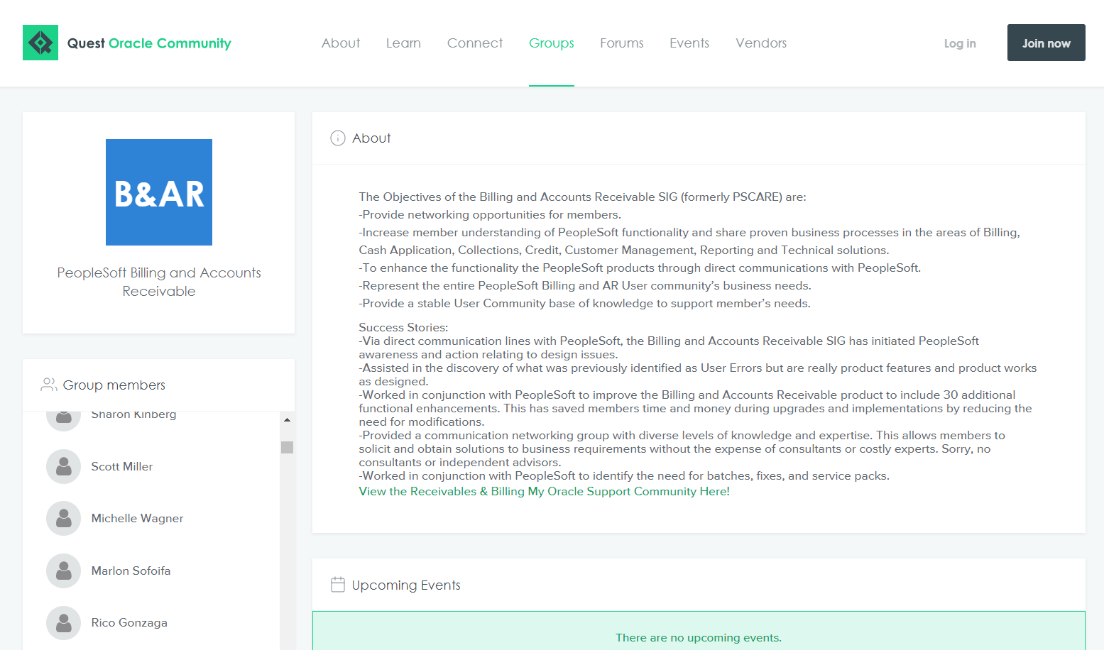

Slide 9
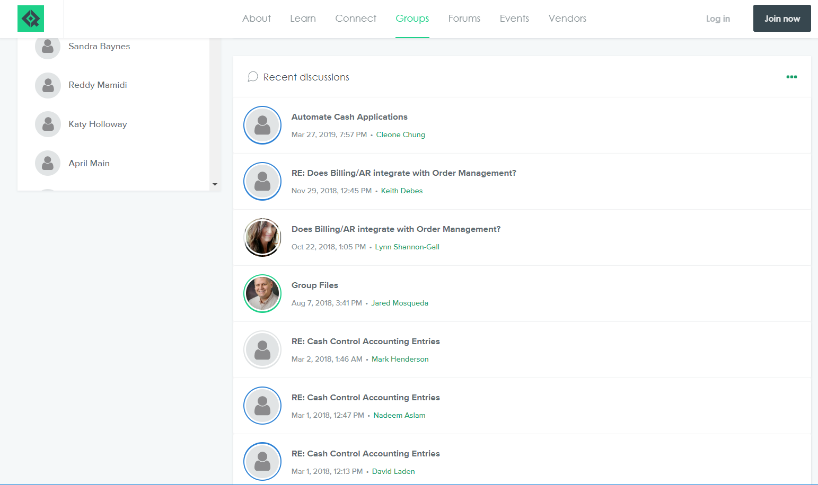

Slide 10
Questions, Pain Points, Enhancemnets
What questions do you have about using PeopleSoft
Billing
Accounts Receivable
eBill pay
Grants, Contracts, Projects
Are you experiencing any particular pain points?
What enhancements would you like to see in these modules?

Slide 11
Please complete a session evaluation
Session ID: 2019PSFT-102030
Contact Info:
David Laden
laden003@umn.edu
Tel: 612-624-0929

