Slide 1
Setting Up Fluid Candidate Gateway for Target Audiences
Nancy Bucher, Sierra-Cedar, Inc.
July 18, 2019
Session: 102410

Slide 2
Agenda
Introduction
How to set up Fluid Candidate Gateway for different target candidate audiences:
  Set up Sites
  Set up Recruitment Sources
  Create Job Openings
  Build Search Index
  Update Recruiting Installation to Test
  Fluid Candidate Gateway
Demonstration
Tips and techniques

Slide 3

Today’s Presenter
Nancy Bucher
Senior Consultant, Sierra-Cedar, Inc.
20 years of PeopleSoft HCM Experience – Release 8.3 through 9.2
HR functional, PS end user
Additional PS Financials, Student, UPK, and PTF experience
Prosci-certified Change Practitioner

Slide 4
Sierra-Cedar Fast Facts
20
7
950+
Years of Leading
Systems Research & Thought Leadership
Service & Solution Areas
Application Services
Business Intelligence
Host & Managed Services
Infrastructure Services
Integration & Cloud Solutions
Research
Strategy
Training
Employees
5
1,500+
Industry Focus
Commercial
Healthcare
Higher Education
Public Sector
Justice & Public Safety
Consulting
Projects
Delivering industry-focused client success by providing consulting, technical, and
managed services for the deployment, management and optimization of
next-generation applications and technology.

Slide 5
Why use Candidate Gateway for targeted audiences?
For the ease of the Applicant!
Employment Type:
  Exempt Jobs vs. Non-Exempt Jobs, or Part-time vs Full-time
  Regular Jobs vs. Internships
Job Category or Location:
  Jobs at Plants vs. Jobs at Headquarters
  Physician Jobs vs. Non-Physician Jobs
  Teaching Jobs vs. Non-Teaching jobs
Recruiting Source: Paid sources vs. Networking
Recruiting Process: Proceed with caution here
Notes:
Objective: Pre-filter jobs for your target. Safe Harbor

Slide 6
Set up Fluid Candidate Gateway for Different Target Candidate Audiences

Slide 7
High Level
Site
Source
Postings
Processes
Target
URL

Slide 8
Demo Scenario
A global organization that has corporate headquarters and a hospital
There are two recruiting websites for external candidates:
  Website for Job Postings at the corporate headquarters
  Website for Job Postings at the hospital

Slide 9
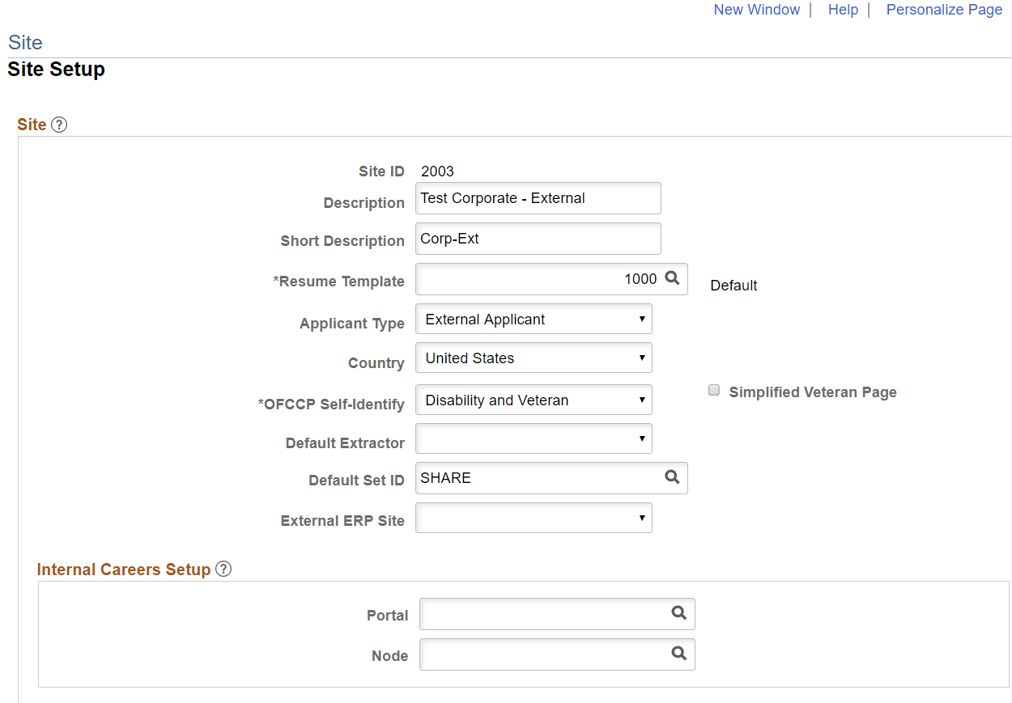
Set up Sites
Site for the external Job Postings at the corporate headquarters

Slide 10
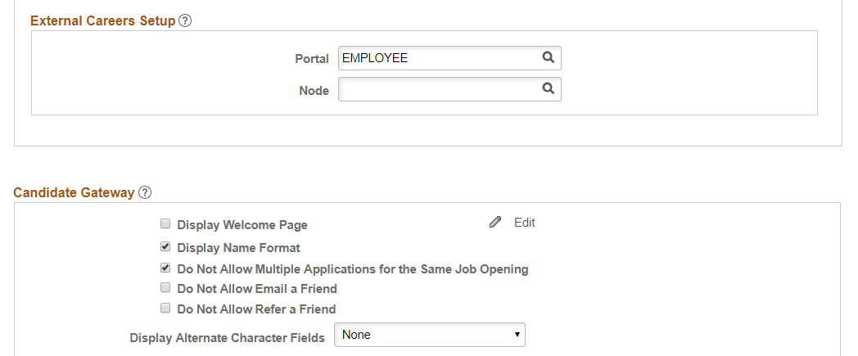
Set up Sites
Site for the external Job Postings at the corporate headquarters

Slide 11
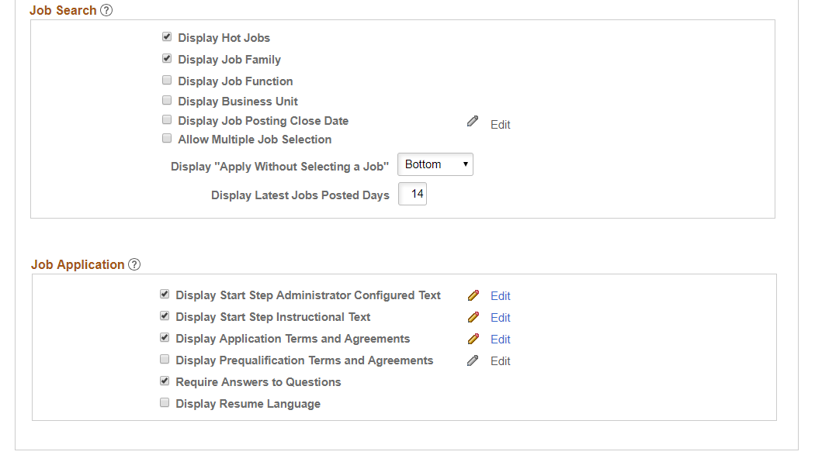
Set up Sites
Site for the external Job Postings at the corporate headquarters

Slide 12
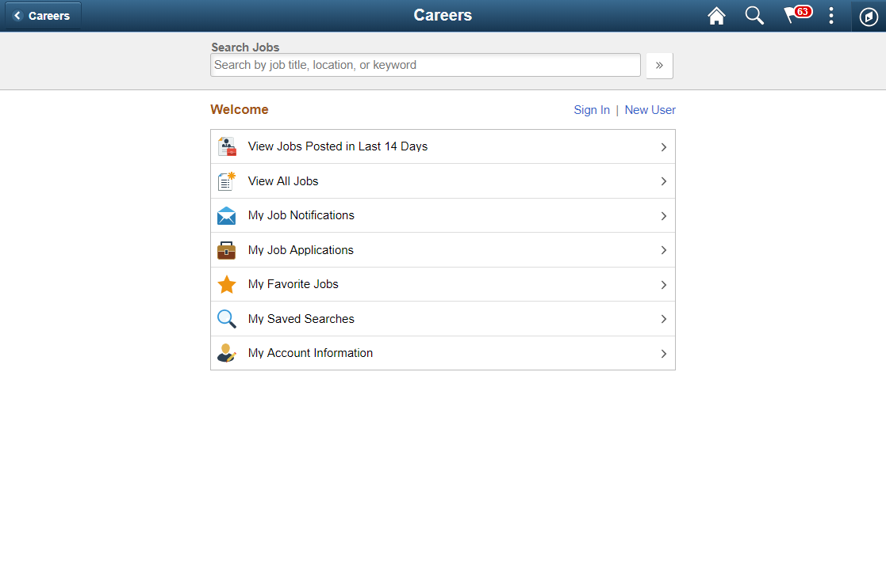
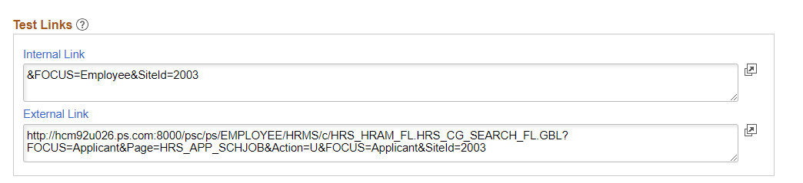
Set up Sites
Note change to URL

Slide 13
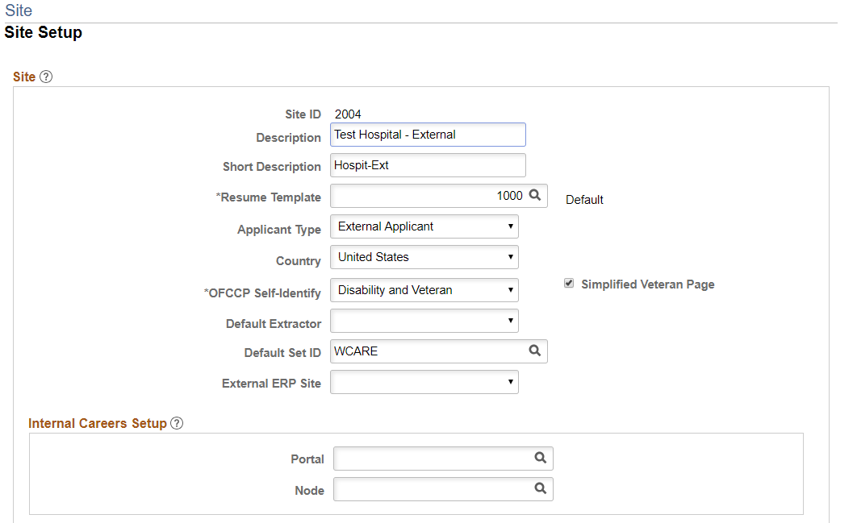
Set up Sites
Site for the external Job Postings at a hospital
Notes:
Different SetID but has to be same as where jobs are located

Slide 14
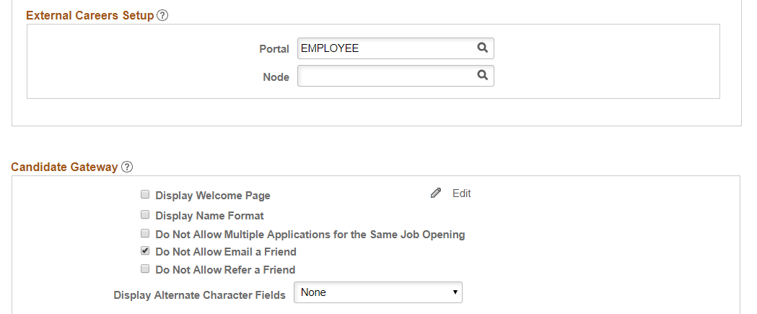
Set up Sites
Site for the external Job Postings at a hospital

Slide 15
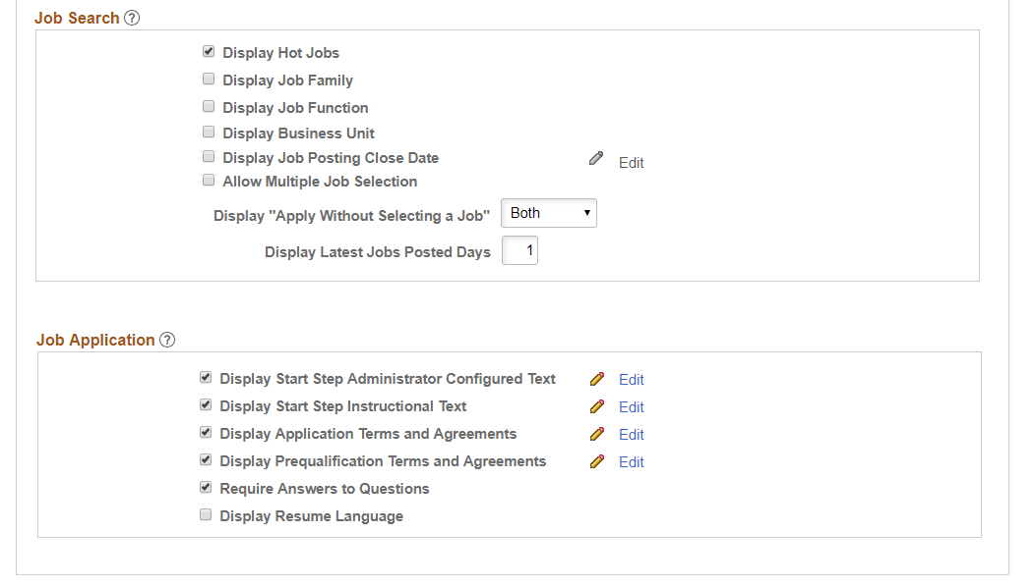
Set up Sites
Site for the external Job Postings at a hospital

Slide 16
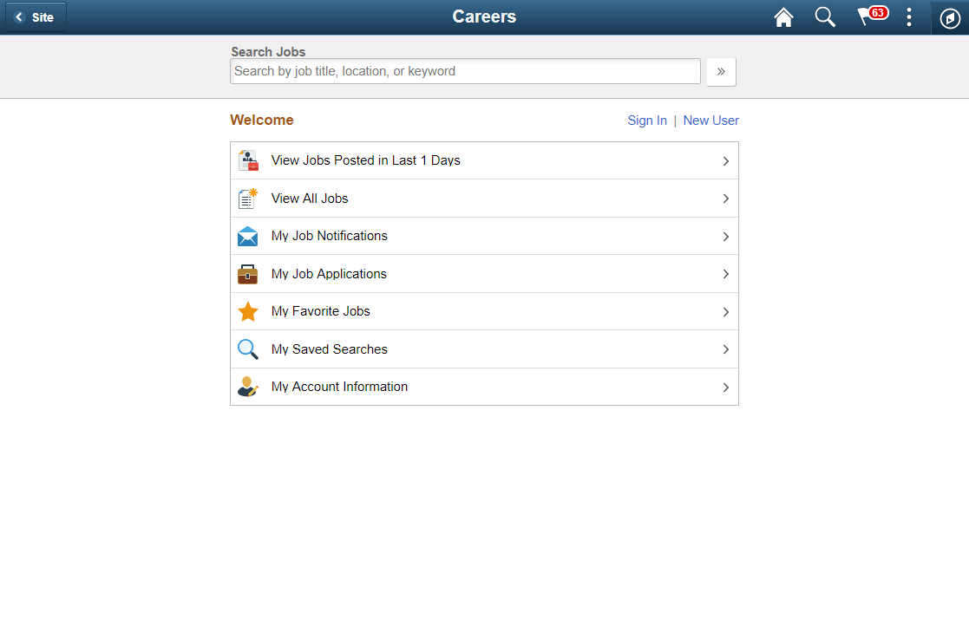
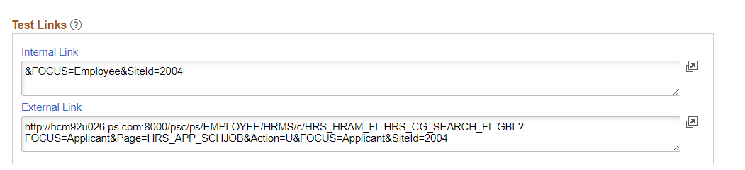
Set up Sites
Note URL

Slide 17
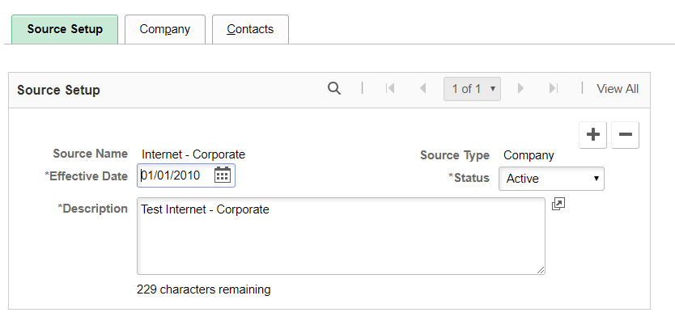
Set up Recruitment Sources
Set up Recruitment Source by using Site for the external Job Postings at the corporate headquarters

Slide 18
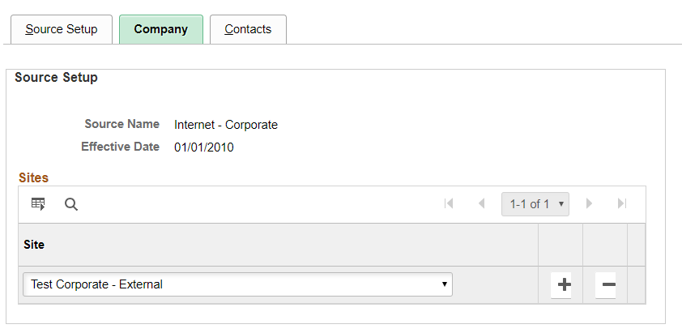
Set up Recruitment Sources
Set up Recruitment Source by using Site for the external Job Postings at the corporate headquarters

Slide 19

Set up Recruitment Sources
Set up Recruitment Source by using Site for the external Job Postings at a hospital

Slide 20
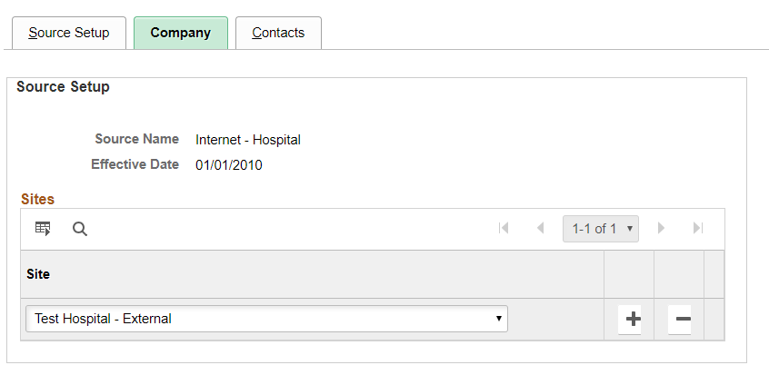
Set up Recruitment Sources
Set up Recruitment Source by using Site for the external Job Postings at a hospital

Slide 21
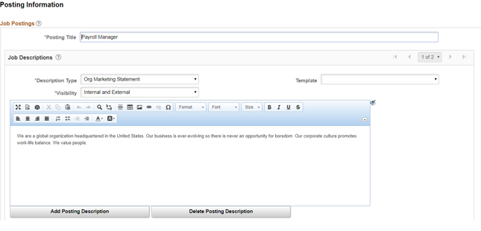
Create Job Openings
Job Opening for the external Job Postings at the corporate headquarters

Slide 22
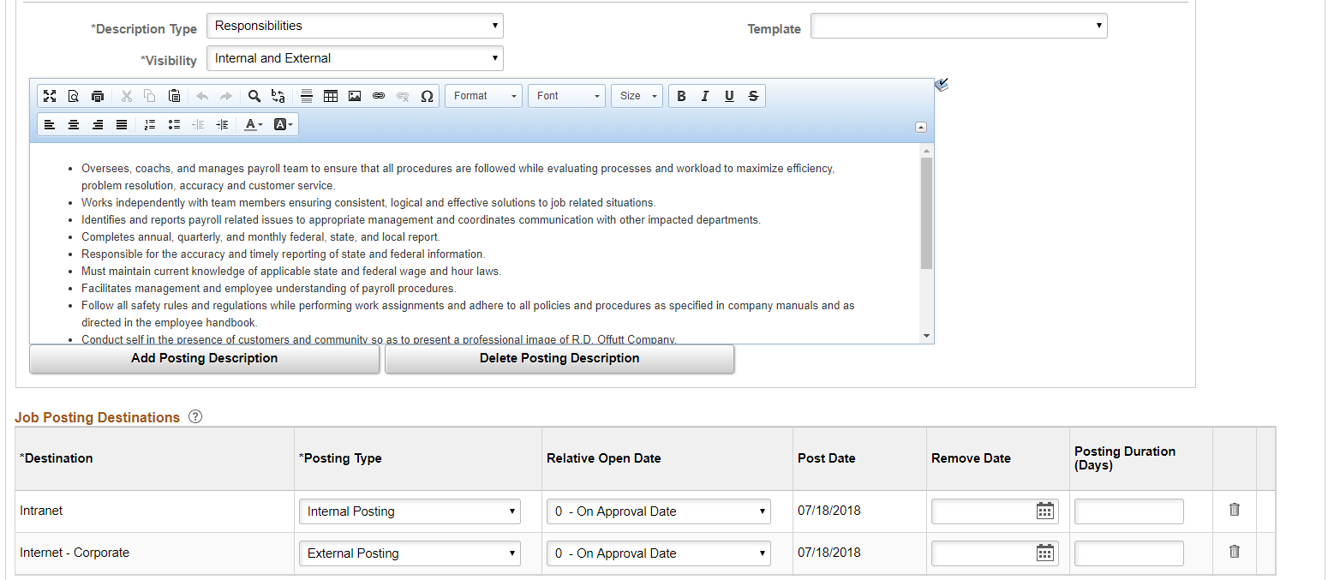
Create Job Openings
Corporate headquarters: Add new Job Posting Destination

Slide 23
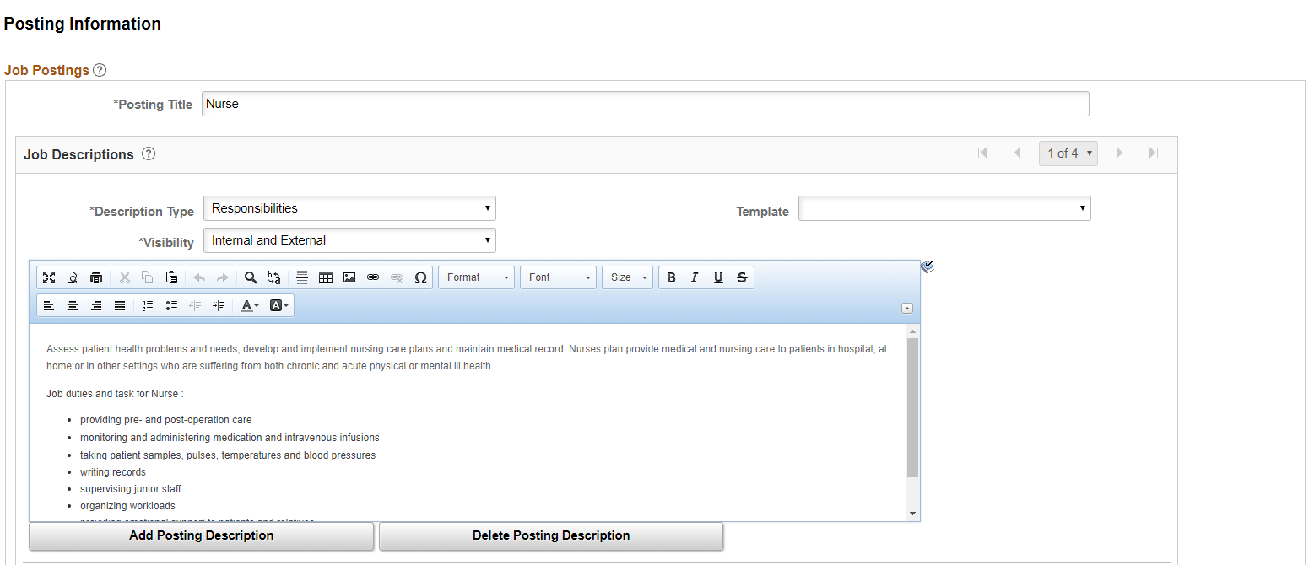
Create Job Openings
External job posting at the hospital

Slide 24
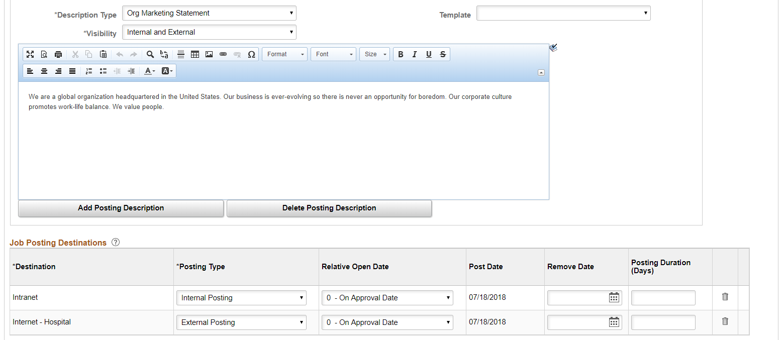
Create Job Openings
Add new Job Posting Destination
Hospital:

Slide 25
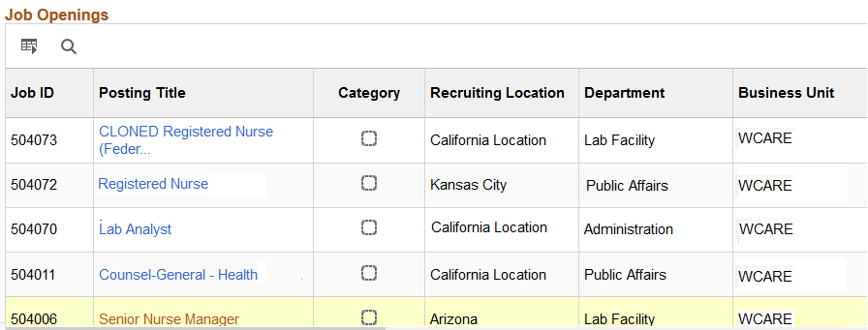
Pair Multiple Jobs
Working from Search results can add efficiency

Slide 26
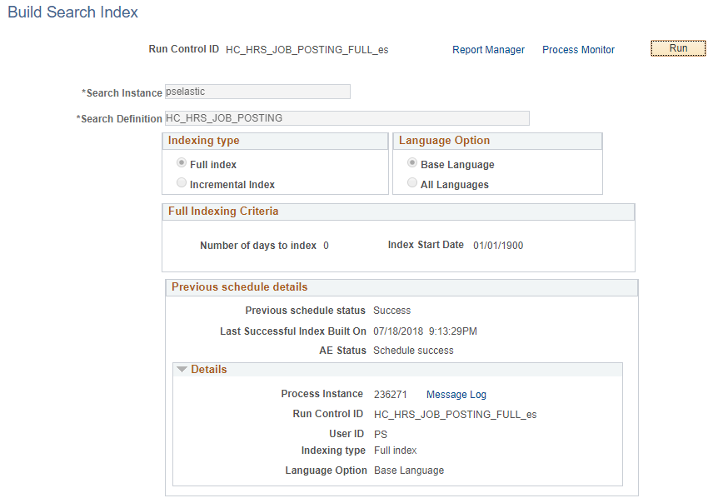
Build Search Index
Run the Build Search
Index Process for
Job Search Definition
HC_HRS_JOB_POSTING
and
Search Category
HC_HRS_CG_JOB_POSTING

Slide 27
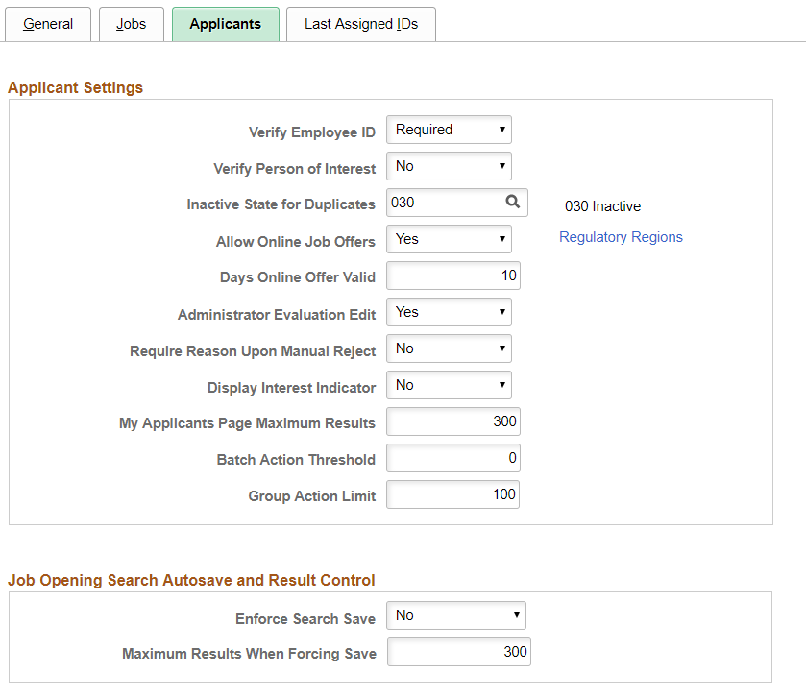
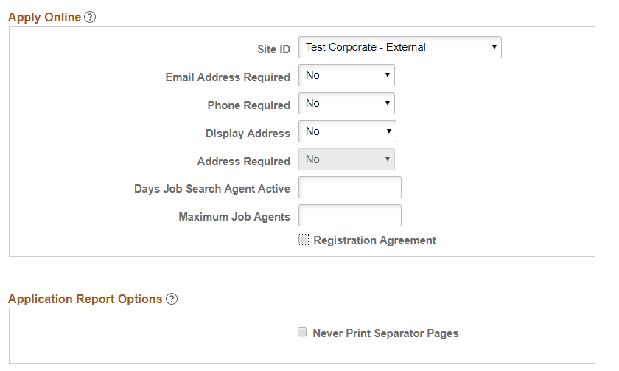
Update Recruiting Installation to Test
Change Site ID to test Job Openings at the corporate headquarters

Slide 28
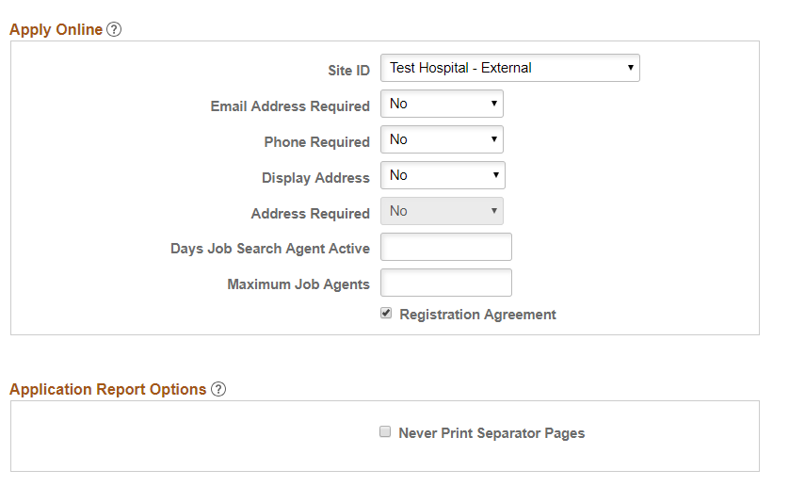
Update Recruiting Installation to Test
Change Site ID to test Job Openings at a hospital

Slide 29
Check Your Results
Rendering, recruiting details and other components look as expected

Slide 30
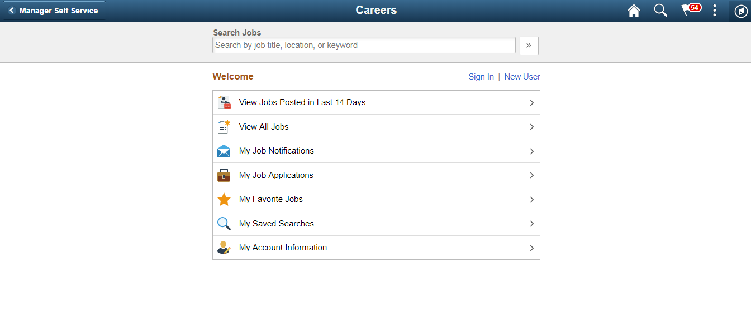
Fluid Candidate Gateway
Careers at the corporate headquarters – Desktop

Slide 31
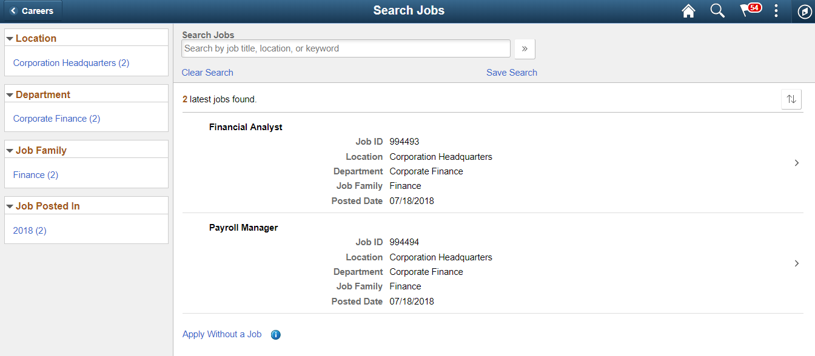
Fluid Candidate Gateway
Job Openings at the corporate headquarters – Desktop

Slide 32
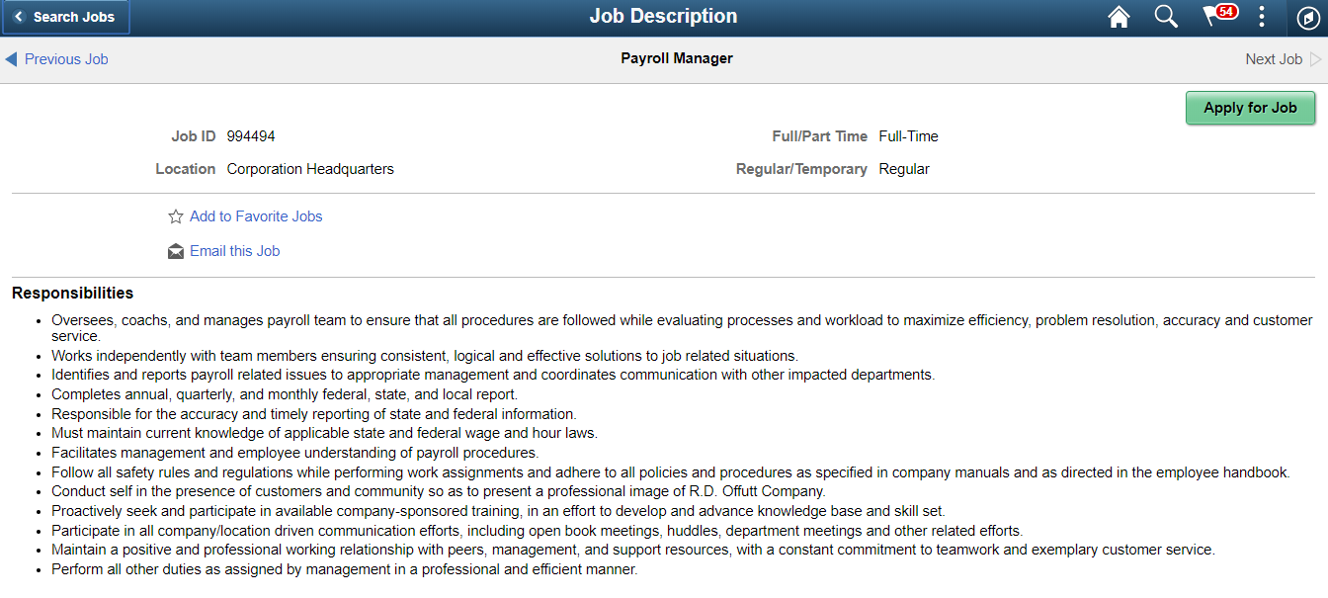
Fluid Candidate Gateway
Job Openings at the corporate headquarters – Desktop

Slide 33
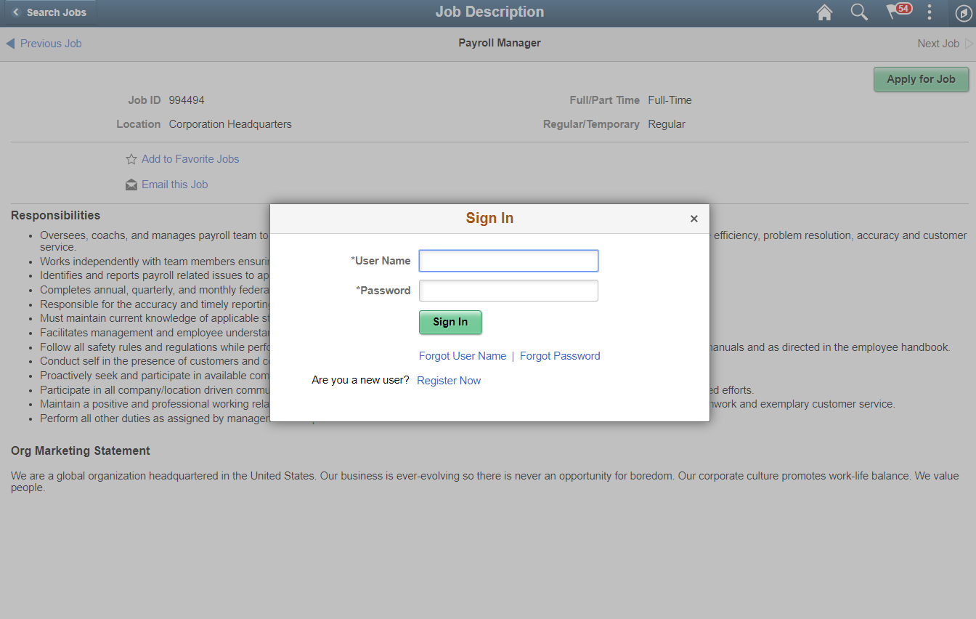
Fluid Candidate Gateway
Job Openings at the corporate headquarters – Desktop

Slide 34
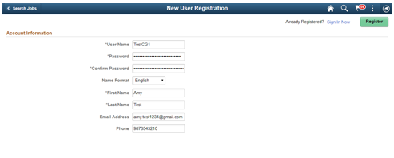
Fluid Candidate Gateway
Job Openings at the corporate headquarters – Desktop

Slide 35
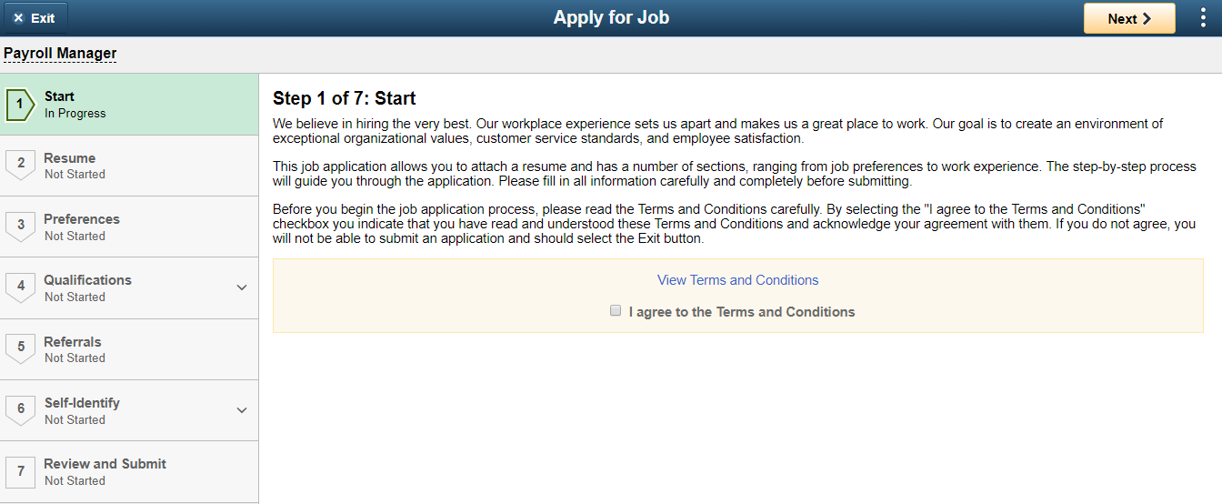
Fluid Candidate Gateway
Job Openings at the corporate headquarters – Desktop

Slide 36
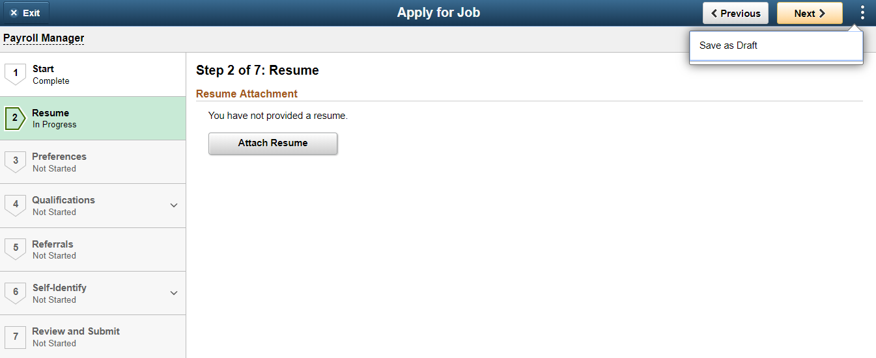
Fluid Candidate Gateway

Slide 37
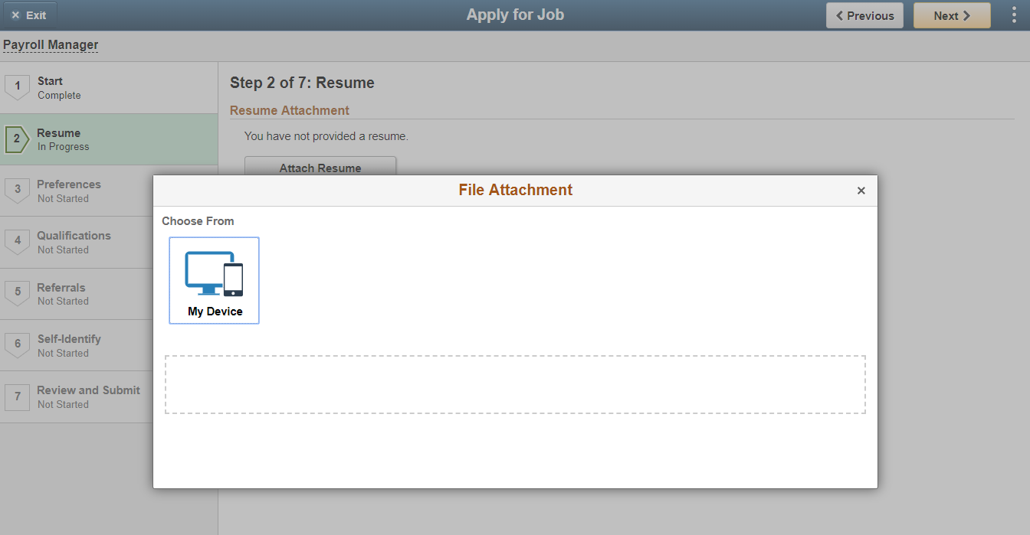
Fluid Candidate Gateway

Slide 38
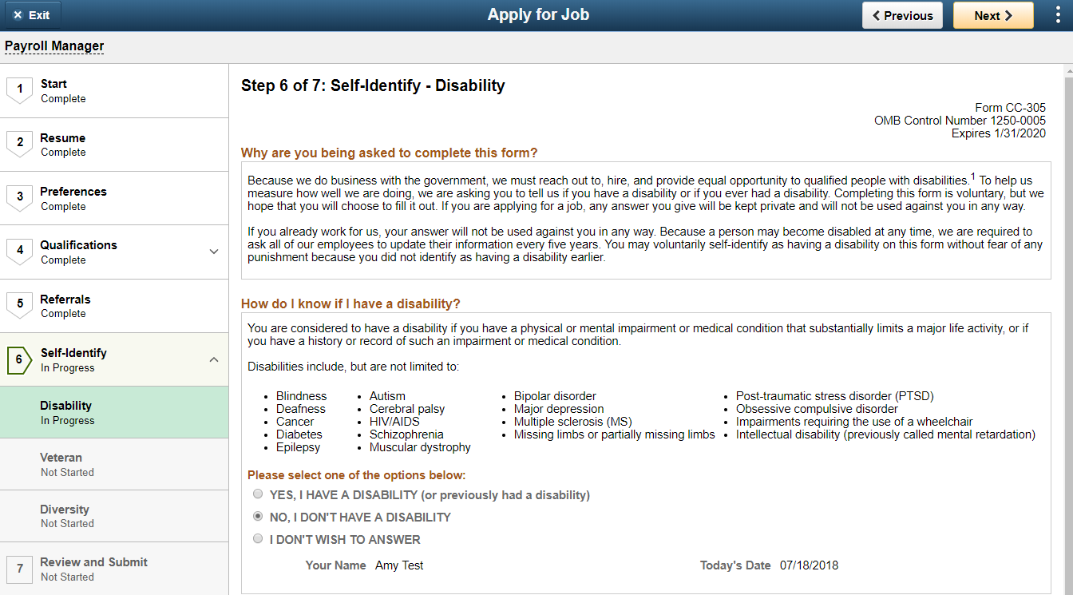
Fluid Candidate Gateway

Slide 39
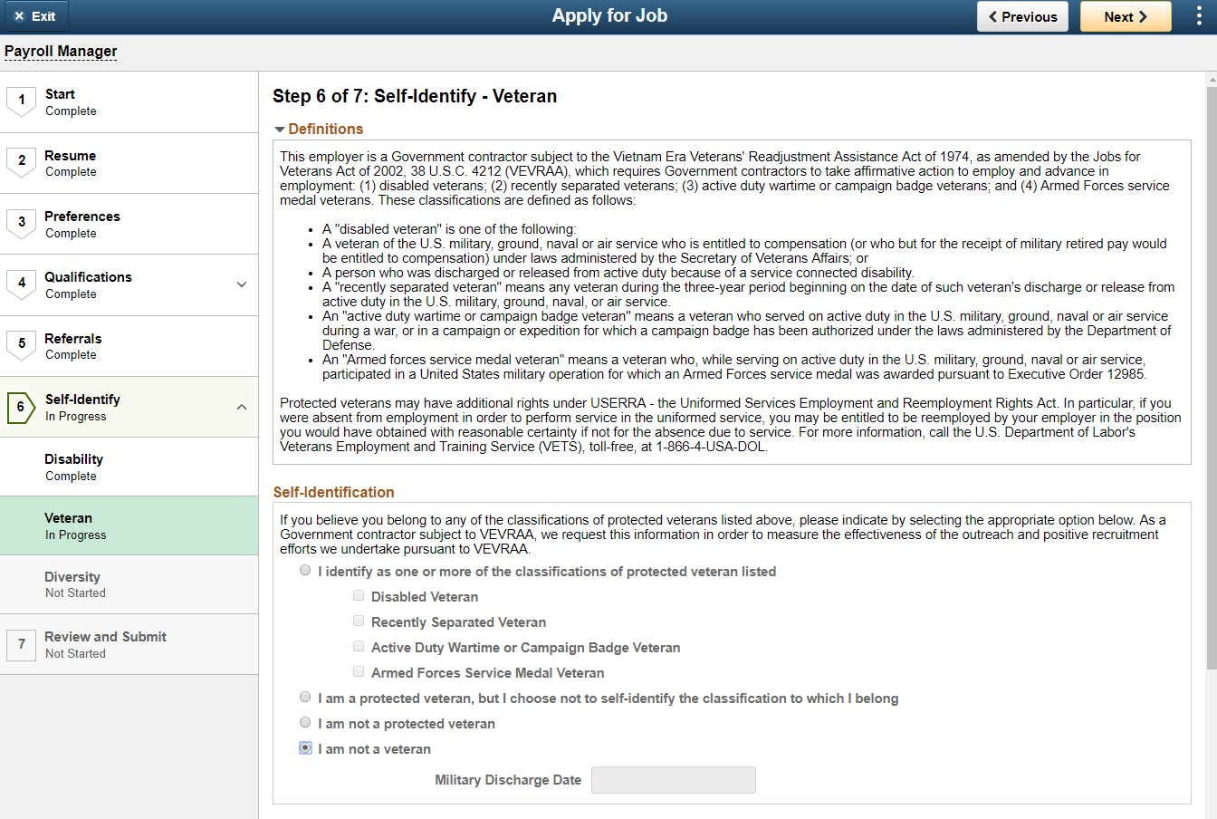
Fluid Candidate Gateway

Slide 40
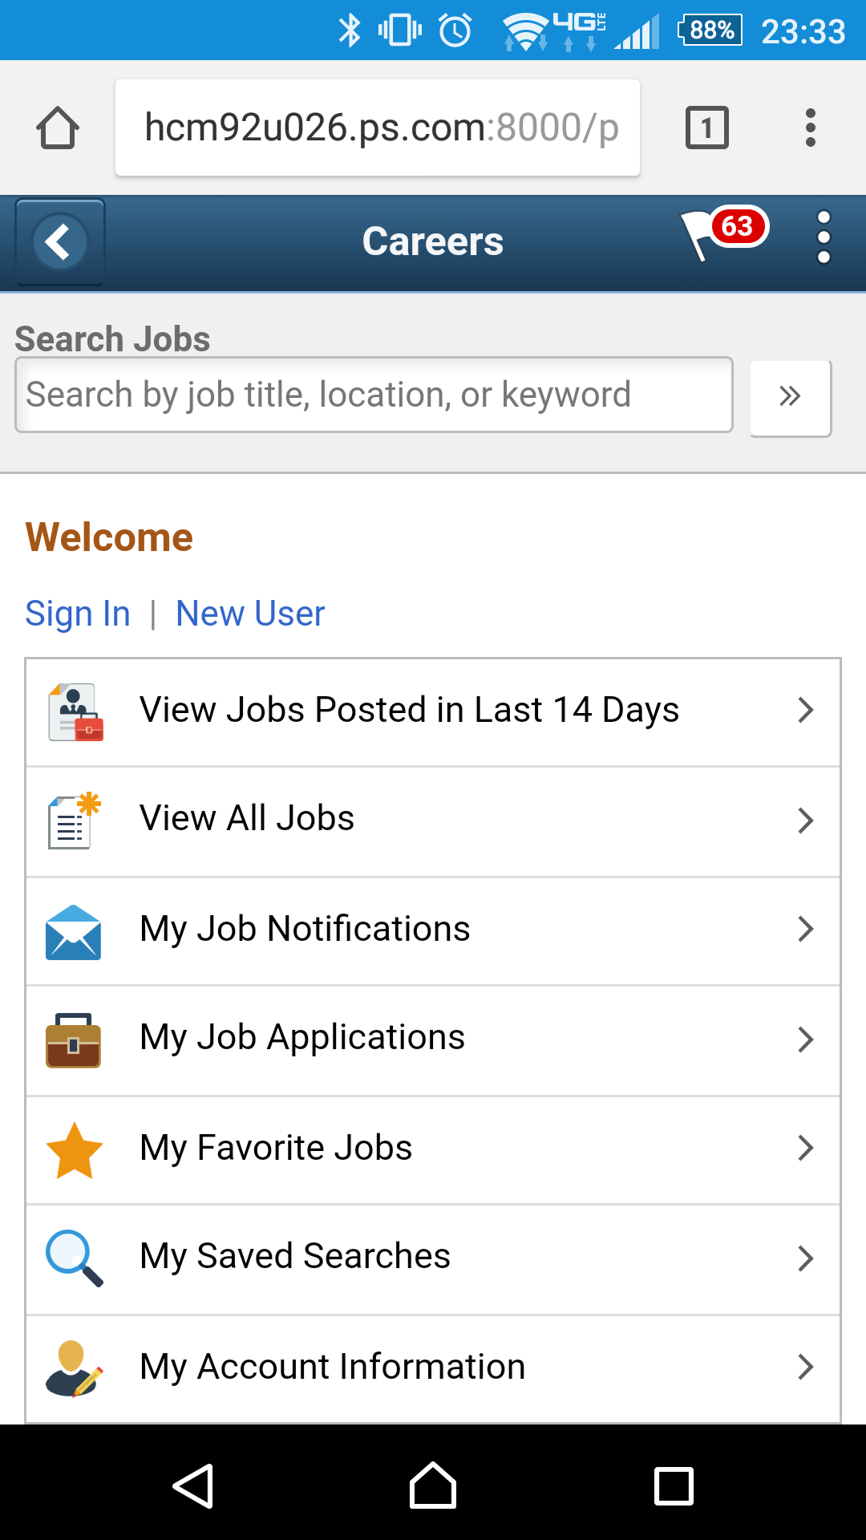
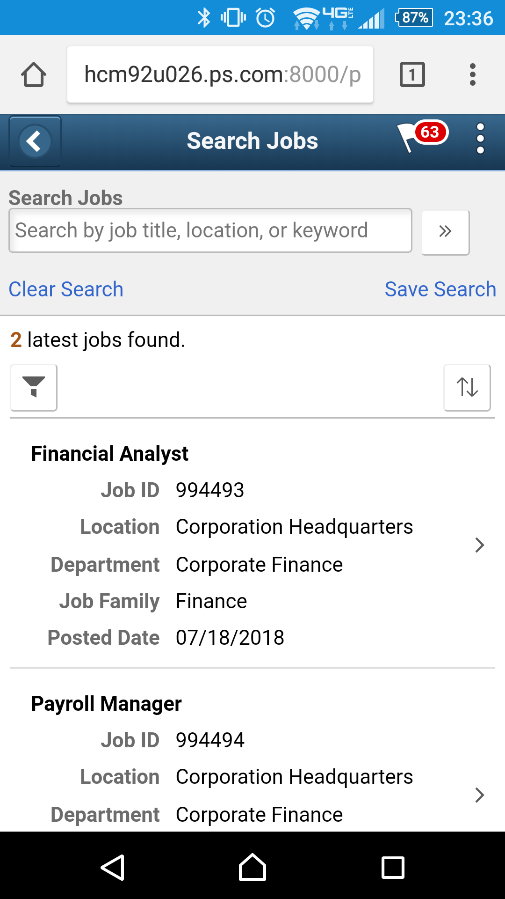
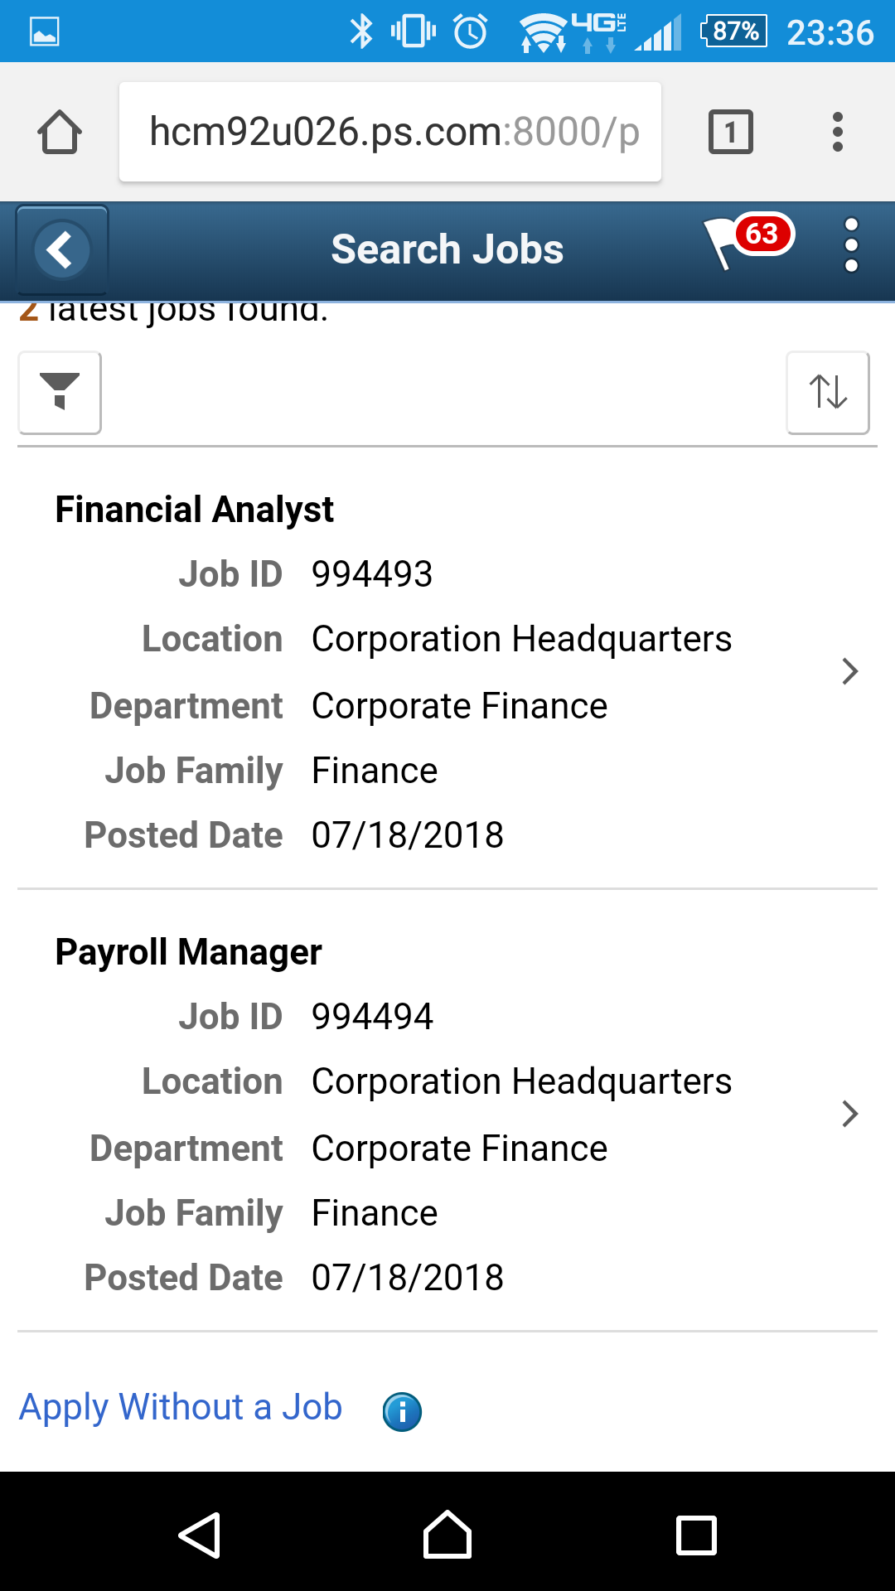
Fluid Candidate Gateway
Job Openings at the corporate headquarters – Mobile

Slide 41
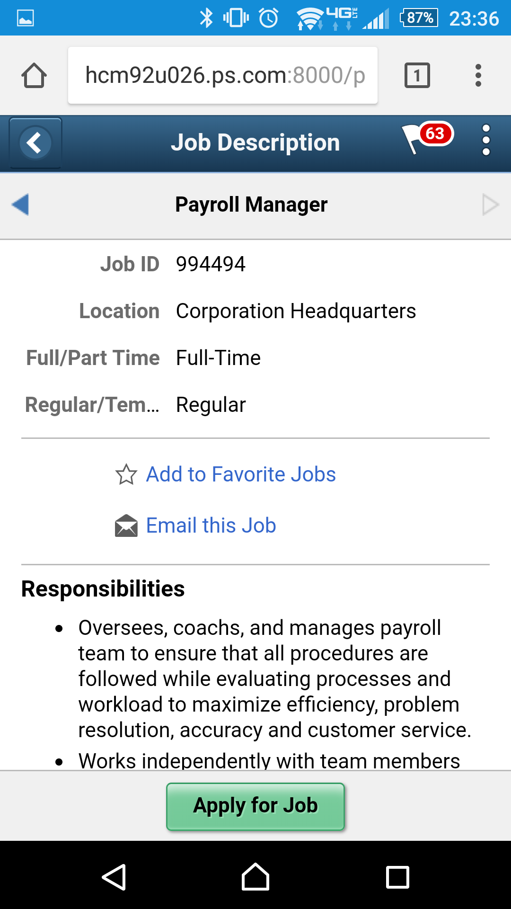
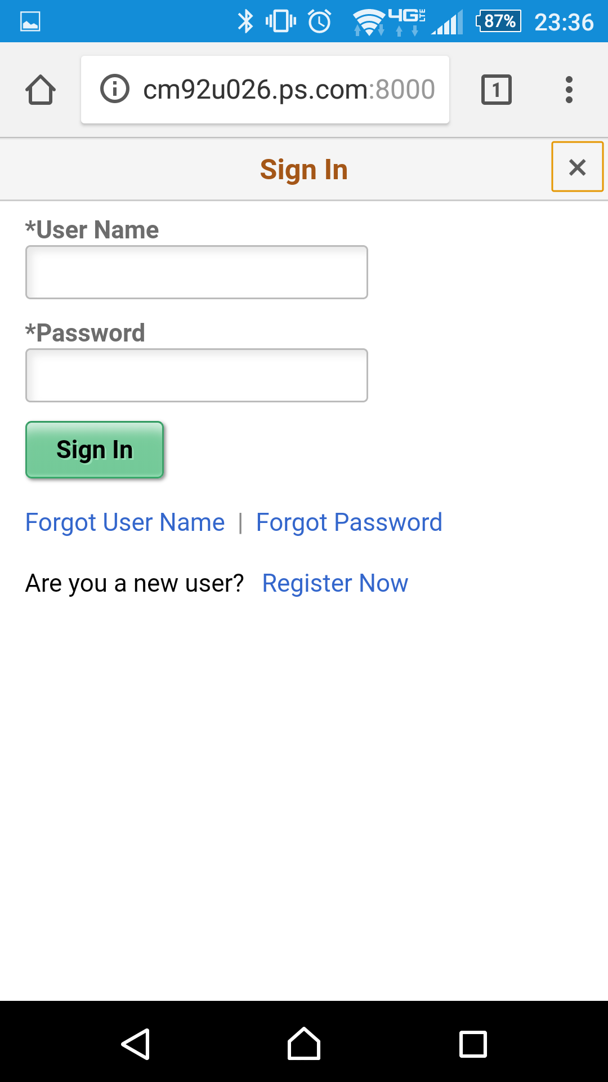
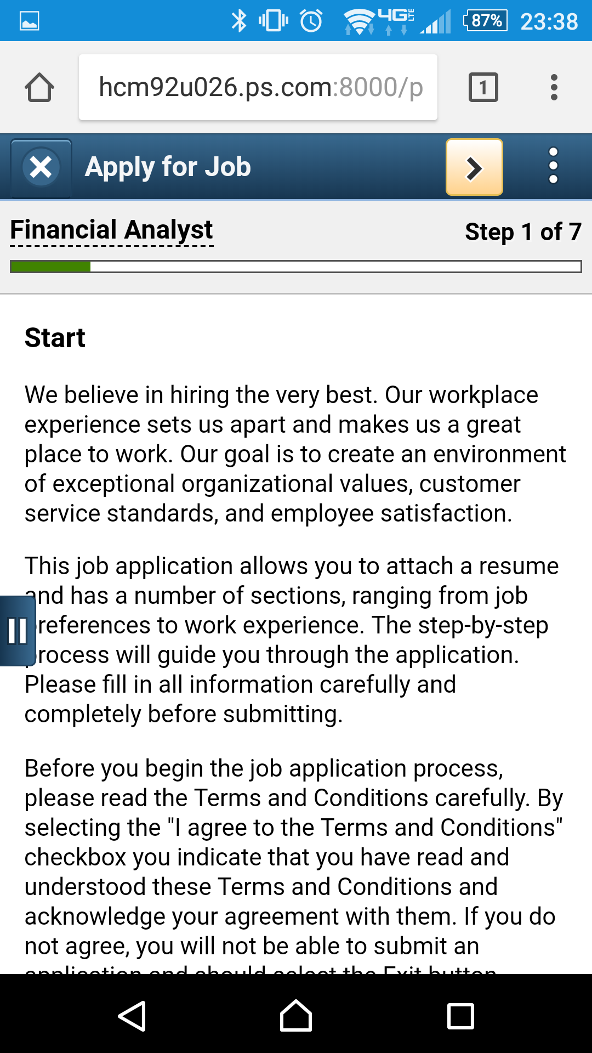
Fluid Candidate Gateway
Job Openings at the corporate headquarters – Mobile

Slide 42
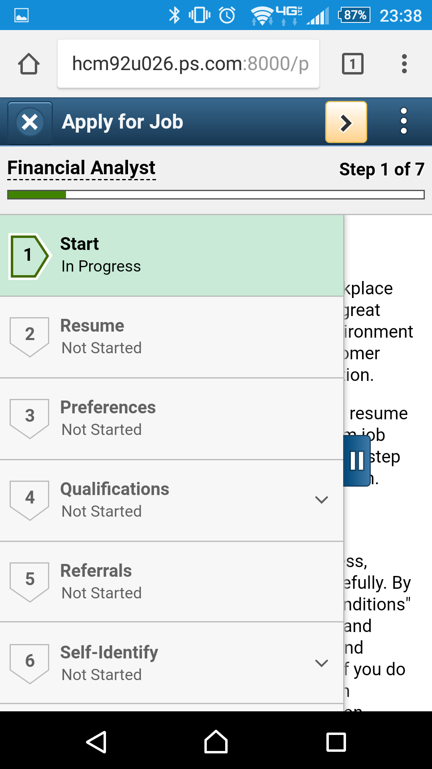
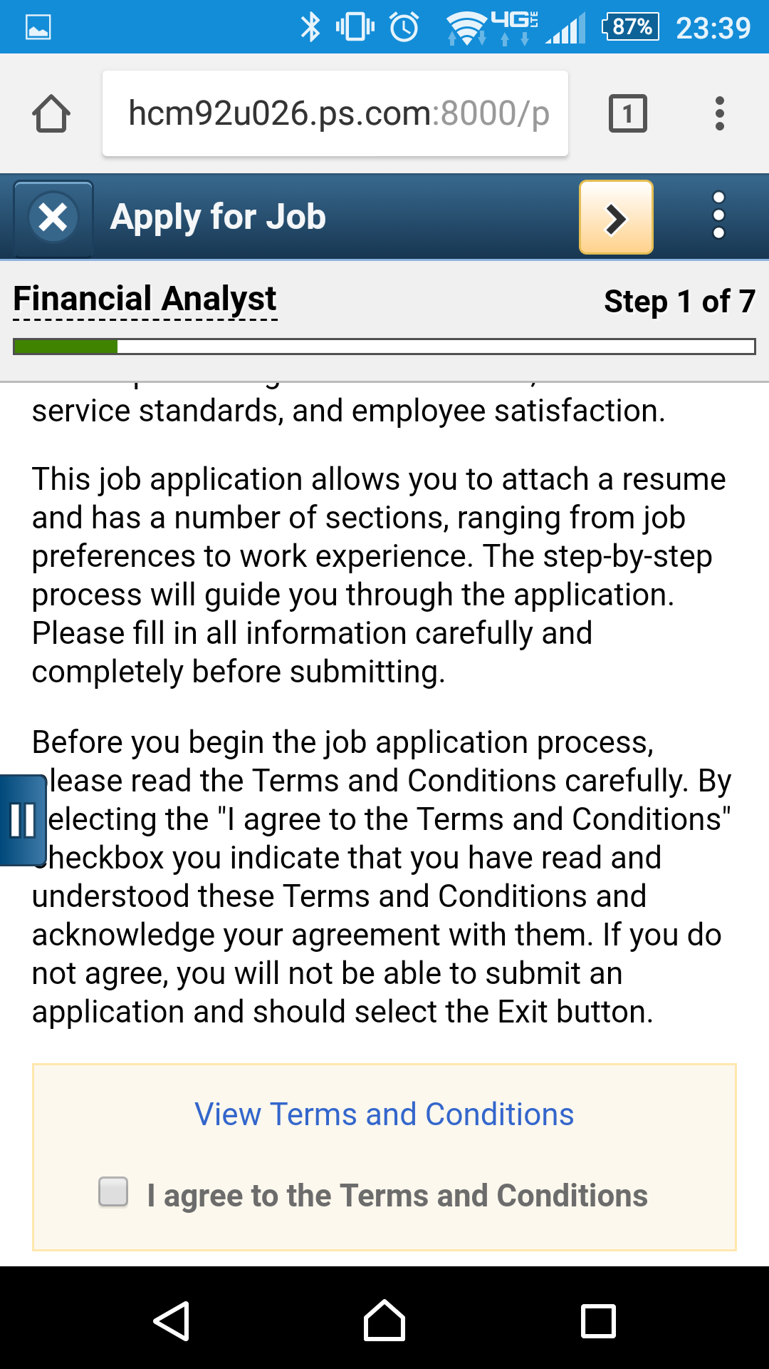
Fluid Candidate Gateway
Job Openings at the corporate headquarters – Mobile

Slide 43
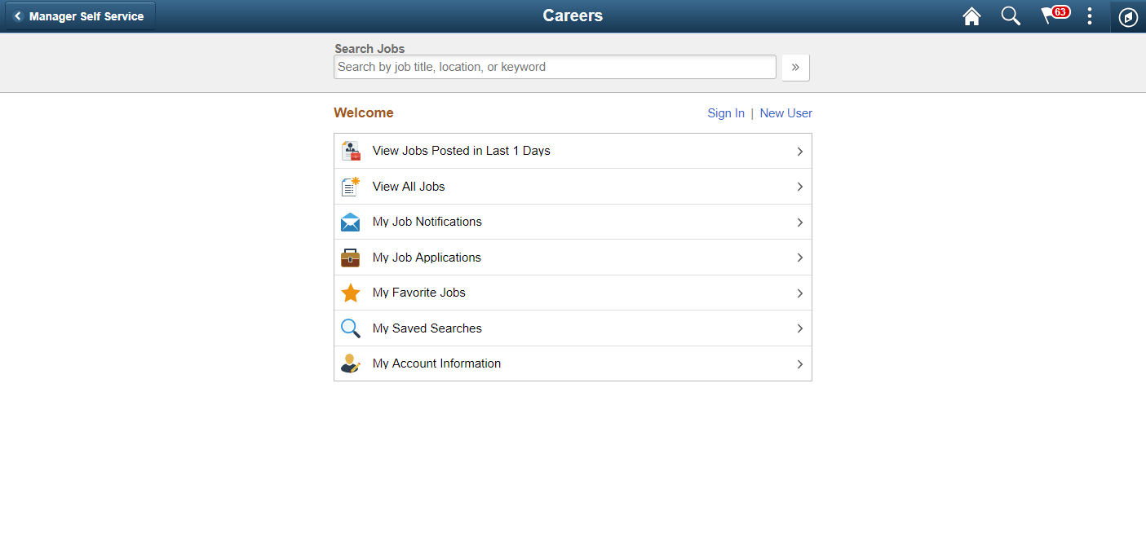
Fluid Candidate Gateway

Slide 44
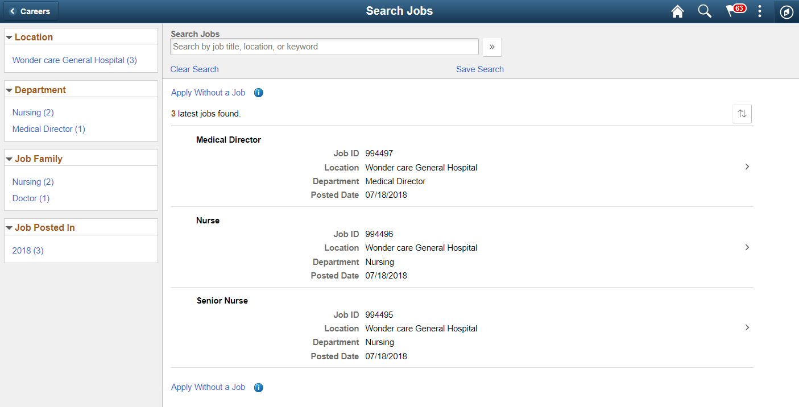
Fluid Candidate Gateway

Slide 45
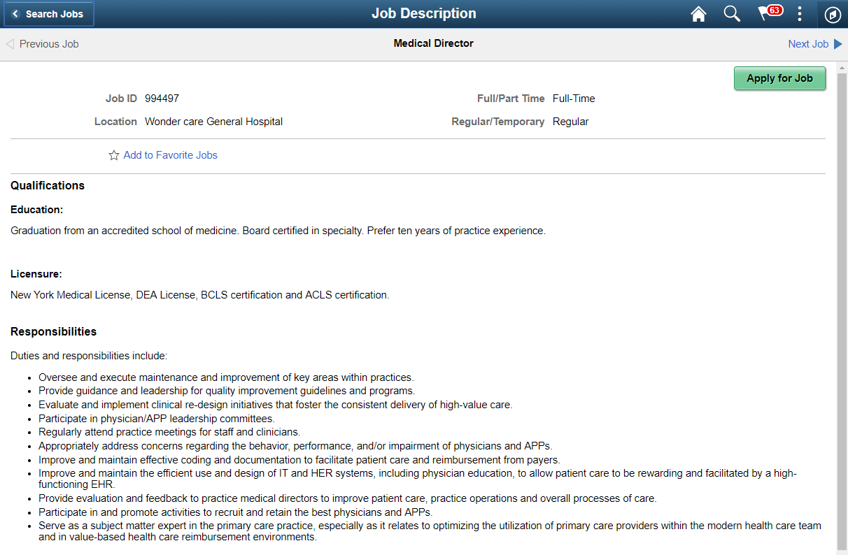
Fluid Candidate Gateway
No “Email this Job” Link

Slide 46
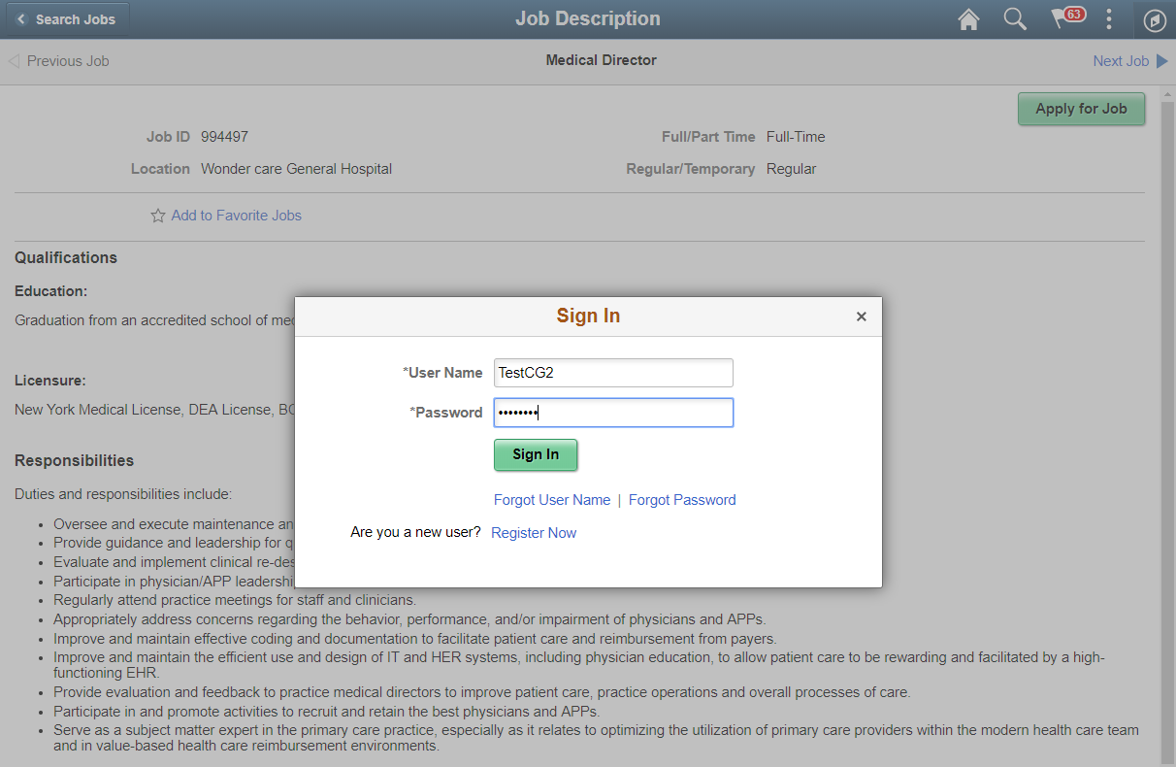
Fluid Candidate Gateway

Slide 47
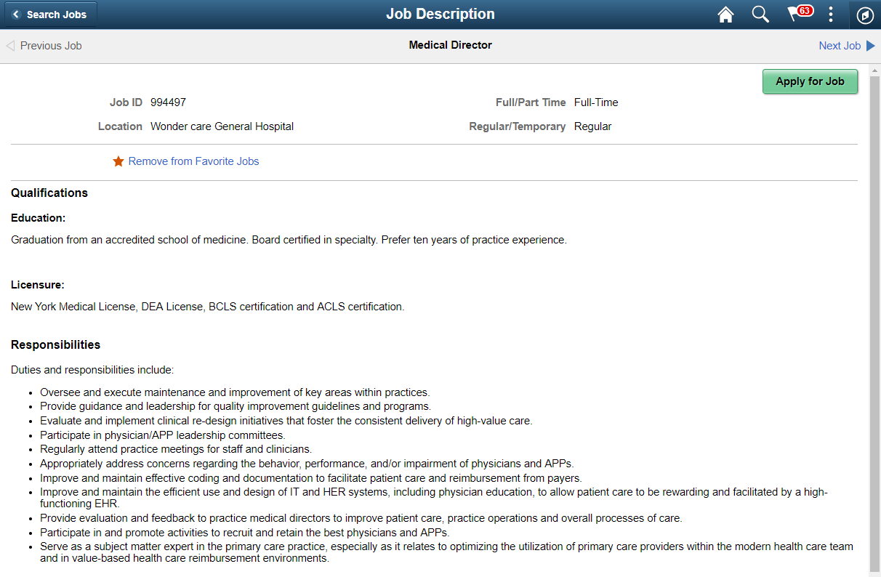
Fluid Candidate Gateway

Slide 48
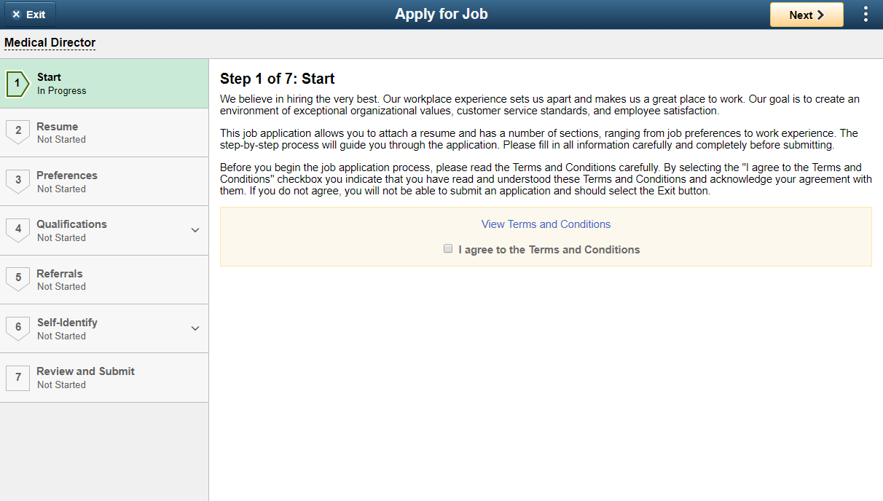
Fluid Candidate Gateway

Slide 49
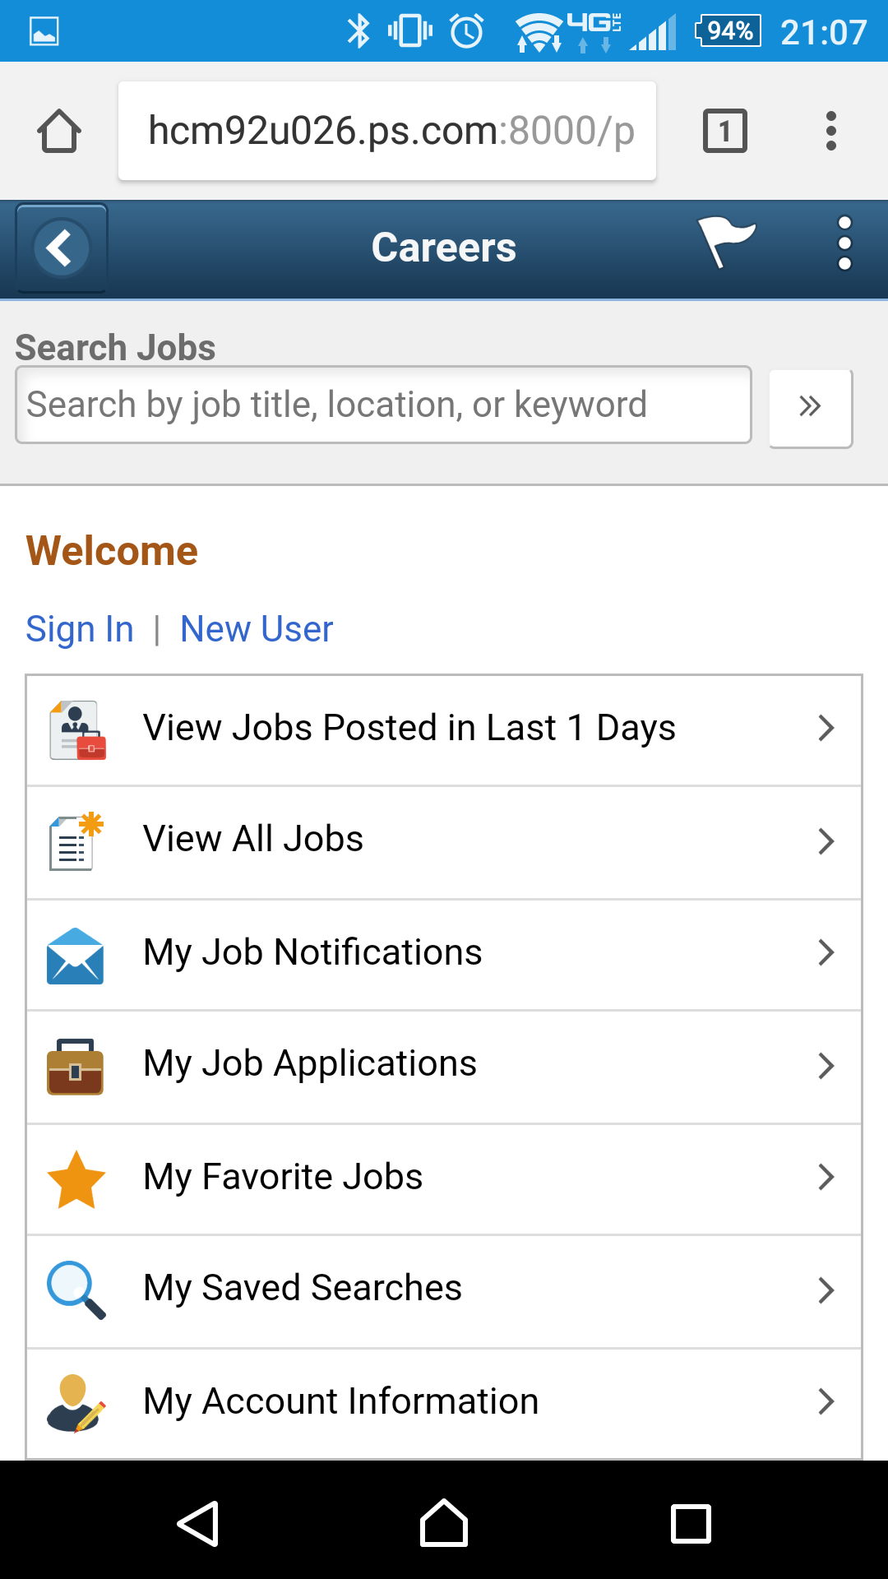
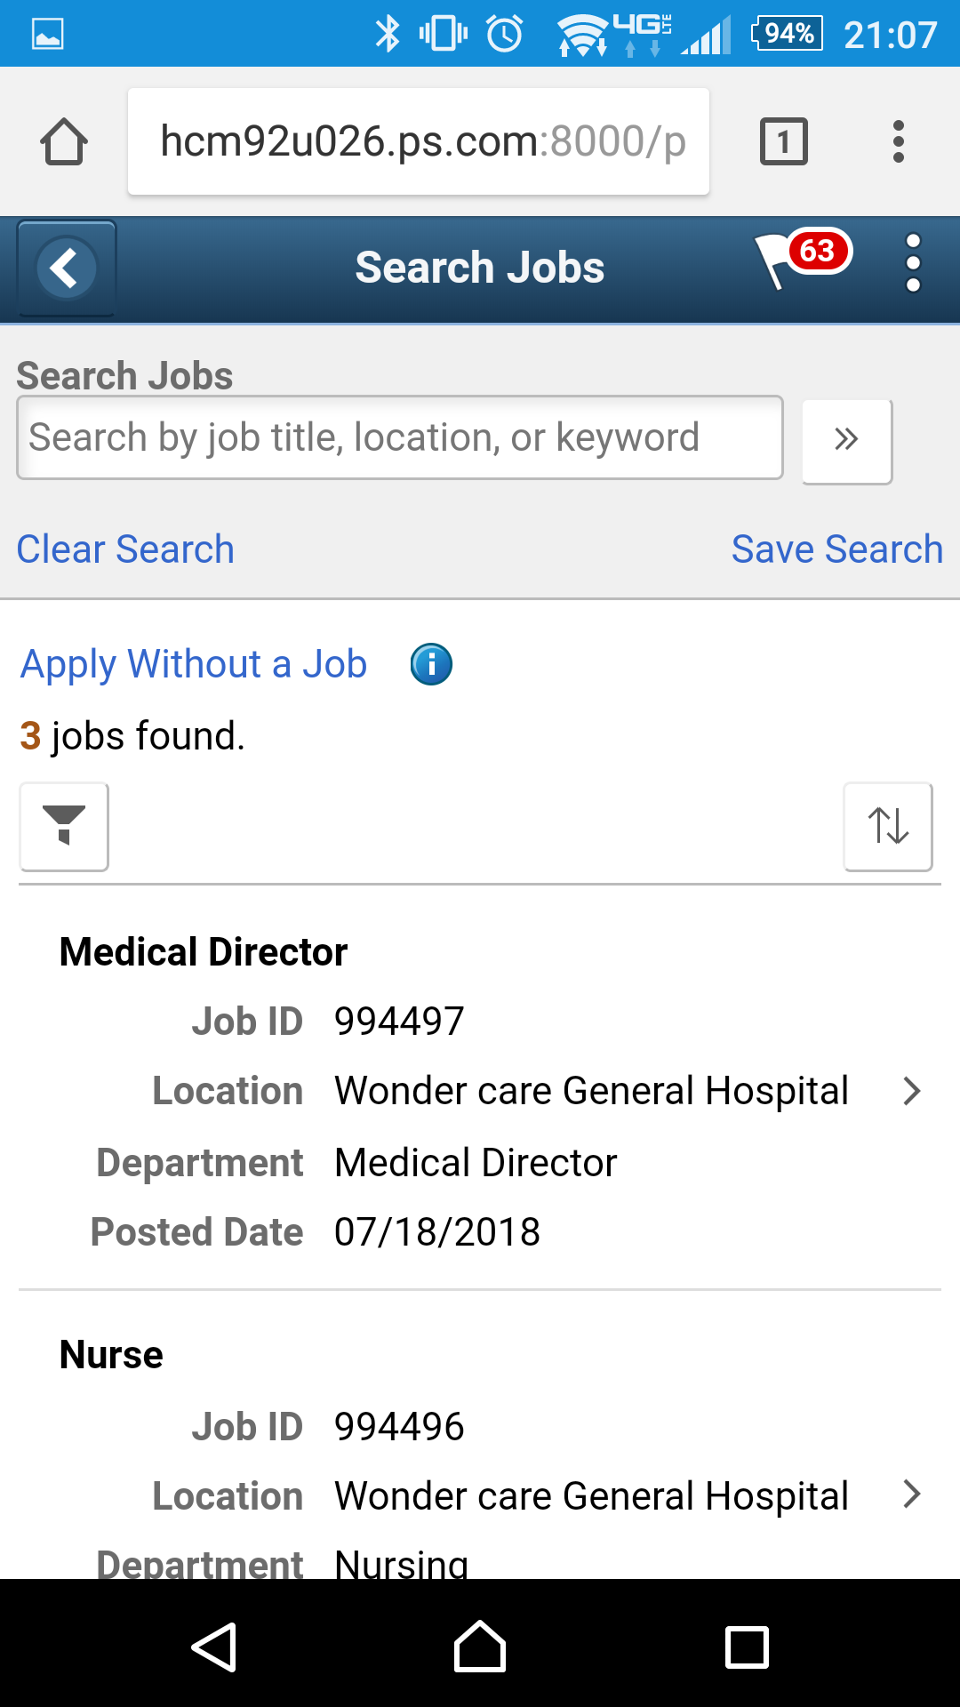
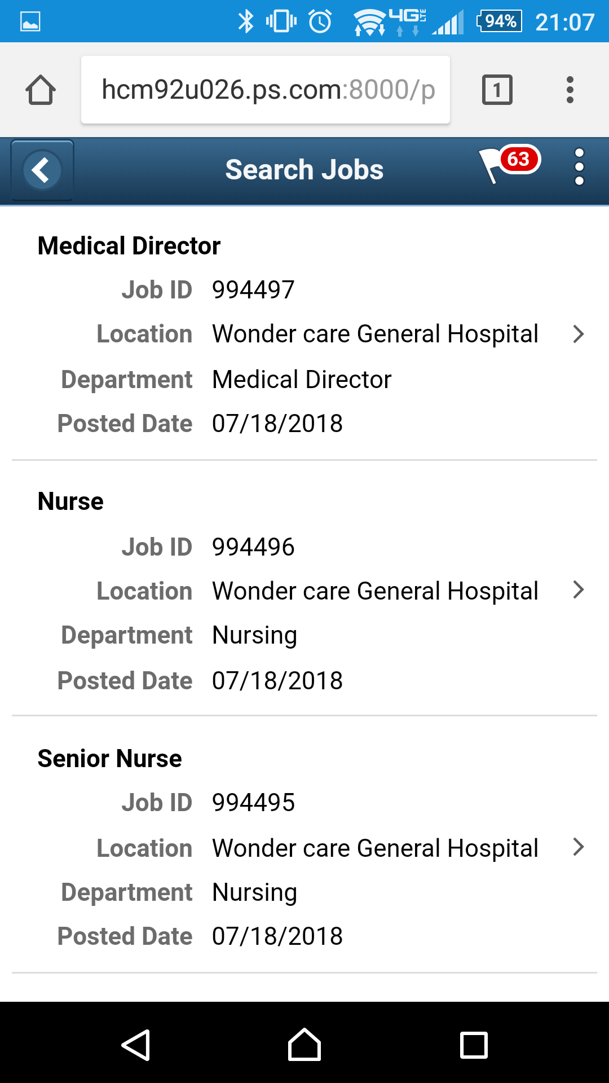
Fluid Candidate Gateway
Job Openings at a hospital – Mobile Devices

Slide 50
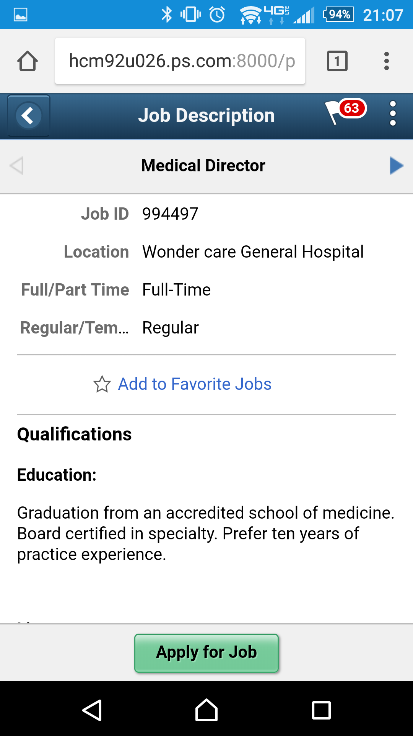


Fluid Candidate Gateway
Job Openings at a hospital – Mobile Devices

Slide 51



Fluid Candidate Gateway
Job Openings at a hospital – Mobile Devices
Amy.Test@gmail.com
Amy.Test@gmail.com

Slide 52



Fluid Candidate Gateway
Job Openings at a hospital – Mobile Devices

Slide 53



Fluid Candidate Gateway
Job Openings at a hospital – Mobile Devices

Slide 54
Tips and techniques
How to differentiate target candidate audiences:
    By business process
    By job component: location, job family, organizational level
    By recruiting source
    Get creative for conference attendees, giveaways
Leverage the delivered functionality:
    Search capability
    Delivered Text Catalog
    Update Recruiting Installation to Test different Job Posting Sites

Slide 55
Thank You!
Please complete a session evaluation
Session ID: 102410
Contact Info:
Nancy.Bucher@Sierra-Cedar.com
678.256.2194

