Slide 1
Challenged, Accepted, Accomplished
Tammie Knapper
July 17, 2019

Slide 2
Challenged
Spectrum’s Opportunity
Spectrum’s HR Technology team was tasked to replace the HR business partner data entry tool as part of the upgrade to PeopleSoft 9.2. Over ten years ago, a custom tool was created to allow our HR community to enter HCM transactions for employees in a centralized location.

Slide 3
Accepted
Determine the Best Replacement Option
HR Technology decided what functionality would carry forward, what could be added and what should be retired. Options were researched to ensure the replacement would continue to serve users with an enhanced experience in alignment with the PeopleSoft 9.2 upgrade.

Slide 4
Accomplished
Deliver an Enhanced Product with the PS 9.2 Upgrade
The HR Transaction Tool was successfully launched with the PeopleSoft 9.2 upgrade leveraging HR SmartForms, guided questions and new functionality.
In truth, whatever is worth doing at all is worth doing well.

Slide 5
Challenged
Replace the HR Self Service Tool

Slide 6
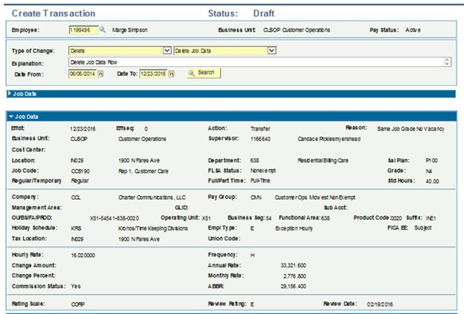
Replace HR Self Service Tool
PS 9.2 upgrade would not refresh the existing HR Self Service tool
Component most used within PeopleSoft creating transactions for employees
Replacement needed to leverage a fresh look and new PeopleSoft functionality
Any sufficiently advanced technology is equivalent to magic.
- Arthur C. Clarke (Author)

Slide 7
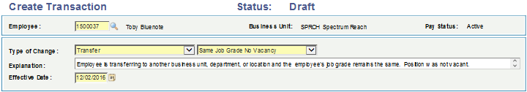
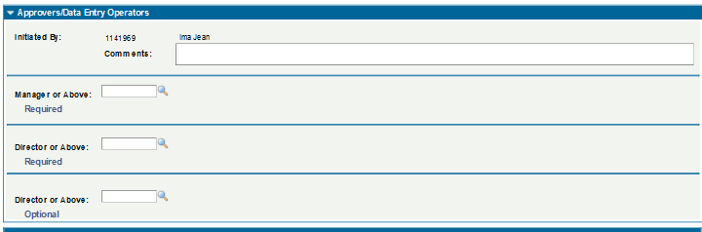
HR Self Service Tool Gaps
Users manually selected Action Reasons
Manual approvals not leveraging AWE
Transactions loaded to Job via batch three times a day

Slide 8
Accepted
Determine the Best Replacement Option

Slide 9
Determine the Best Replacement
Researched opportunities to replace the HR Self Service Tool
Identified requirements and desired functionality
Viewed demonstrations
Received bids from various vendors
It’s not hard to make decisions when you know what your values are.
- Roy E Disney

Slide 10
PS WebSolution Selected
Determined PS WebSolution was the right fit for Spectrum for the below reasons
  Solid, existing functionality that would not require us to start from scratch
  Product currently in use by other companies proving functionality
  Evergreen product that would continue to enhance in the future
  Highly configurable to minimize PeopleCode customizations
  Additional tools delivered in product that could benefit Spectrum in the future
  Product built, launched and supported by a team with a “do the right thing” mentality

Slide 11
Accomplished
Launch HR Transaction Tool (HRTT)

Slide 12
Launch HR Transaction Tool (HRTT)
HR Transaction Tool launched April 30, 2019 with PeopleSoft 9.2 Upgrade
PS WebSolution supported testing, requirements and requests to ensure alignment to project timeline
New tool has a refreshed look and feel
Centralized and easy to use navigation
Introduced new functionality
Plug-in solution minimizing customizations
Integrations with custom tables and custom fields
Custom program provided to clear stale drafts
Special email notification capabilities added various transactions

Slide 13
HRTT Usage since Launch
52,816 Single Transactions
885 Mass Change Online Transactions / 11,380 Records
148 Mass Upload Files Submitted / 4,300 Records
138 Job Code Requests and Changes
There are no secrets to success. It is the result of preparation, hard work and learning from failure. - Colin Powell

Slide 14
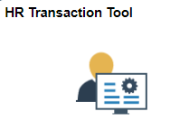
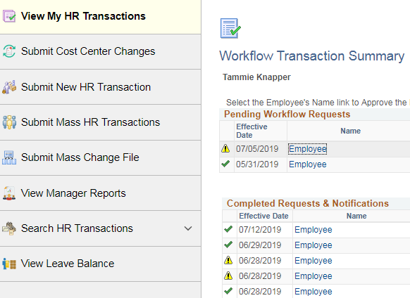
HR Transaction Tool
One Stop Shop to Approve, Create, Submit and View Transactions
Real time load to Job table
Manager Maintenance
Built in business rules to support data integrity
Workflow Summary inclusive of all PeopleSoft transactions

Slide 15

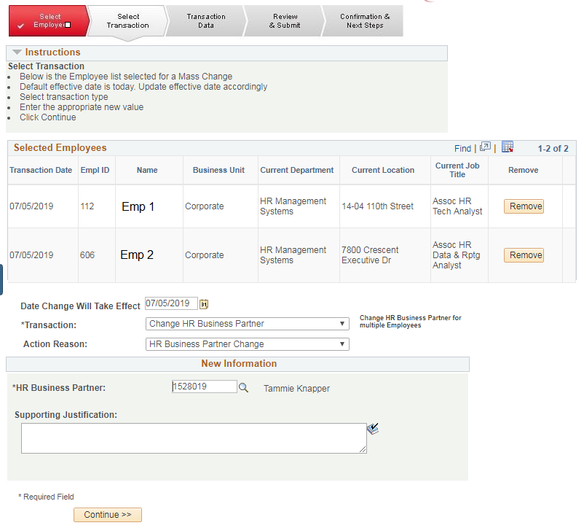
HR Transaction Tool
New Feature to Submit Mass HR Transactions
Faster processing for online mass transactions
Utilizes integration broker for real time Job updates

Slide 16

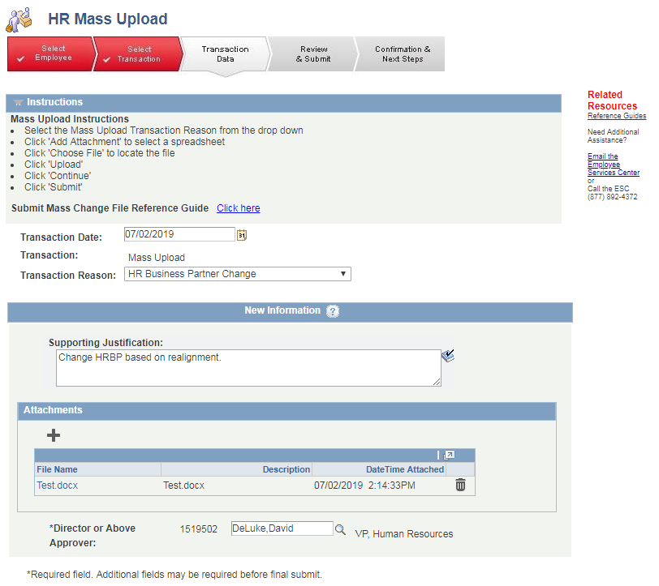
HR Transaction Tool
New Feature to Submit Mass Upload Files via PeopleSoft
Approvals obtained and tracked within PeopleSoft
Transaction status can be tracked submitter

Slide 17
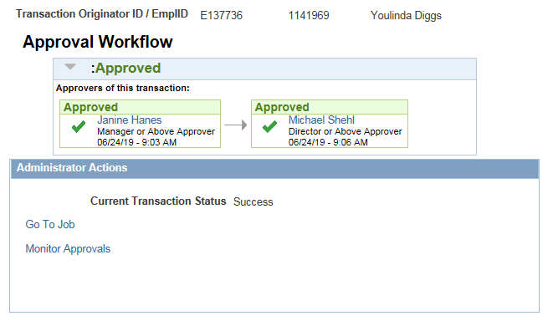
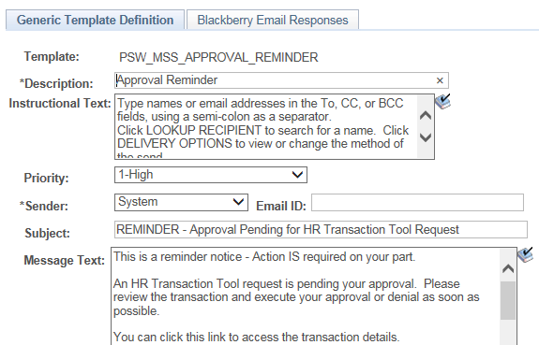
HR Transaction Tool
Leverage Delivered PS AWE Work Flow
Reminder Notifications

Slide 18
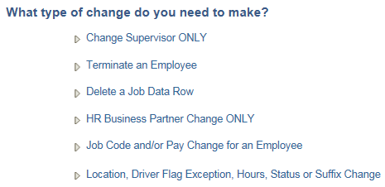
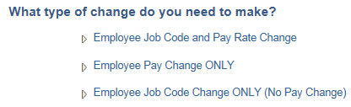
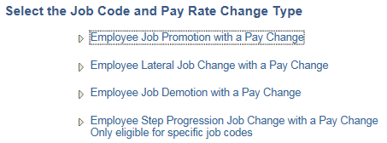
HR Transaction Tool
Question
1
Guided Questions to support consistent usage of Action Reasons
Question
2
Question
3

Slide 19
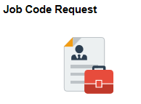
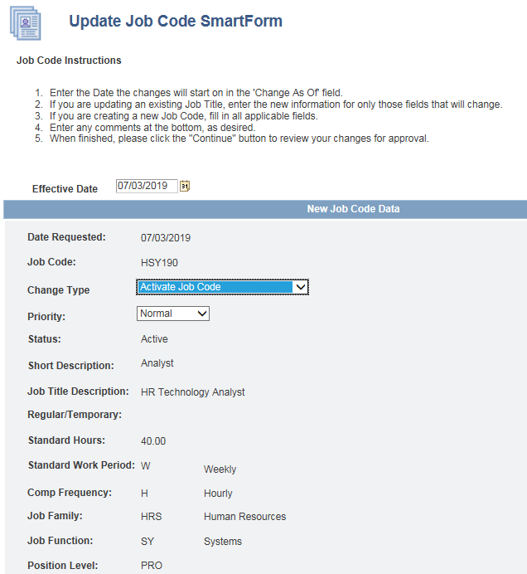
Job Code Request
Job Code Request module delivered by PS WebSolution
Leveraged functionality to replace stand alone SharePoint Job Code request process
Request New Job Code
Request Changes to Job Code
AWE approvals
Real time load to Job Code table

Slide 20
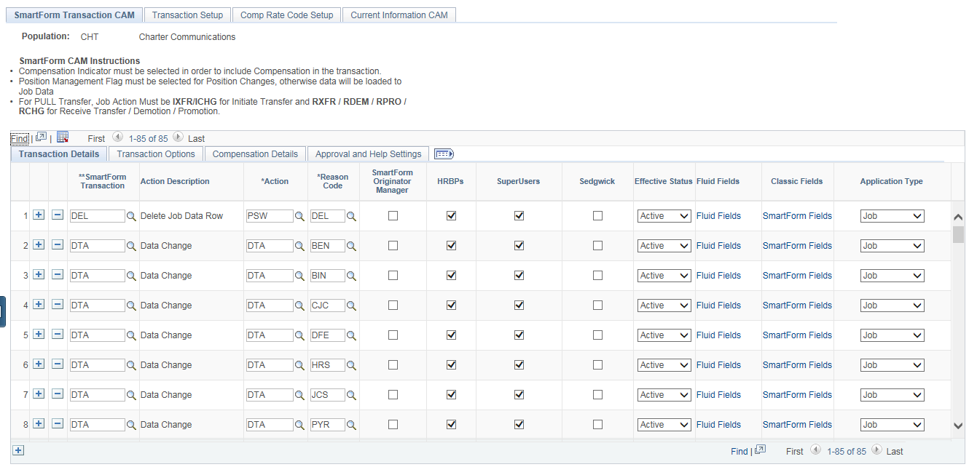
SmartForm Transaction CAM
PS WebSolution CAM allows Spectrum to edit most transactional data elements via configuration
Configuration
  Add new transactions
  Update existing transactions
  Reduces development requests
  Allows for quicker modifications
Grant transaction permissions by User Groups

Slide 21
HR Transaction Tool Roadmap
PS WebSolution launch FLUID for Administrator transactions (next 6 month release)
Spectrum to enable Manager access to transactions
  Phased transaction roll out (Termination)
  Leverage CAM configuration to add new functionality internally
Spectrum to consider leveraging other PS WebSolution delivered modules
  Transaction Blackout
  Position Management
  SmartRules Engine

Slide 22
Please complete a session evaluation
Session ID: 102630
Contact Info:
Tammie.Knapper@charter.com
Tel: 704.731.3499

