Slide 1
Drop Zones and Other Special Forces Tactics to Go Vanilla Session # 101430
July 17, 2019

Slide 2
Agenda
Welcome and Introductions
What To Expect from This Session
Drop Zones
Page and Field Configurator
Event Mapping
“Go Vanilla” Strategy
Creating Configuration-Based Fluid Bolt-On Applications
Q&A

Slide 3
Gideon Taylor Consulting
Gideon Taylor, headquartered in Pleasant Grove, Utah, is a PeopleSoft custom solutions provider for business, education, and government organizations.
Our MISSION is to revolutionize business processes through innovative automation strategies, integration and custom development expertise, and electronic forms technology.
Our VISION is to help our clients work simply, effectively, efficiently, and flexibly.
Founded in 2001 by Paul Taylor,
Original creator of GT eForms™ and ePAF™

Slide 4
The Services We Provide
Solution Experts
Solution Architect – Discover, Direct, Deliver
Business Analyst – Confer, Design, Model, Configure, Test, Train
Technical Consultant – Advise, Prototype, Develop, Update, Maintain
Innovative Discovery and Design Approaches
Simplify – Remove unneeded elements, conditionally include elements
Default and Automate – default elements, automate user tasks
Restrict – Limit valid values
Edit – Leverage system edits, add custom edits
Facilitate – Guided user experience, faster loads/saves, workflow
Notes:
Principal – Senior consultant who will do the initial project planning and solution design. Making sure the proper team is in place for both GT and client, and then assuming an ongoing role directing the project team and managing solution delivery.
Functional – Working side-by-side on a daily basis, ensuring that the business requirements are met by the solution design and configuration.
Technical – Technical integration and development specialist. Helps with the technical aspects of the initial solution design. Acts as lead developer and technical architect for the solution.

Slide 5
Some of our Clients…

Slide 6
What To Expect from This Session

Slide 7
Challenge: Demodify and Modernize Position Data
Position Data component is:
Dated – Position Data is a Classic component, and users want a modern, mobile look and feel.
Modified – custom fields have been added, fields removed, labels changed, with some fields populated by custom code, and changed to be made read-only.
Core office-only – there is no approval process, so requests come in on PDFs and emails and are hand-keyed by specialists in the HR Office.
Expensive to maintain – all the modifications have to be reapplied with every upgrade.
Go-Vanilla Strategy:
Implement new delivered Fluid Position Management from HCM 9.2 Image 29.
Use hot new technologies – Drop Zones, Page and Field Configurator, and Event Mapping to replace modifications with configurations and touchless extension code!

Slide 8
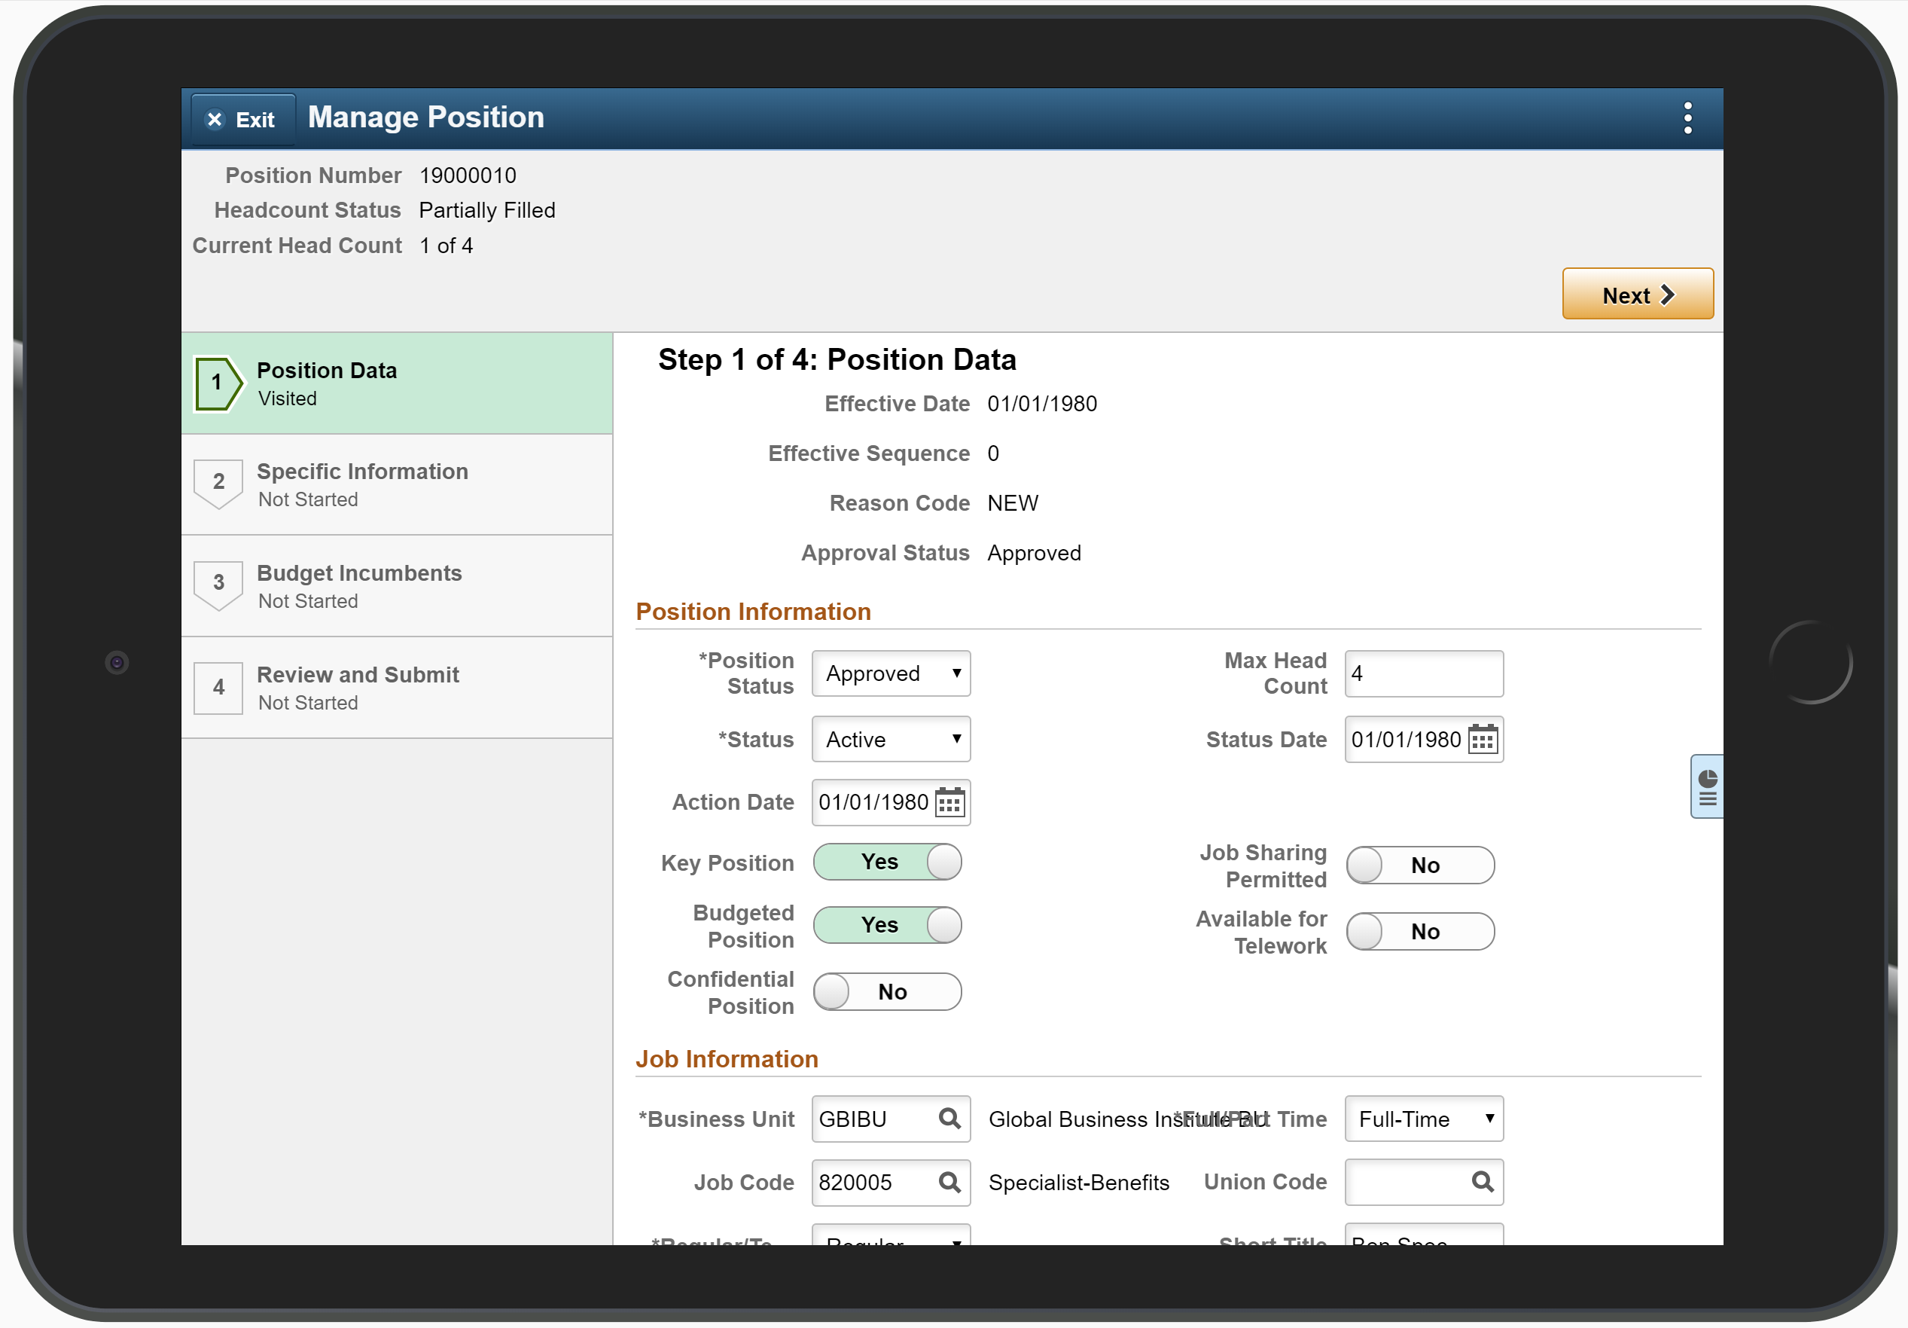
Requirements: Customize Fluid Manage Positions Page
Add Custom Fields
Annual Review Level dropdown
Budget Source dropdown
Handles HIPAA Data checkbox
Change Existing Fields
Hide Checkbox fields (Key Position, Budgeted, Confidential, Job Share, Telework)
Change Union Code label to Bargaining Affiliation, make required, default to RSW
Custom Edits
Update Annual Review Level when Grade changes

Slide 9
Drop Zones – Introduction
Q: What is a Drop Zone?
A: A tool to add custom fields to delivered fluid pages without modifying any delivered objects.
Q: What skill set do I need to use them?
A: Technical –App Designer-based plus PIA configuration. You need to develop new subpage and record objects, possibly style sheets. It helps to know the Component name and Market for the target component.

Slide 10
Drop Zones – Introduction
Q: When are they available?
A: The Drop Zones feature is delivered with PT 8.57. Fluid applications with Drop Zone support currently include:
HCM Image 30: Absence management, Benefits Administration, Company Directory, eCompensation, ePerformance Management, Employee Snapshot, Guided Self Service, My Team, Onboarding, Personal Details, Position Management, US Federal, Global Payroll, Payroll for North America, Recruiting, Time & Labor
FSCM Image 31:
Asset Management: Find Asset, Scan Asset, Scan By Location, Physical Inventory
eProcurement: Create Requisition, My Requisitions, ePro Receiving
Expenses: Create Expense Report, My Wallet, Create Travel Authorization, View Travel Authorization
General Ledger: Simple Journal
Grants Management: Update Award Certification, Award Expiration, PI Portal Summary, Update Award Milestone
Inventory: Par Count, Par Count Ad Hoc, Count by Item, Count by Location, Manual Count, Guided Count, Receiving PO
Payables: Payment Request Center, Payment Request Wizard
Resource Management: Resource Assignment Detail
https://docs.oracle.com/cd/F16440_01/psft/pdf/fscm92fspf-b022019.pdf
CS Image 13: Not Yet – Keep you eyes open and fingers crossed for Image 14!

Slide 11
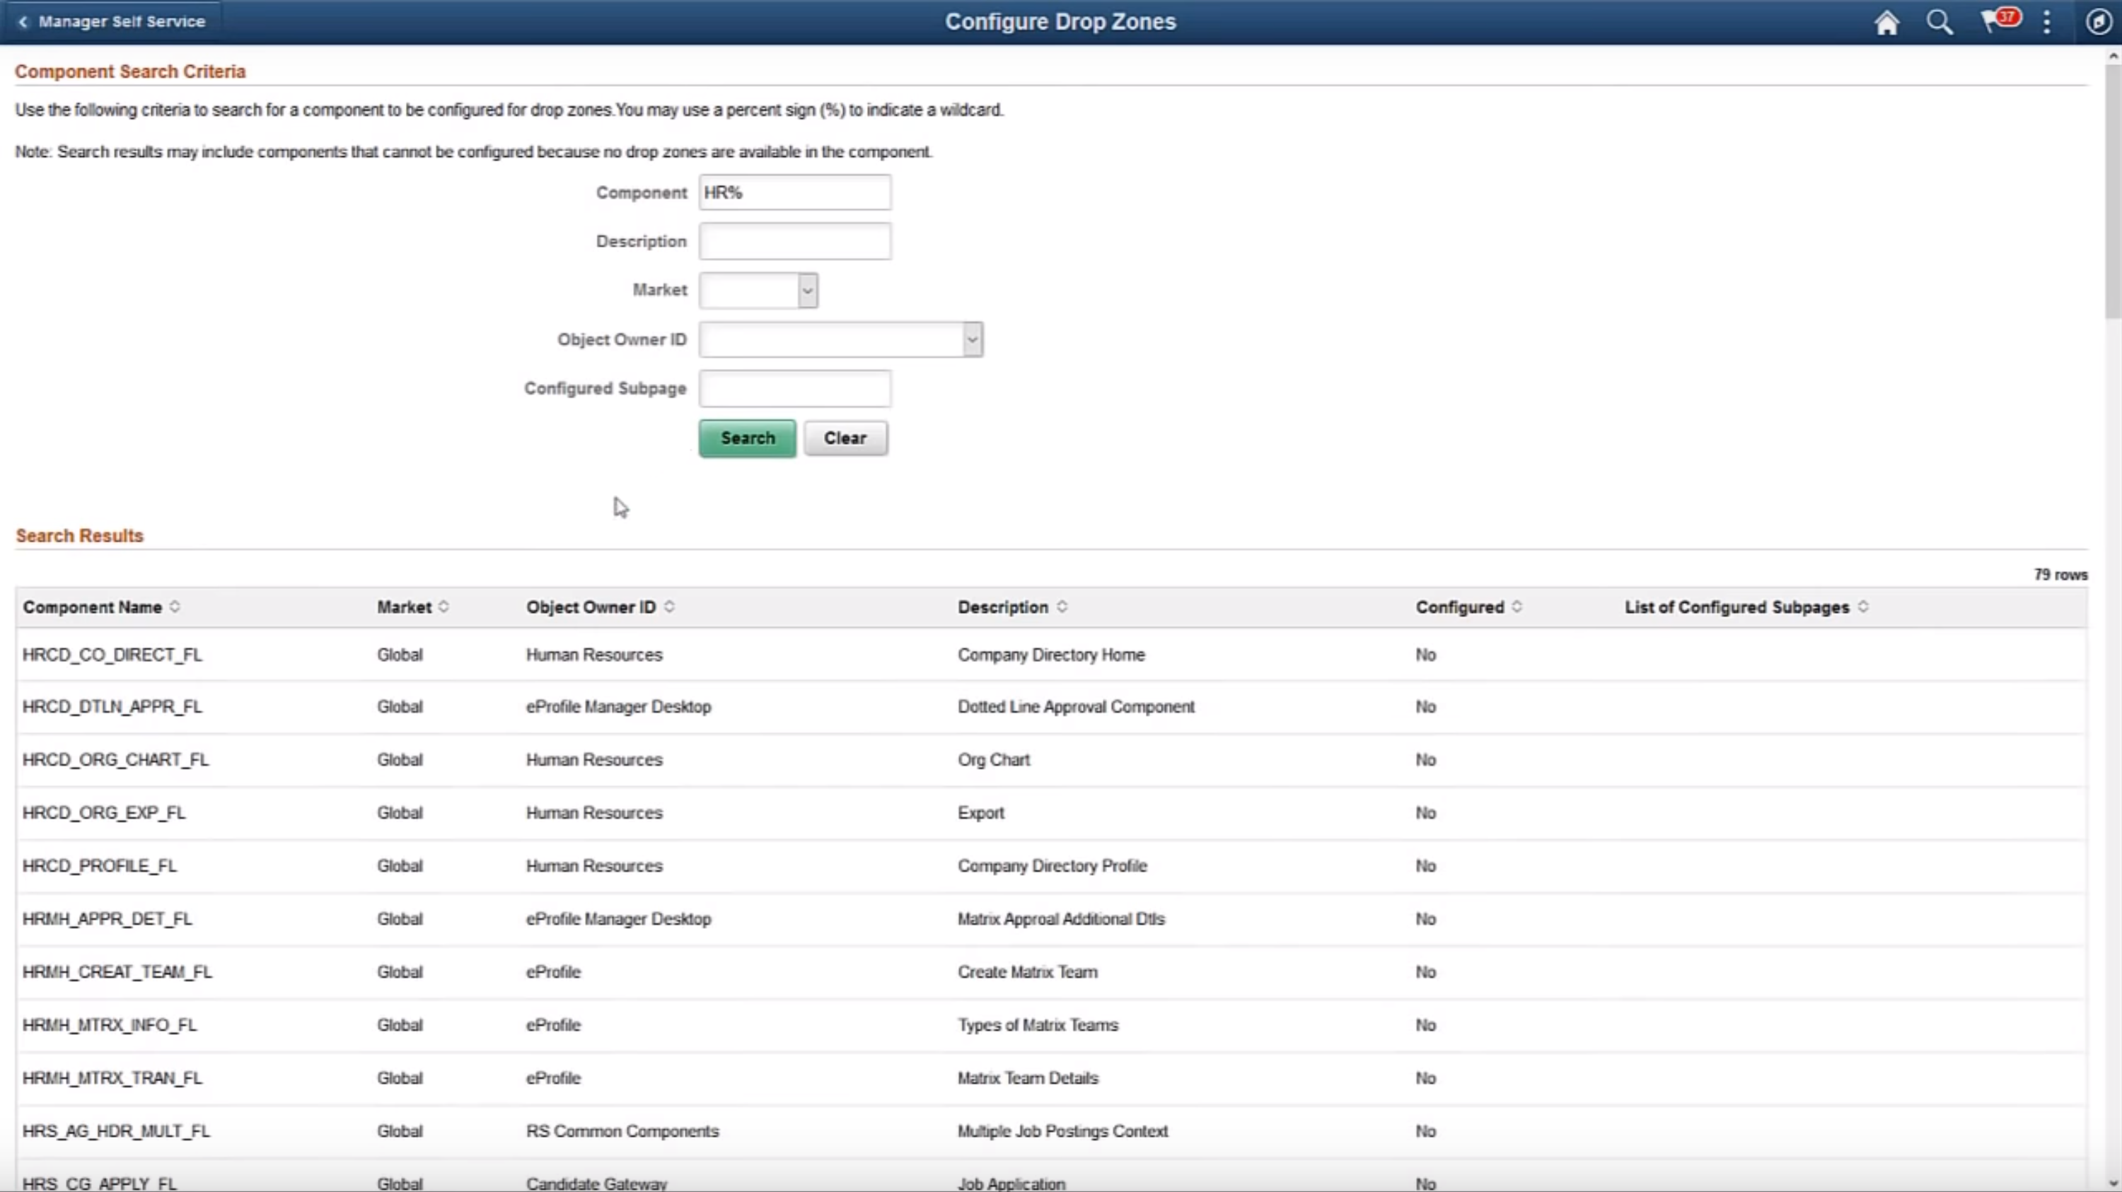
But with HCM Image 30…

Slide 12
Enabling Fluid Position Management – A Brief Comedy

Slide 14
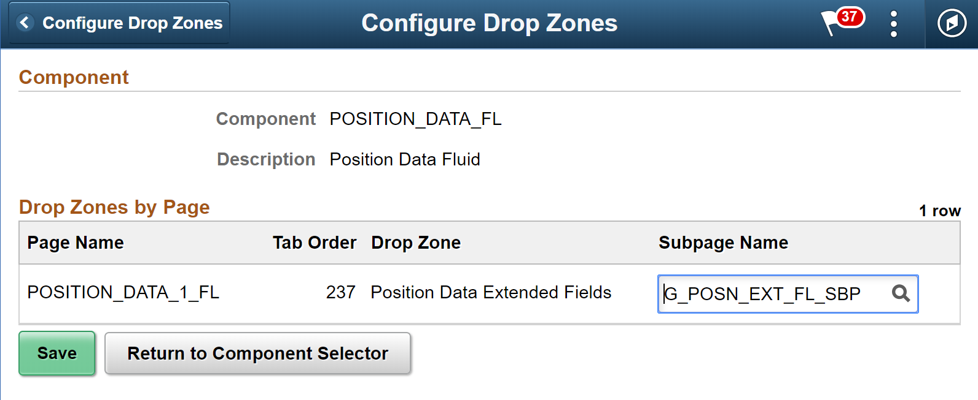
Drop Zones – How-To
Create a Fluid Subpage with your new fields on it
Use the PSL_SIMPLE_SBP page layout
Assign the Subpage to an existing Drop Zone
PeopleTools > Portal > Configure Drop Zones
Style your Subpage appropriately (optional)

Slide 15
Drop Zones – Walkthrough

Slide 16
Drop Zones – Video

Slide 17
Drop Zones – Considerations and Reference
Remember that:
Drop Zones only prevent modifications if the page you want to add fields to already has a Drop Zone delivered for it.
Drop Zones are currently only available for Fluid pages.
Drop Zones add fields to the Component Buffer. They are subject to the same page order and level restrictions and rules as in regular page development – including the rule that only one database record can exist on any level above 0.
Drop Zones can potentially be nested up to two levels.
https://docs.oracle.com/cd/E99483_01/pt857pbr1/eng/pt/tflu/task_CreatingAndConfiguringDropZones.html?pli=ul_d41e41_tflu#u60a85cdb-d142-421e-8578-2e4a3f9038a7
https://www.youtube.com/watch?v=Z9pJI5nInJ8&t=104s

Slide 18
Page and Field Configurator – Introduction
Q: What is the Page and Field Configurator?
A: A tool to customize the appearance and behavior of delivered classic and fluid pages and their fields without modifying any delivered objects.
Q: What skill set do I need to use them?
A: Functional – PIA-based configuration. You need to know the Component Name and Market.
Q: When is it available?
A: The Page and Field Configurator feature requires PeopleTools 8.56.02, plus:
HCM Image 24
FSCM Image 25
CS Image 8

Slide 19
Page and Field Configurator – How-To
Find the Field names and the target Component name and Market
Field Names: Use your browser’s Inspect tool – right-click on the field you need the name of, choose Inspect to get a hint
Component Name and Market: Use Ctrl-Shift-J
Set field and page override properties in the Page and Field Configurator
Enterprise Components > Page and Field Configuration > Page and Field Configurator
Restrict configuration application to certain field value criteria or user lists (Optional)
Don’t forget to map the new configuration to the Portal Registry!
Map to Portal Registry tab, check the checkbox, Apply Configuration

Slide 20
Page and Field Configurator – Walkthrough

Slide 22
Page and Field Configurator – Considerations and Reference
Remember that:
Configuration can be applied to registered components only. Secondary pages and other modal windows cannot use the Page and Field Configurator.
Configurations still require maintenance and migration – especially conditional and user list-specific ones.
Configurations must often be applied on multiple components where the same fields and pages appear.
https://docs.oracle.com/cd/E90017_01/hcm92pbr16/eng/hcm/ecch/task_UsingPageAndFieldConfigurator.html
https://www.youtube.com/watch?v=sJBeqK8gJ0A

Slide 23
Event Mapping – Introduction
Q: What is Event Mapping?
A: A Tool to add custom code to delivered components, pages, records, and fields without modifying any delivered objects.
Q: What skill set do I need to use them?
A: Technical – App Designer-based plus PIA configuration. You need to develop Application Class PeopleCode. You need to know the Portal Registry navigation for your target component.
Q: When is it available?
A: Event Mapping became available with PeopleTools 8.55.

Slide 24
Event Mapping – How-To
Write Application Class PeopleCode
Define an App Class Related Content Service
PeopleTools > Portal > Related Content Service > Define Related Content Service
Find the Portal Registry navigation path to the target Component
Use Ctrl-Shift-J for the Component name, then Enterprise Components > Find Object Navigation
Create an Event Map to tie the Related Content Service to the component-level PeopleCode event
PeopleTools > Portal > Related Content Service > Manage Related Content Service
import PT_RCF:ServiceInterface;
class [classname] implements PT_RCF:ServiceInterface
method execute();
end-class;
method execute
/* Extends/implements PT_RCF:ServiceInterface.execute */
[your code]
end-method;

Slide 25
Event Mapping – Walkthrough

Slide 27
Event Mapping – Reference
Remember that:
A new Event Mapping indicator in App Designer shows whether a component has Event Mappings associated.
Event Mappings could be hard to remember about. Where is this behavior coming from?? Document well!
Be careful that you are using the correct Portal Registry navigation. You can bring up any record and field name on any target component reference, including the right record and field on the wrong content reference!
https://docs.oracle.com/cd/E99483_01/pt857pbr1/eng/pt/tprt/task_CreatingAndManagingRelatedContentServiceDefinitions.html#u2b82b080-4b59-475d-9d33-21afbfe75d7f
https://docs.oracle.com/cd/E99483_01/pt857pbr1/eng/pt/tprt/task_MappingApplicationClassPeopleCodeToComponentEvents.html

Slide 28
Strategic Considerations for Going Vanilla
Going Vanilla doesn’t mean you can’t get the functionality you want, it means getting what you want at the lowest Total Cost of Ownership
Traditional Upgrade vs. Selective Adoption – Hitting your mods more and more frequently
Agility in leveraging new functionality from Oracle
Avoid Maintenance Gridlock – What is the ratio of ongoing maintenance effort to initial development effort? High-ratio mods kill future automation opportunities
Maximize Value and Minimize Maintenance by Going Vanilla!

Slide 29
What Is Vanilla?
Isn’t Vanilla: Modifications to App Designer-level delivered PS objects
Is Vanilla: Leveraging configuration options
Is Vanilla: Touchless extensions of existing features
Is Vanilla: Bolt-on applications
This CC BY-SA

Slide 30
Strategic Process for Going Vanilla
Review each modification
Review latest delivered feature set in an up-to-date DEMO environment (consider PeopleSoft Cloud)
Adopt delivered: Change business process to fit? What would be the additional benefits?
If differences from delivered are still needed:
Look at specific configuration options of the feature
Look at general functional config options (Configurator, new Frameworks (Questionnaire, Attachments, Acknowledgements))
Look at general technical extension options (Drop Zones, Event Mapping, Fluid Approvals)
Look at functional bolt-on applications (Forms and Approval Builder, Frameworks, GT eForms; new front-end, workflow, delivered as black-box)
Look at technical bolt-on applications (Custom development, extending app packages, GT eForms, other native 3rd-party bolt-ons)
Consider integrated non-native hosted 3rd-party providers
Consider keeping the modification

Slide 31
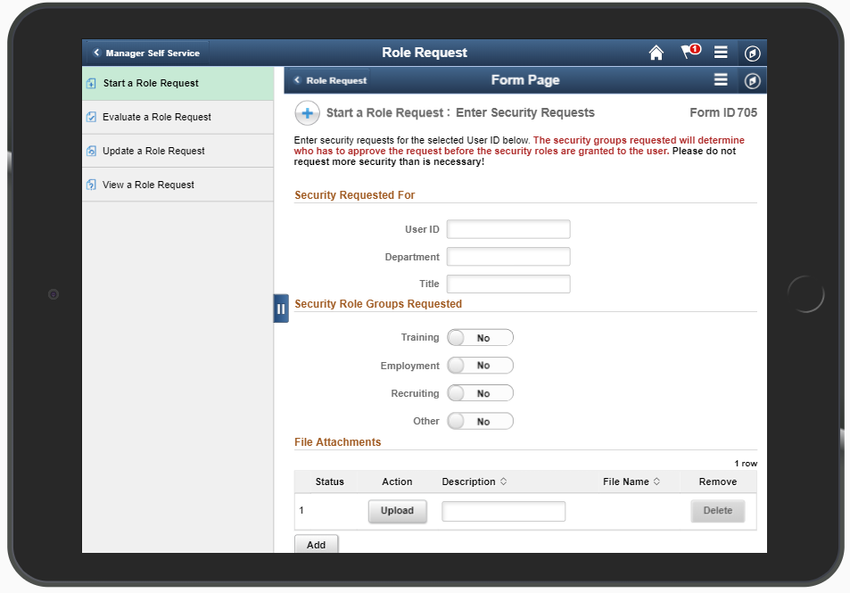
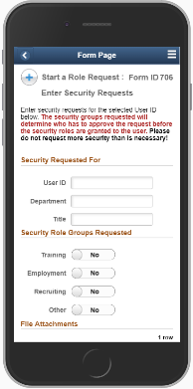
GT eForms™ – Unparalleled Automation
Deliver powerful, custom automation – any device, anytime, anywhere
Oracle-validated, bolt-on electronic forms framework and toolset for PeopleSoft
Built 100% in PeopleTools – Familiar toolset for PeopleSoft developers
Configuration-based form creation and management with setup tables to control business logic, form actions and routing
Native, real-time access to PeopleSoft data, including employee, student, and financial data – no external interfaces to maintain!
Leverage existing PeopleSoft workflow, security and infrastructure
Unlimited flexibility in presentation, pageflow, workflow, and routings
MOBILE! Fully Fluid-enabled to deliver dynamic eForms on any device

Slide 32
Empowering users through mindful automation
Auto-population and intelligent defaulting ensure accuracy, increase speed, and reduce the amount of data required of the user
Related displays provide meaningful information to the user
Restricted prompt values simplify choices and remove opportunities for error
Field attributes and form layout define an intuitive user experience
Conditional logic guides the user, hiding complexity and reducing need for training and documentation
Conditional routing and email notifications ensure compliance and accelerate turnaround
Easy access to forms, form status and form data empowers users with on-demand information and reduces calls to the help desk

Slide 33
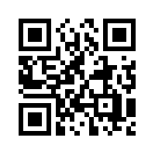
GT eForms Demo
http://bit.ly/GTReconnect19

Slide 34
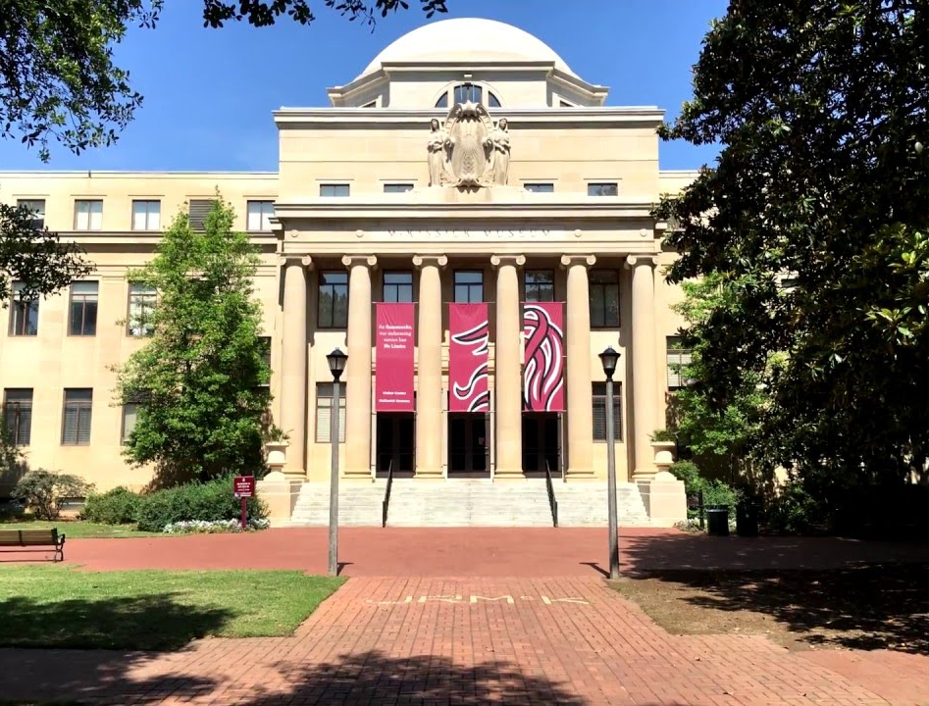
University of South Carolina
In April 2019, USC went live on their new PeopleSoft HCM 9.2 implementation including the following eForms-based processes:
403(b) elections
Affiliate appointments
Affiliate updates/terminations
Education profile
Employee profile
Temporary faculty returns
Account funding changes
Retro funding changes
Additional assignments
Hires
Job changes
Status changes
Student hires
Additional pay
Benefits enrollment
86% of all human interaction with the PeopleSoft applications is through an eForm.
eForms also provide dynamic integration between the University’s PeopleSoft system and the recruiting (PeopleAdmin) and student (Banner) systems, delivering even greater efficiency for student workers, faculty, and staff.

Slide 35
State of Tennessee
An Oracle Showcase Client, the State has created enterprise-scale, custom PeopleSoft applications using GT eForms since 2014.
Position Change Requests
Sick Leave Bank
Alternate Workplace Solutions
Personnel Actions
Retiree Benefits Enrollment
Policy Acknowledgements
Radical efficiency gains:
Over 200,000 eForms processed
Over 700% gain in benefits enrollment processing
Turnaround time reduced by over 40%
Eliminated “lockouts” during payroll processing
Enforced policy compliance
Eliminated lost forms
Gideon Taylor and GT eForms™ was recommended by Oracle as a result of an Insight Initiative in 2012.
Today, the State’s eForms serve over 250,000 employees and retirees.

Slide 36
University of California, Berkeley
Replaced 30 manual forms with
9 intelligent, multi-purpose, PeopleSoft-based eForms:
Emergency Loan Request
Change of Academic Program eForm
Concurrent Enrollment eForm
Special Enrollment Petitions eForm
Graduate Committees eForm
Term Withdrawal form
Late Petition Form
Veteran's Benefit Form
Course Attributes
Campus-wide impact:
Reduced turnaround time
Enhanced customer satisfaction
Extended self-service for faculty and students
Reduced errors
Eliminated duplicate data entry
Automated edits, validations, and calculations
Over 250,000 eForms processed since June 2016
Over 500,000 pages of paper and thousands of person hours saved each year!

Slide 37
Q&A

Slide 38
Please complete a session evaluation
Session ID: 101430
Contact Info:
paul@gideontaylor.com
Tel: 801-434-7260

Slide 39
Who is the Quest Community?
A 55,000+ member user community for Oracle Cloud, JD Edwards and PeopleSoft customers.
What the Quest PeopleSoft Community offers:
Customized digital content
Official PeopleSoft newsletter
Customer success stories
Virtual and face-to-face events
PeopleSoft networking groups
Visit www.QuestOracleCommunity.org for more information!

Slide 40
Scott Antin VP Business Development
651.207.6599 | Office
651.271.3827 | Cell
scott@gideontaylor.com
www.gideontaylor.com

