Slide 1
Customer-Centric Parts Ordering with JD Edwards EnterpriseOne Online Portal
Rolynn Larson, Fermin Rodriguez
Wednesday, August 21

Slide 2
Agenda
Introduction to Chart Industries
The Chartparts.com Project
Journey to Digital Transformation
Current Online Portal
Demo of Current System

Slide 3


Chart Industries
Chart is a recognized global brand for the design and manufacture of highly engineered cryogenic equipment used from the beginning to the end in the liquid gas supply chain.
Running JD Edwards EnerpriseOne 9.2, tools 9.2.2.0
IBM DB2

Slide 4
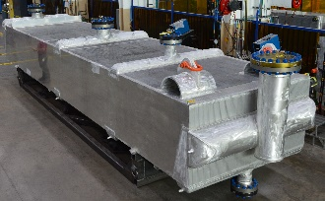
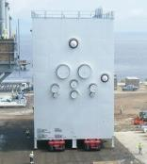
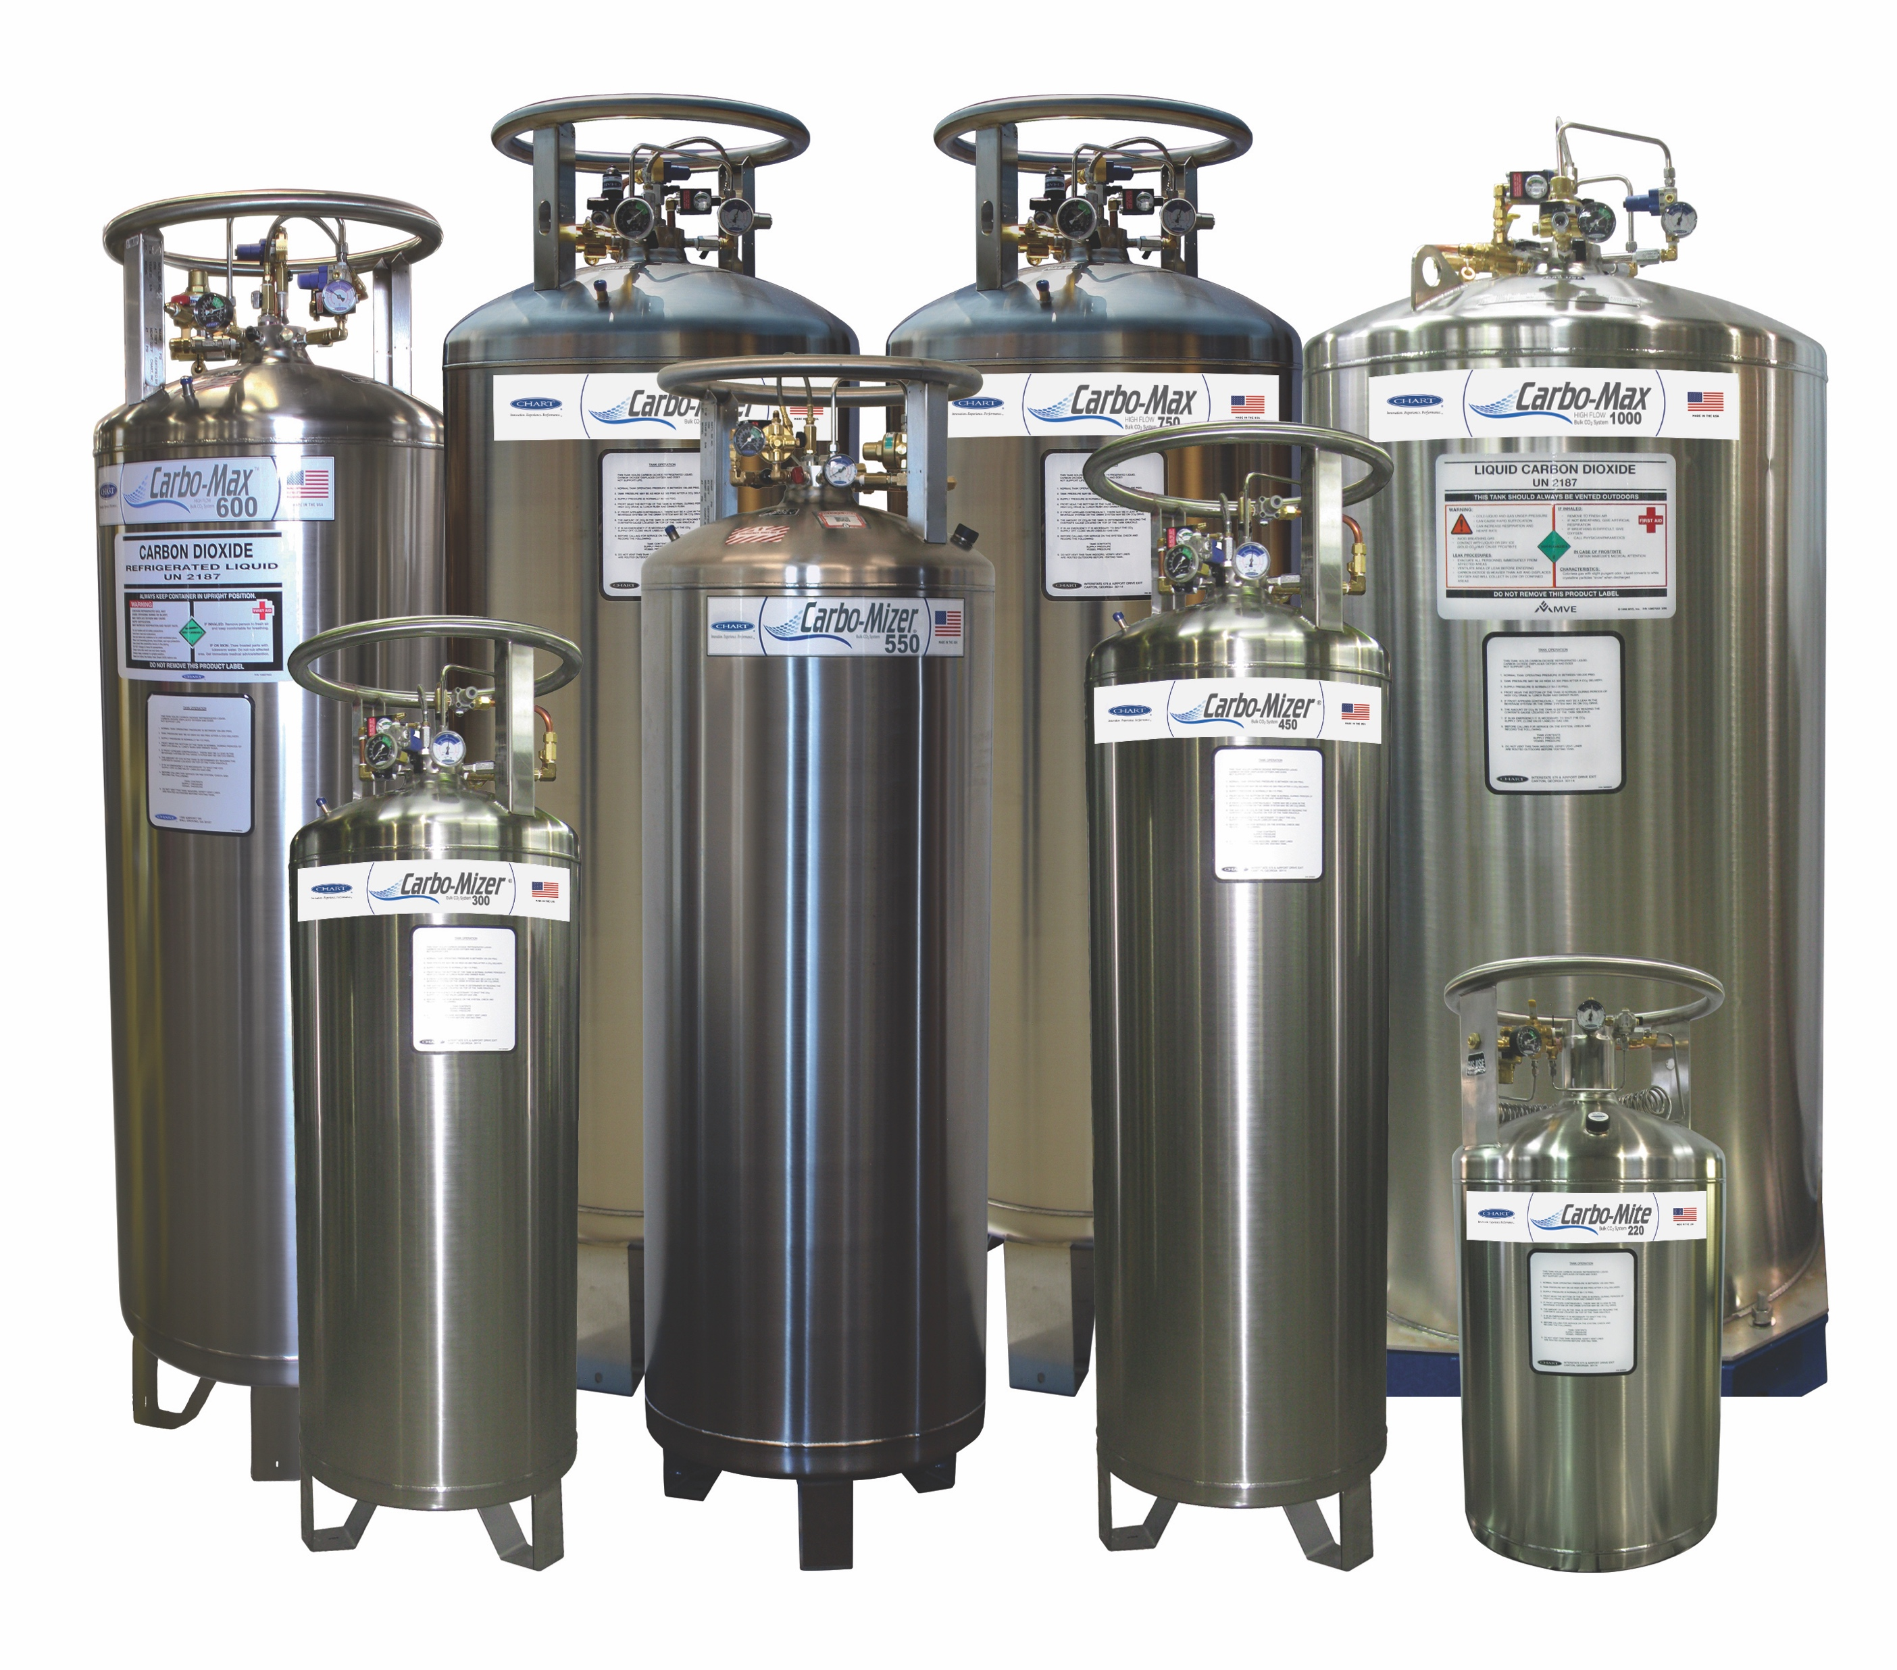





Chart Industries
1
2
Energy & Chemicals
Distribution & Storage
Supply Brazed Aluminum Heat Exchangers (BAHX), Air Cooled Heat Exchangers (ACHX) and Cold Boxes
Provide integrated systems and aftermarket services for gas processing, LNG and petrochemical applications
Lead in technological advancements
Offer a complete portfolio of cryogenic distribution and storage equipment
Spearhead innovation in cryogenic packaged gas and MicroBulk systems
Excel with over 20 years of experience in LNG applications
Set the standard for storage of biological materials at low temperatures

Slide 5
Chartparts.com Project
Old Chartparts.com
Dated and needed major overhaul
Was not integrated to JDE
All updates were manual
Data needed to be cleaned up

Slide 6
Chartparts.com Project
Business Requirements
JDE integration
Customer level pricing
Real-time item availability
Sales tax calculations
Automatically create sales order in JDE
Real-time shipping pricing/UPS
Credit Card processing
Easy to use toolset for updating website
Customizable (chart points)
Supported solution (with periodic upgrades)

Slide 7
Journey to Digital Transformation
New Ecommerce project started Oct 2016
Reviewed Multiple Vendors
Selected Smarter Commerce from Premier Group April 2017
Caire Medical B2C Website 2017
Chartparts Project April 2018 – Live in December 2018
Limited initial rollout in December – expanded rollout in March
Continually adding new parts
What’s next – International Chartparts, other product lines, CTO, customer portal

Slide 8
Challenges
Data Cleanup
Credit Card Processing
Customer Registration
UPS Shipping Tables/Shipping Options
Chart Points Reward Program

Slide 9
Current Online portal
Chart Parts (chartparts.com)

Slide 10
Current Online portal
Key Functionality
Realtime JD Edwards integration
Visual Parts diagrams
Customer account management
Shipping Costs
Sales Tax
Customer Pricing
Availability
www.chartparts.com

Slide 11
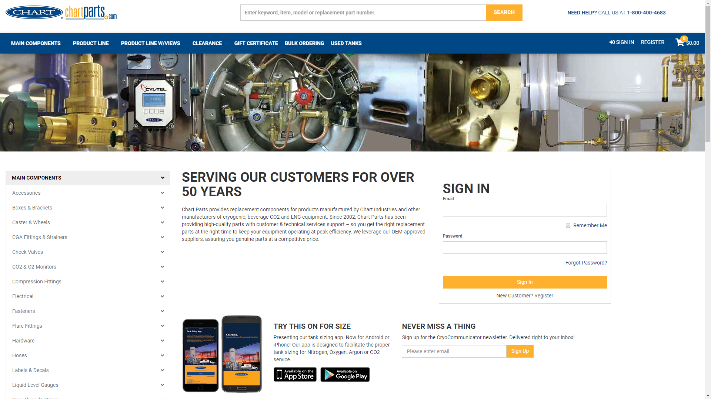
Current Online Portal

Slide 12
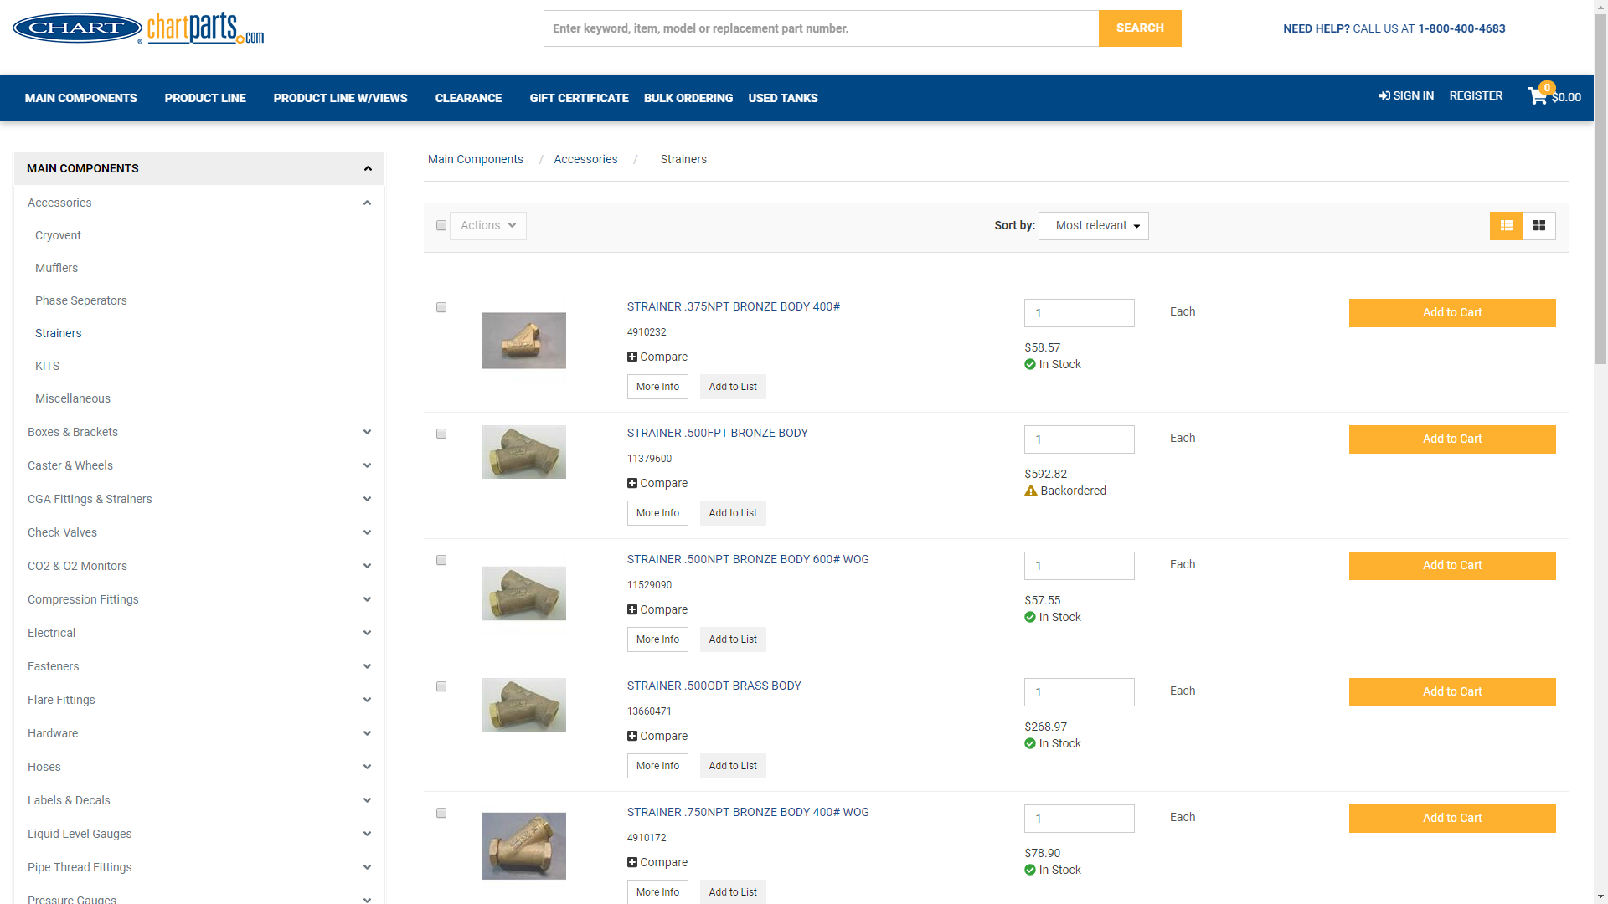
Product Catalog

Slide 13
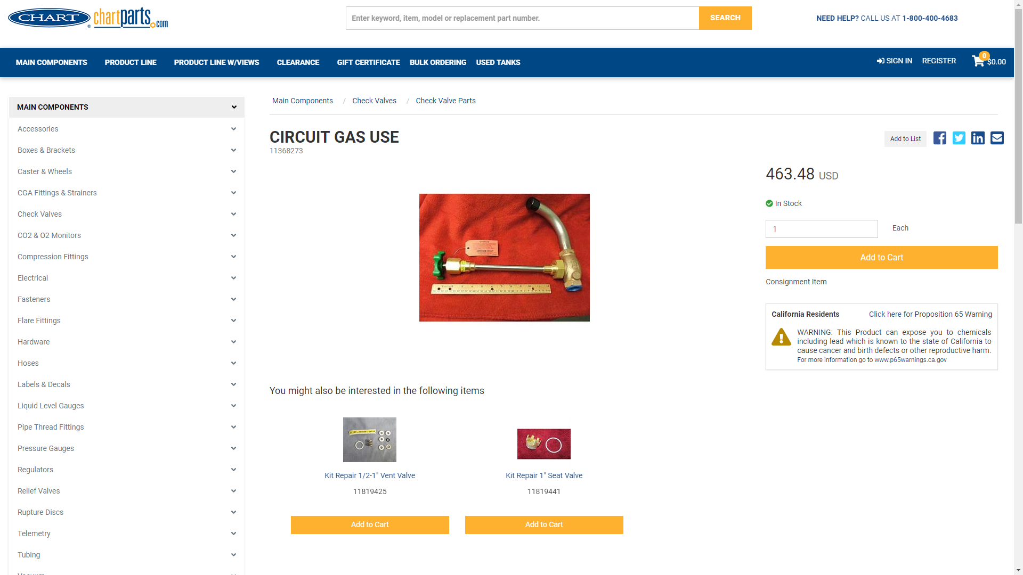
Product Detail Page

Slide 14
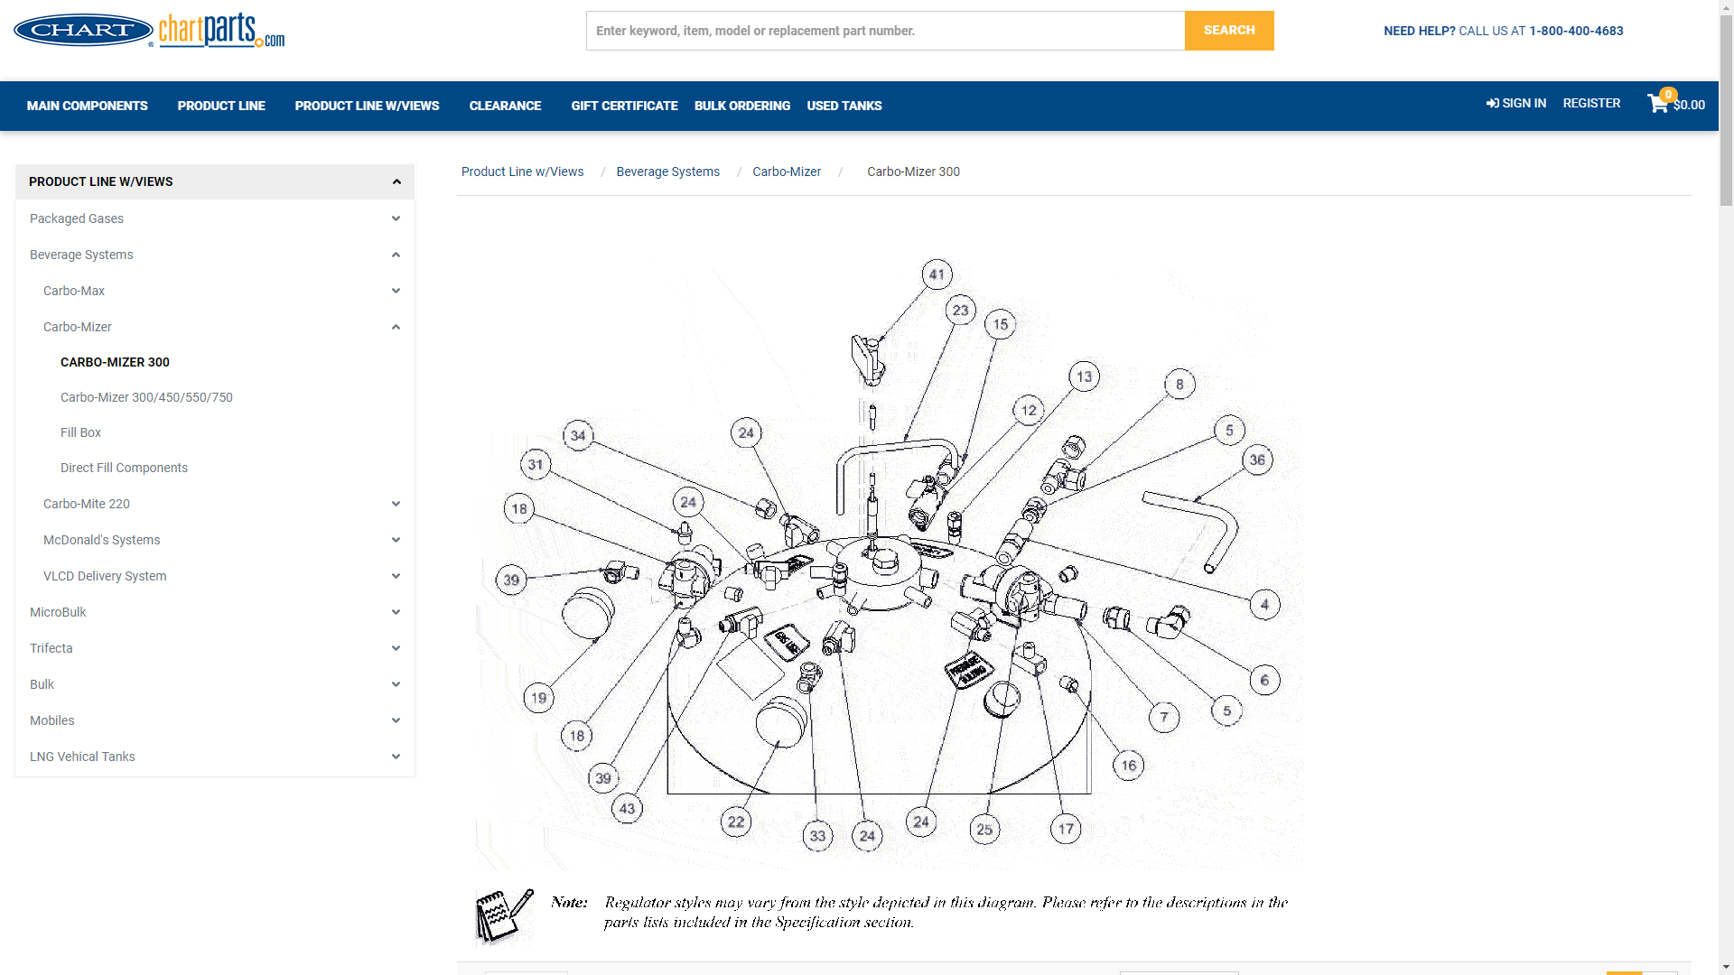
Visual Parts Diagrams

Slide 15
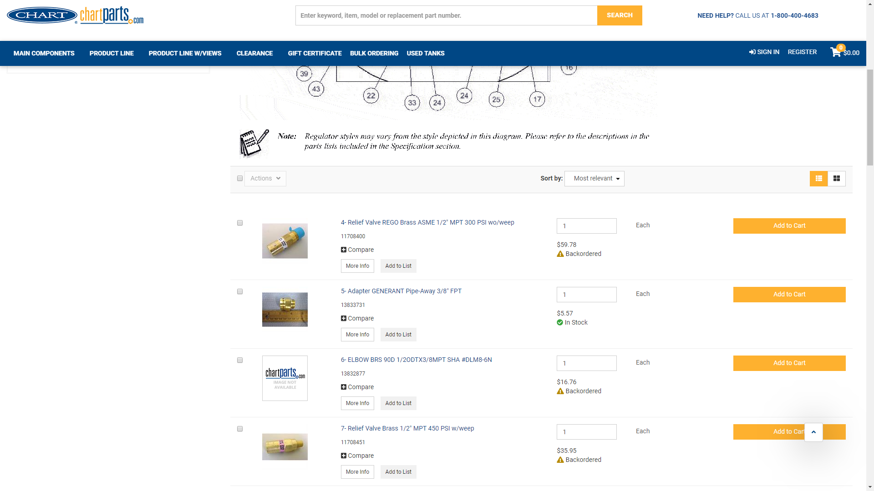
Visual Parts Diagrams

Slide 16
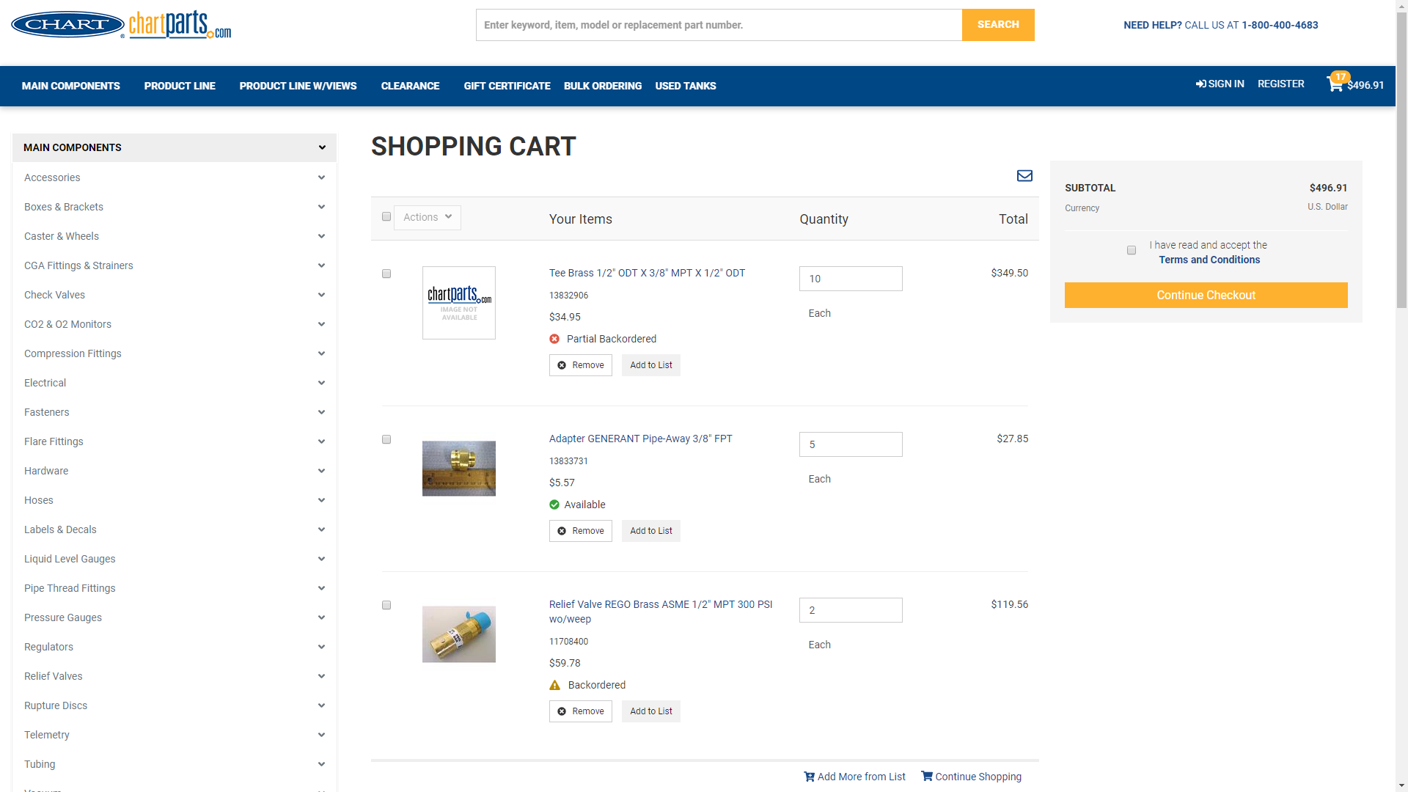
Shopping Cart

Slide 17



Premier Group
Premier is a solutions provider with a 26+ year history of delivering business solutions in the U.S. and internationally, specializing in JD Edwards ERP solutions
Network of offices and professionals
United States- Miami, Florida
International- Canada and Latin America
Oracle Gold Partner
Software Developer of SmarterCommerce Unified Commerce Solutions
Assisted over 225 customers worldwide
Over 300 JD Edwards projects across in broad range of industries including home builders, wholesale distributors, manufacturers and retailers
Specialized in rapid deployment of SmarterCommerce based on integration with JD Edwards

Slide 18








































Leading Companies are Choosing SmarterCommerce Over 120 JD Edwards Customers and Growing at 20%+ per Year

Slide 19





SmarterCommerce Overview
Payment Processing
World-class integrated payment platform to reach your customers with their preferred payment method
Retail Point of Sale (POS)
Enabling retail commerce through JD Edwards integrated POS solutions
Ecommerce
JD Edwards Ecommerce web store platform to deliver the ideal solution for all your organization’s B2B and B2C needs
Sales Tax Automation
Automate your tax compliance process with Avalara AvaTax in the cloud and the SmarterCommerce Connector
Call Center Management
Transform all your contact centers into experience improvement hubs

Slide 20
Please complete a session evaluation
Session ID: JDE-103170
Contact Info:
Rolynn Larson, rolynn.larson@chartindustries.com
Fermin Rodriguez, fermin_rodriguez@premierway.com

