Slide 1
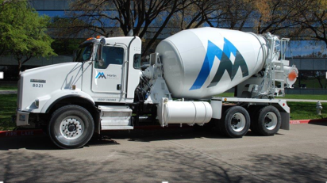
Enhanced User Experience with JDE : Orchestrator, UX One, and Social Networking
Notes:
2 mins

Slide 2
Agenda
Introduction
About Martin Marietta
ERP Eco-System
Story behind the journey
Transformation goals
Solution Demo
Solution Architecture
Mobile strategy
Lessons Learned
Q&A
Appendix
Notes:
2 + 1 = 3

Slide 3
About Martin Marietta
It's not just WHAT we make. It's what WE MAKE POSSIBLE.®
Notes:
3 + 2 = 5

Slide 4
ERP Eco-System
JD Edwards shop, with Oracle backend, running on Solaris Supercluster
Running both 9.1 & 9.2 with latest 9.2.3.4 tools
Have all the modules from JDE implemented (almost all) and widely used
Sales Order Management
Purchase Order Management (w/ Oracle Procurement cloud)
Work Order Management
Inventory Management
Finance/Accounting (AR, AP, GL)
Fixed Assets, Job Cost & Contract Billing
HR & Payroll (w/Kronos)
Lease Accounting**
Customer Relationship Management*
Supporting 3rd party applications
Vertex
Bottomline AP automation
Blackline Reconciliation
Infor expense management
Industry specific fulfillment systems
Command Alkon – Apex - For bulk products
Command Series – For ReadyMix
Notes:
5 + 2 = 7

Slide 5
The Journey
#72 in the list of fastest growing companies in the world – Fortune.com 2017 list
SOAR 2020
One of many in the market place…
Become the vendor of choice…
Be the preferred customer…
Technology needs to become the enabler to reach the goals
Identified barriers
Complex Architecture - Simplify it
Data silos - Break it
Too many points of failure -Eliminate it
Lack of Enterprise mobility features -Enhance it
No customer 360 degree view -Create it
Think BIG!!!
Leverage all the tools and capabilities provided by JDE, and centralize most functions with JDE
Notes:
7 + 3 = 10

Slide 6
Transformation Goals
Overarching goal
Simplify | Standardize | Transform
Goal # 1:
Successfully build and deploy Customer Relationship Management (CRM) functions in JDE, using JDE 9.2 and the tools that came with 9.2; such as IoT; UX and ADF. Integrate with social media using JDE 9.2 for customer news and sales team collaboration. Build IoT functions and eliminate phone calls and touch points.
Goal #2:
Successfully replace SalesForce.com, MS excel and other solutions; and provide a single centralized platform with Customer 360° views, Sales rep 360° degree views and other such views; all within JDE.
Goal #3:
Deploy JDE CRM on Mobile Devices and provide all the capabilities and views at the sales teams hands to be more effective and productive.
Notes:
10 + 2 = 12

Slide 7
Approach
Manage by exception
Push vs Pull the information
Alert, Analyze & Act
More visual
Personalization and extensions
Partnership with Oracle and Birlasoft
Notes:
12 + 3 = 15

Slide 8
Solution Demo
Let’s have a live look into the system and we can come back and discuss the architecture and other things.
Demo
Notes:
15 + 15 = 30
Landing page (Sales Manager)
- Watch Lists
- Sales Person
Customer 360 (From Oppty)
- Select – 365336 (Maria Sinacola)
Sales rep 360
Sales Funnel
Quote – Haul Rate lookup
Opportunity – Pin drop (address selection)
Fuel price – Automatic pull
Quote preview ( If we have time)
Sales coordinator (in QA – if we have time)

Slide 9
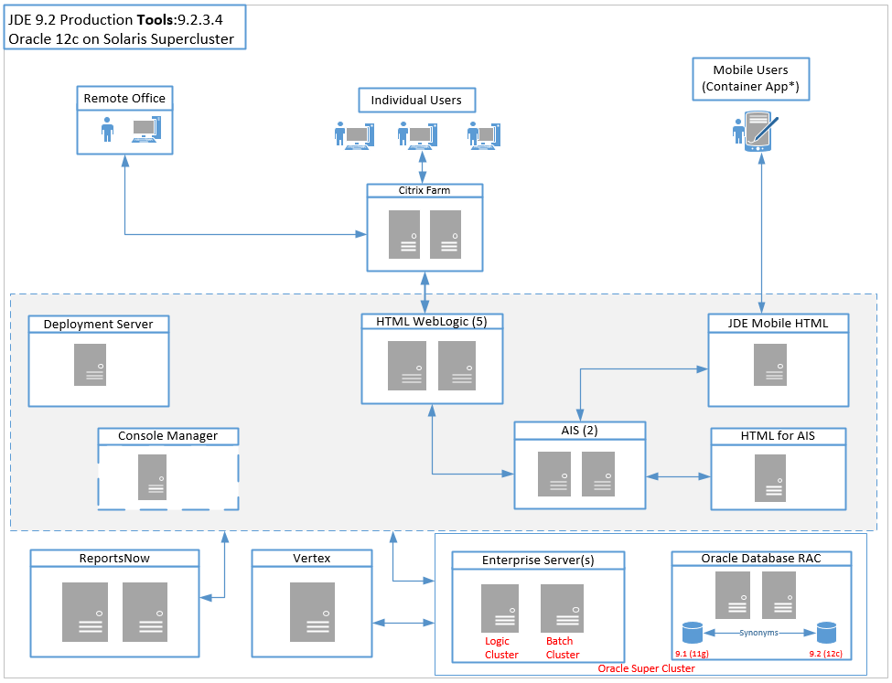
System Architecture – JDE 9.2
Notes:
30 + 3 = 33
91 synonyms

Slide 10
Solution Architecture – Capability Enablers
Composite/UX One Pages
Using Alert, Analyze, Act design pattern
Custom Watchlists and Springboard
JET, HTML and JavaScript components
Embedded E1 Pages using External Forms
Form Service calls
Processing Options Service
Data Service
Drilldown and Application Calls using RunE1App()
CafeOne layouts with inline quote preview using BI Pub
Orchestrator (Event Triggered)
Google GeoCode API (Long & Lat services)
Google Distance Matrix API (driving distance)
Automatic Diesel price pull from eia.gov
Third Party integration
Google Maps JavaScript integration
Embedded Twitter Timeline HTML/JavaScript
Slack WebHooks
List View format
Global Search
Notes:
33 + 5 = 38

Slide 11
Mobile Strategy
Mobile strategy, which is our 3rd goal of the program, is still evolving.
Container App provided by Oracle JD Edwards
IoT capabilities provided – for actionable email notifications
Purpose built apps
Notes:
38 + 2 = 40

Slide 12
Lessons Learned
The results
Change management
Limit number of watchlists on a composite page
Complexity of table joins within UDO components & watchlists
Dedicated servers for watchlists
Naming standards for UDO’s
Integrating UDO management into existing SDLC processes
UDO security dependencies
Leverage the Oracle container app + Personalization + E1 Pages
Be strategic about developing custom mobile apps (MAF Based)
Mobile Device Management (MDM) Strategy & Support
Think about TCO
BSSV vs. Orchestrator
ADF vs. JET/JavaScript
Notes:
40 + 3 = 43

Slide 13
Thank you!
Krishna.Muthuperumal@MartinMarietta.com
Palani.Durairaj@MartinMarietta.com
Notes:
43 + 2 = 45

Slide 14
Appendix
Screen captures to illustrate the JDE UX, IoT and other tools capabilities
Role based landing pages
Customer 360° view
Sales rep 360° degree view
Sales Funnel
IoT with Google

Slide 15
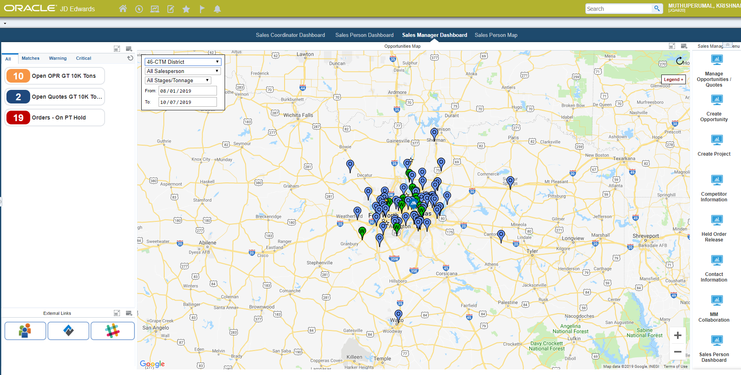
Appendix : Sales Manager landing page

Slide 16
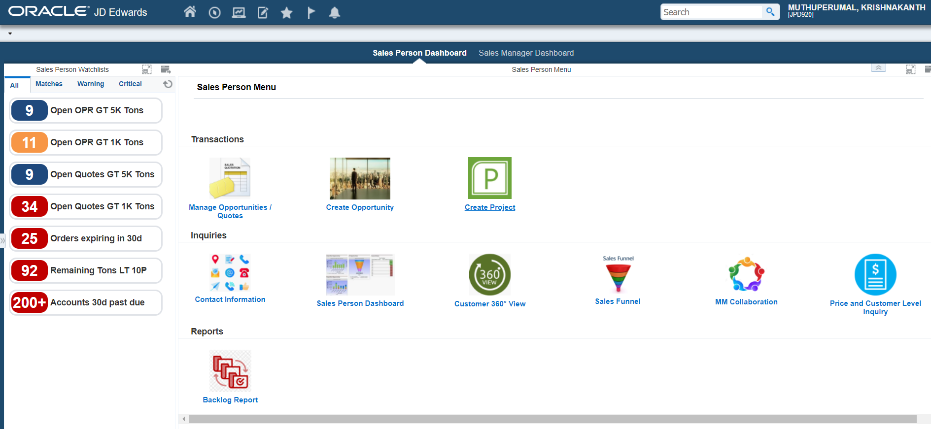
Appendix : Sales Person landing page

Slide 17
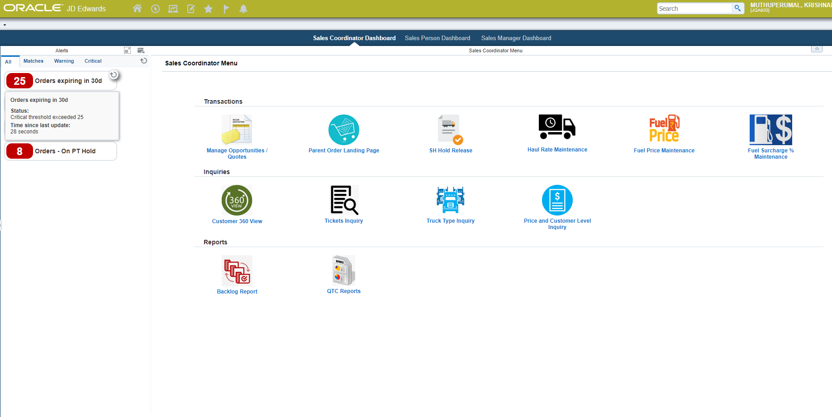
Appendix : Sales Coordinators landing page

Slide 18
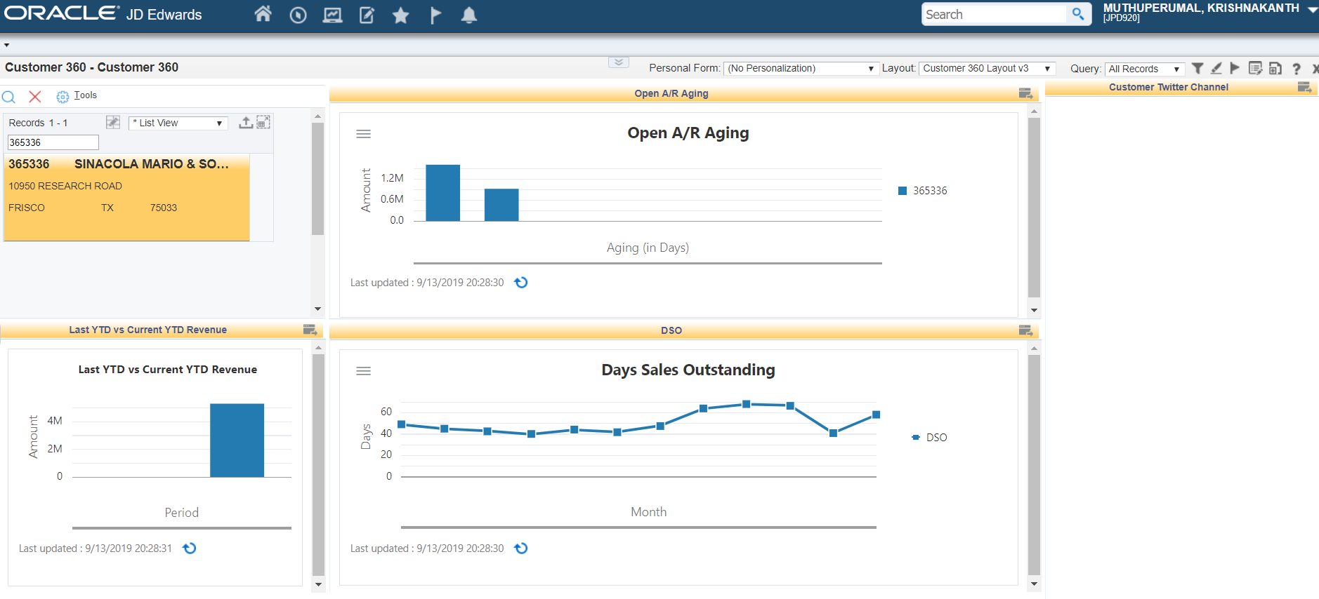
Appendix : Customer 360° view

Slide 19
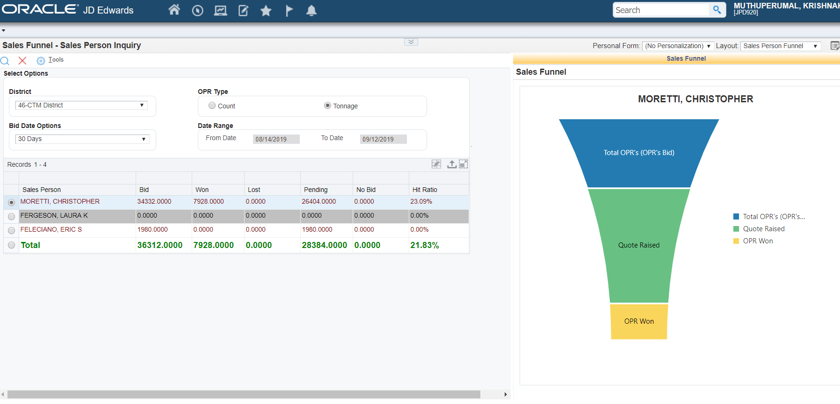
Appendix : Sales Funnel

Slide 20
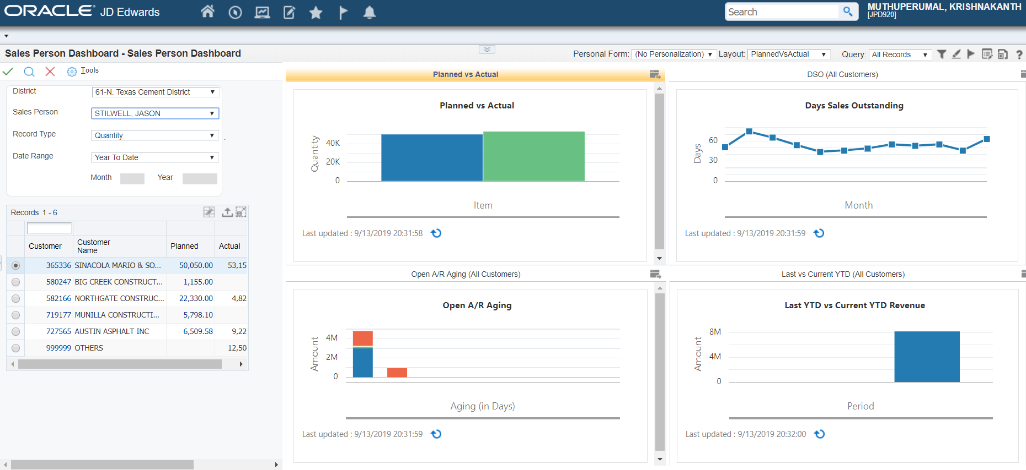
Appendix : Sales person 360° view

Slide 21
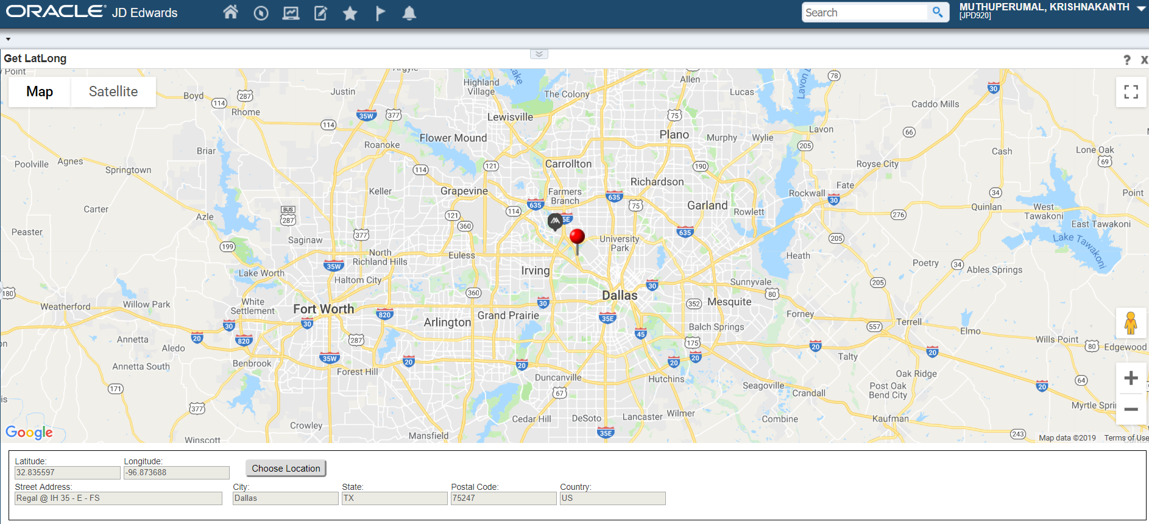
Appendix : IoT to get Long & Lat using Google API

Slide 22
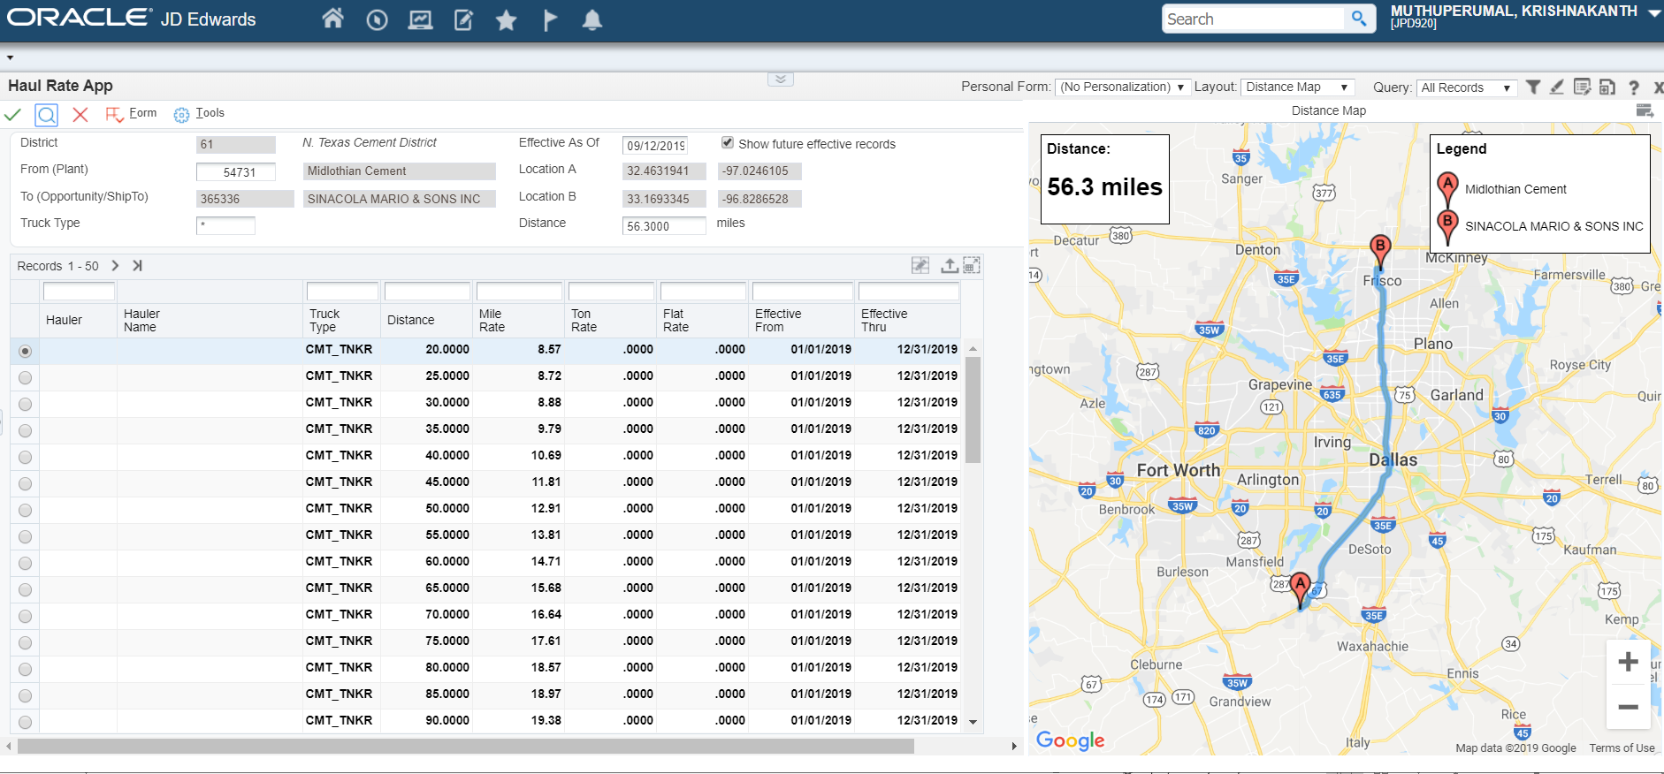
Appendix : IoT to get distance and route using Google API

