Slide 1


WINSUPPLY DIGITAL TRANSFORMATION STRATEGY
Sheloo Koul
April 2017
Notes:
Good Afternoon!
Show of hands – How many of you are familiar the the show “The Office”?
What I am going to share today would be good material for a new season of The Office.
I want to start by saying how excited I am in my role, in laying down the digital transformation roadmap and more so excited for Win because, no pun intended, the digital journey ahead is a win-win for us!
By the end of this presentation, you will have a clear view of our strategic approach toward our digital journey in order to execute successfully besides being demystified about digital transformation being just a buzz word.

Slide 2
SHARINGS
Who we are
Current State
Changing Marketing Technology Landscape
Digital Vision and Mission
Table Stakes/Building Blocks
How Do We Reach Our Digital Goal?
Lessons Learned
Notes:
By the end of this presentation, you will have a clear view of our strategic approach toward our digital journey in order to execute successfully.

Slide 3

WINSUPPLY
Leading distributor of residential and commercial construction and industry supplies
Headquarters in Dayton, Ohio
Privately-held
580 locations in 45 states
Second largest plumbing products distributor
Notes:
Who we are
Winsupply’s roots began in 1875 with the founding of the N.O. Nelson Manufacturing Company.
Primus investment company formed in 1956
Bought N.O. Nelson in 1958 in Pueblo, Colo.
Acquired more Nelson locations
Plumbing
Heating and Air
Pipes, valves and fittings
Waterworks
Electrical supplies
Pumps
Fire protection
Irrigation
Fasteners
Hydronics

Slide 4
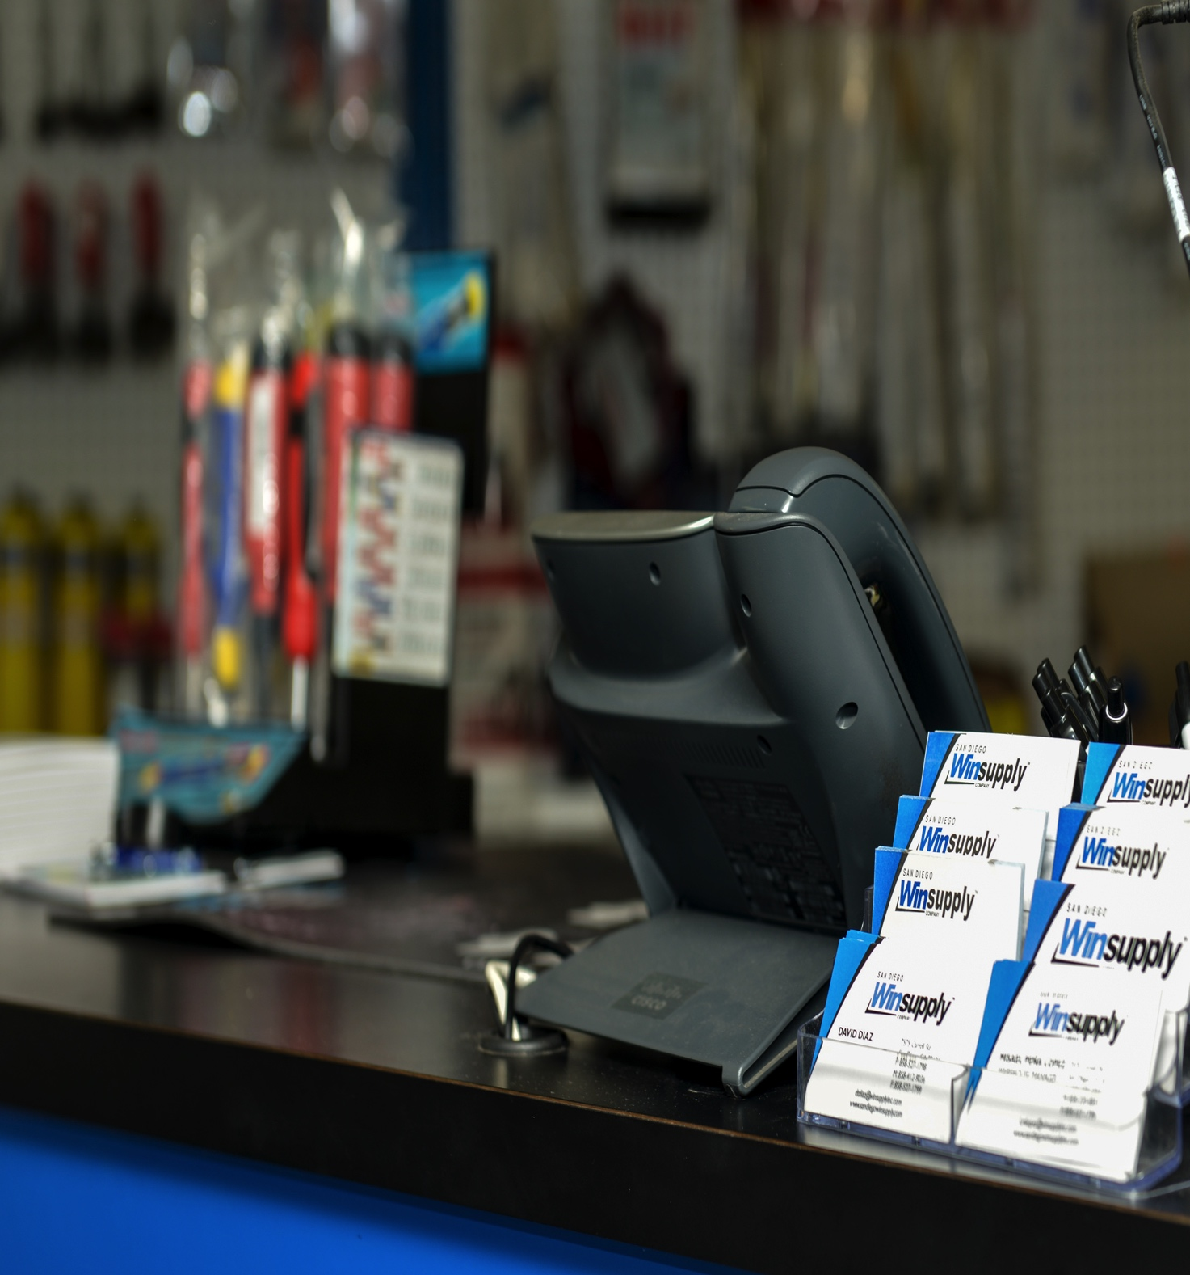
OUR CUSTOMER BASE
Our customer base consists of B2B (business-to-business) companies – local companies, sourcing (WSS) and SMBs (small to medium-sized businesses); B2C (business-to-consumer) customers; and D2D (distributor-to-distributor) – our competitors.

Slide 5
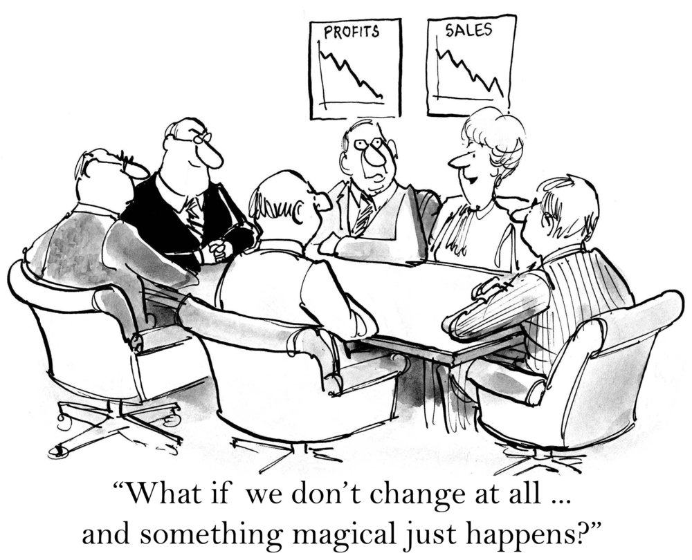
CURRENT STATE
Notes:
I will tell you that digital transformation does not happen magically.
We have history of proven success that needs to be battled.
However, There are proven methods to forage ahead.

Slide 6
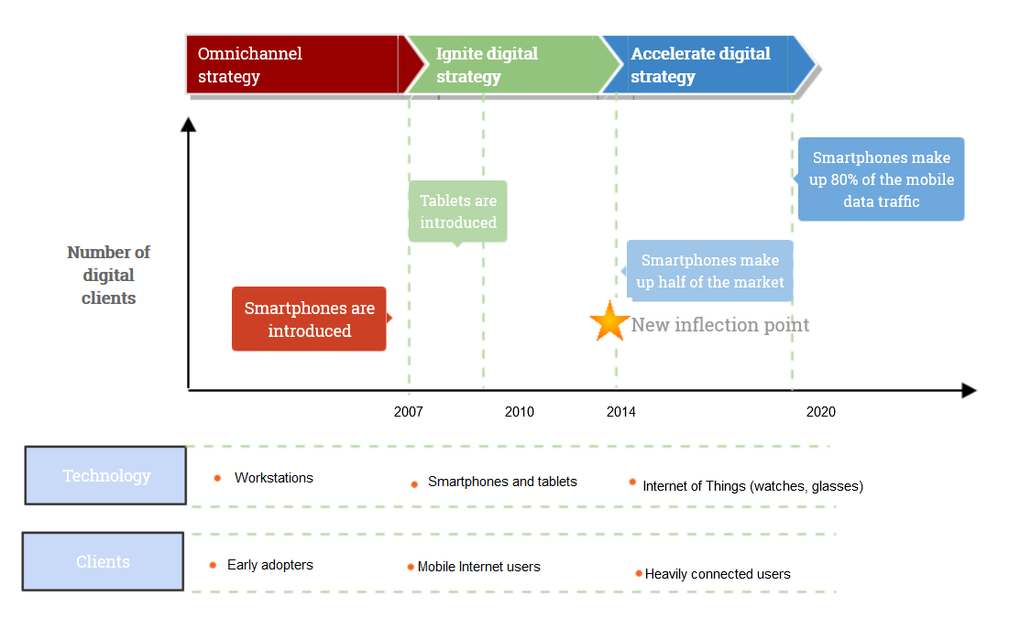

MARKETING TECHNOLOGY LANDSCAPE
DIGITAL ACCELERATION
Industry is changing
Customer behavior is changing
Customer needs
are evolving
Notes:
Before I deep dive into any of that however, lets talk about the landscape..
Digital technology is being accelerated at a really fast pace.
As the marketing technology landscape evolves to meet the growing needs of consumers, delivering an omnichannel experience is crucial for an engaging customer experience. This ranges from brand engagement to checking out at the end of the buying process. What is interesting is that the omnichannel experience started taking a turn with the introduction of smartphones in 2007. The US embraced this amazing new technology (nine years ago) thanks to former Apple CEO Steve Jobs.
Gartner said that the Internet of Things (IoT) product and service suppliers will generate incremental revenue exceeding $300 billion, mostly in services, in 2020. It will result in $1.9 trillion in global economic value-add through sales into diverse end markets. The verticals that are leading this adoption are manufacturing (15%), healthcare (15%) and insurance (11%).
IoT value-add is composed of the combination of mature IoT, which is already yielding benefits, and a high-growth emerging IoT opportunity. It is derived from a combination of sector-specific technology (such as connected, automated manufacturing systems), and more generic, widely used technology, such as the suite of "smart building" technologies, including light-emitting diode (LED) lighting and smart HVAC systems.
Talk a little bit about what some of our vendors are doing in this space. Due to nondisclosure agreements in place, they could not disclose a lot at Rheem, but they have forged partnerships with Apple, Google and AT&T, to name a few, to grow the smart home and connected customer technologies.

Slide 7
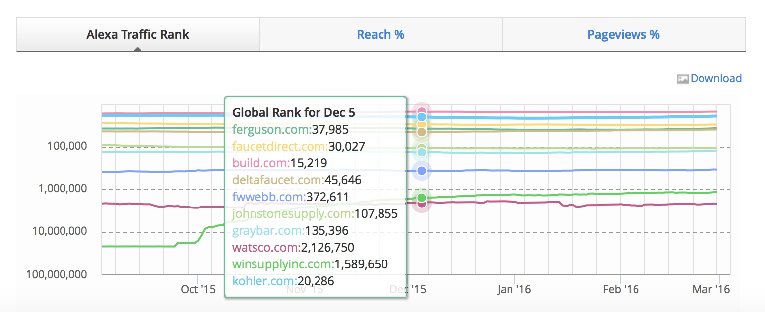
COMPETITION
Notes:
Alexa is an analytics tool that provides insights to benchmark, compare and optimize businesses on the web. You can take guesses as to the top 10, starting with Google and Facebook, and YouTube to Yahoo and Amazon, Wikipedia and Twitter.
We are barely existent.
From a digital perspective, the evaluation of functional gaps has been conducted on several occasions, and while it is important to understand comparative functional deficiencies, it is perhaps more important to understand their overall ethos and organizational capabilities that translate into their relative success.
A high-level competitive analysis shows that while from a digital solution capability perspective, the bar is low as it pertains within our industry, there is clearly an opportunity area as it pertains to digital commerce and digital solutions that we can provide our customers.

Slide 8

VISION
Digital transformation solutions could be a key differentiator to enhance Winsupply’s competitive advantage and improve the customer experience as it pertains to digital interactions.
Notes:
Technology innovation is changing the game for businesses, industries and markets. At the heart of this digital transformation is a host of new technologies that are disrupting the old ways of doing business – with partners, suppliers and customers.
Digital transformation is the process of shifting your organization from a legacy approach to new ways of working and thinking using digital, social, mobile and emerging technologies. It involves a support from leadership, shift in thinking as it pertains to digital, the encouragement of innovation and an increased use of technology to improve the experience of your organization's employees, customers, suppliers, partners and stakeholders.
Winsupply Vision:
To create loyal, profitable customers by offering them superior solutions for their everyday needs and unique challenges.
So we worked on creating a digital vision very much aligned with our organization vision as it pertains to our traditional business model.

Slide 9




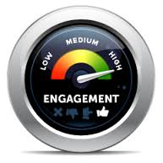
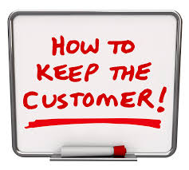
GOALS FOR VISION
  Mobile & Experience – Micro Moments
  Brand Awareness
  Brand Engagement
  Customer Acquisition
  Customer Engagement
  Customer Retention
Notes:
We want them to come back for more.

Slide 10

MISSION
Provide best-in-class digital solutions and be an indispensable partner between our local companies, vendors and customers.

Slide 11

MISSION
Deliver digital solutions in a proactive, timely and cost-efficient manner that enable business agility and support business growth and expansion.

Slide 12

MISSION
Be regarded as an industry leader in the provision of digital services and leverage these services to establish and maintain partner loyalty and business engagement.
Notes:
Finally, last but not least …

Slide 13
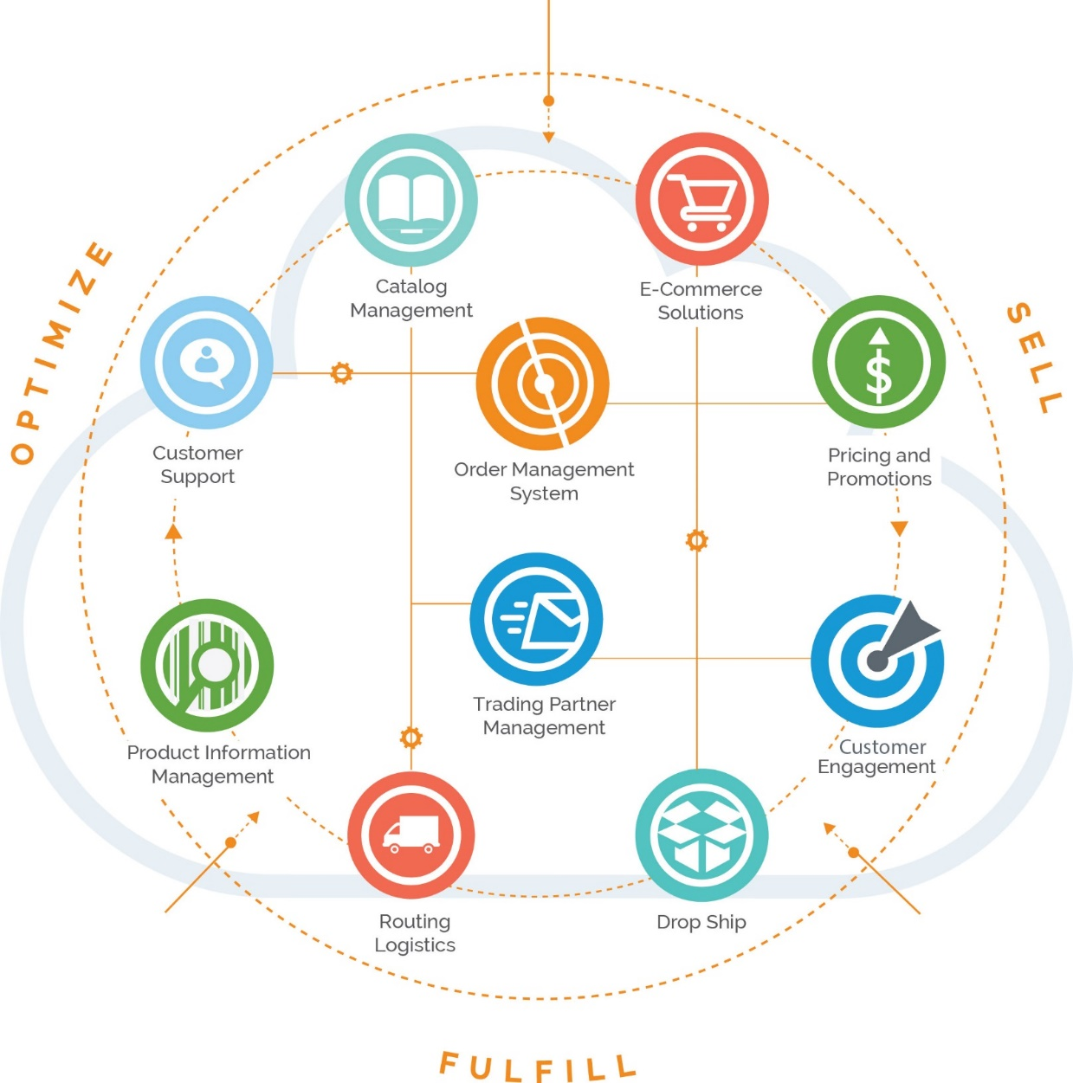
DIGITAL VISION – END STATE – CUSTOMER FACING
Notes:
The Omnichannel Experience and what this means: Seamless integration between the offline and the online across devices of choice irrespective of entry point. It is the convergence of content, digital commerce and clean data to create meaningful and engaging customer interactions – when they want it and where they want it.
Nirvana for most marketers is delivering a true omnichannel customer experience, and this is so true for Winsupply, too. But doing so is usually a difficult and expensive endeavor that involves linking disparate systems and data, and often crosses over into other customer-facing disciplines
The opportunity is to instantaneously understand and strengthen current and future customer experiences as customers move from one touchpoint to the next. In order to do this …
(Hinges on
Engaging content across screens
Buying experiences across devices and platforms with an opportunity to cross-sell and upsell
Clean data)

Slide 14

How do we get there?
WHERE
Strategic Planning
HOW
Business Plan
NOW
Where will we be in the future?
Notes:
All this is good. But what is important is defining the how.

Slide 15
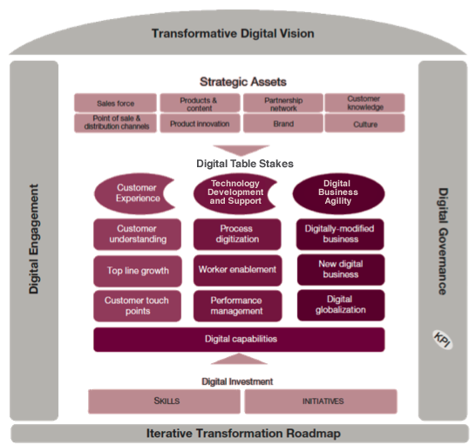
Notes:
You need to have the digital blocks in place.
The transformation roadmap is an iterative process and there is investment to get the capabilities in place to build the foundation.
This is based on customer experience, technical development and support and digital business agility. These enable the growth of strategic assets and allow for fluidity within the marketing technology landscape.
In order to develop a business model that constantly delivers on the iterative transformation roadmap, an acquisition strategy for tapping into creative technology externally should be strongly considered.
We start by focusing on the building blocks. The three main components for this – namely being customer experience, technical development and support and digital business agility.
Only after our entire organization is involved can we begin to integrate all of today’s digital channels and data capabilities, giving our brand the competitive advantage over those still struggling to adapt to today’s digital marketing practices.

Slide 16
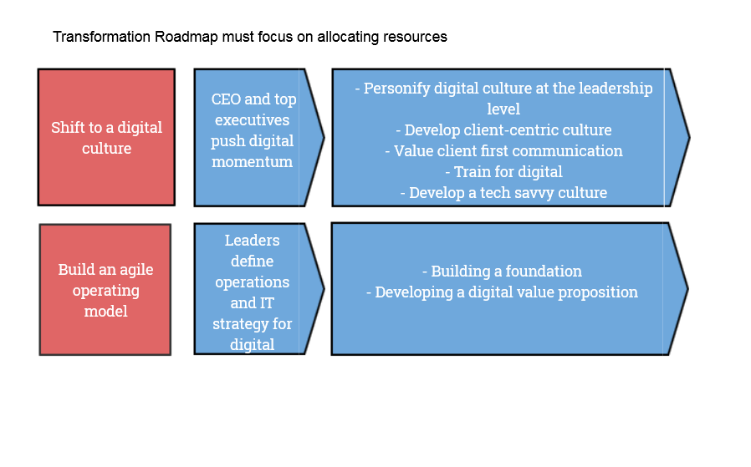
SOLICITING EXECUTIVE SUPPORT
It is now more than 25 years since the birth of the web, but many businesses are still at the early stages of a long journey to make the best of digital marketing to stay competitive.
Notes:
Transformation roadmap must focus on allocating resources.
The shift to a digital culture and building a digital business model that is agile is crucial to a successful start.

Slide 17

LAYING A SOLID FOUNDATION – WIN’S DIGITAL 101
Functionally rich and constantly evolving, improving and adapting to market change
Support multiple types of users and service their different business needs
Primary and default point of interaction and collaboration with Winsupply
Represent and support our local companies to a large extent
Build a digital relationship for our vendors to do business with us
Notes:
Start with winsupplyinc.com

Slide 18

DIGITAL BLOCK – CUSTOMER EXPERIENCE –
THE LITMUS TEST
A consistent customer experience is the new battleground for winning customer loyalty.
Notes:
Elements for the digital transformation roadmap center on the conjunction of content, commerce and data.
Move from as-is model to a digital model. This includes and is not limited to web, social and mobile.
Provide a compelling self-serve experience for our customers.
Start by focusing on the customer buying experience:
Rich, engaging content
Product search
Cart functionality
Evolve digital tools to meet customer experience.

Slide 19
FORMING THE RIGHT PARTNERSHIPS
Notes:
First step in laying the digital foundational block
Partnering with an agency for the customer experience

Slide 20

CHOOSE THE RIGHT AGENCY PARTNER

Slide 21

CHOOSE THE RIGHT TECHNOLOGY PLATFORM
Notes:
Experience Manager and commerce cloud

Slide 22
CHOOSE THE RIGHT SYSTEMS INTEGRATOR

Slide 23
LESSONS LEARNED SO FAR
Change is intimidating
Have a clear plan – Option A
Have a backup plan – Option B
Have a backup to your backup plan – Option C
Be prepared to stand your ground objectively
Choose the right partners
Be prepared to expect pushback
Stop to smell the roses

Slide 24
THANK YOU

