Slide 1
Balancing Payroll Roundtable
Evelyn Bian, Port of Portland
102180

Slide 2
Business Analyst at Port of Portland for 17 yrs
Supported JDE HCM Payroll, HRIC, Benefits for the past several years, supported JDE Finance prior
Port of Portland has 800 employees
Port runs biweekly and weekly payroll
2 kids, 1 husband, 1 dog

Slide 3
Our Scenario
Employee changed benefit plans so we created an interim to refund their benefits deduction. Didn’t occur to us that their Gross Wages should be increased by that refund amount. Ran Final Update because journals balanced.
We ran our custom balancing report days later and saw that our interim caused an out-of-balance in Taxable Wages F06136 for Federal Taxes, State Taxes, etc. The balancing reports compare F06136 to F06146. A second adjustment was needed to correct the Taxable Wages amount for the various taxes.
Are there methods of catching this prior to Final Update?

Slide 4
Balancing Payroll – before Final Update
We use a custom Excel spreadsheet, manually populated with data from:
R073012
R05229 T1 JE
R05229 T3 CF
R05229 T3 CT
R703170
R073162
AAI In Error Object Acct 22001 (9997 issue)
Filter <0 Object Account

Slide 5
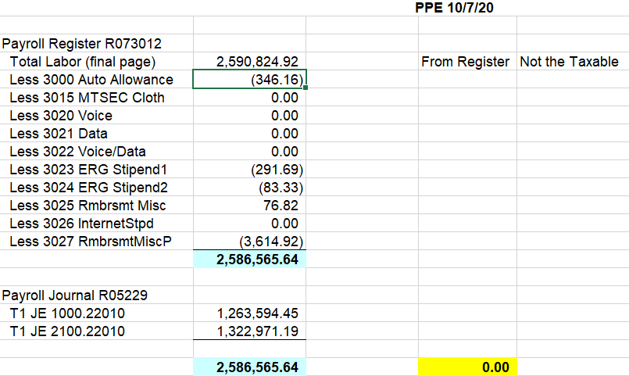
Balancing Payroll – before Final Update

Slide 6
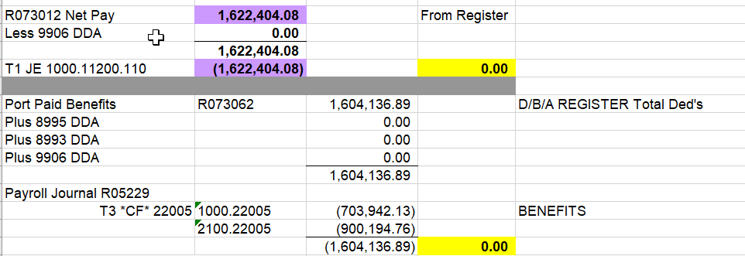
Balancing Payroll – before Final Update

Slide 7
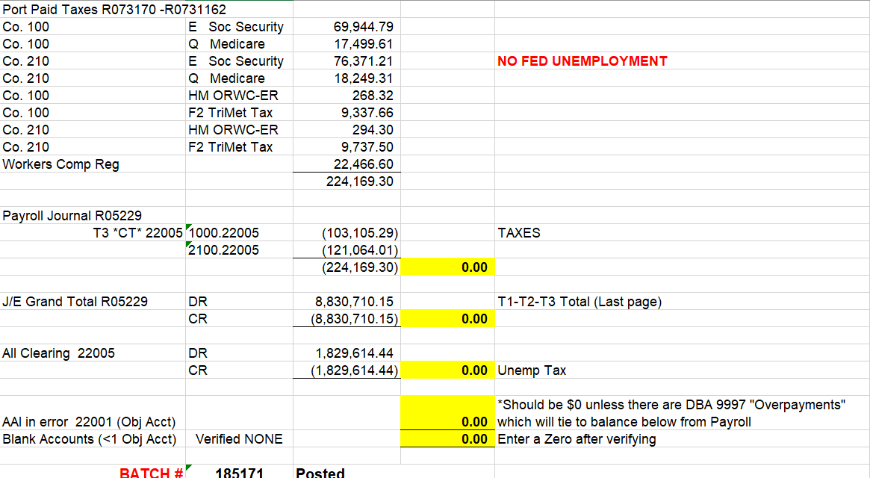
Balancing Payroll – before Final Update

Slide 8
Balancing Payroll – after Final Update
We run a custom report “Balance Payroll Taxes” for Fed A, D, E, P Q and OR State 38 F, H
Report compares F06146 and F06136
Gross Wages, Deduction/Excludable, Taxable Wages
If Taxable Wages are off, show the variance amount

Slide 9
Discussion
What methods do you use prior to Final Update to ensure Taxable Wages and Tax Amounts are balanced?
What methods do you use after Final Update?
What issues around balancing payroll have you encountered?

Slide 11
Evelyn Bian
Port of Portland
Portland, OR
Evelyn.Bian@portofportland.com
102180

